Slide 1
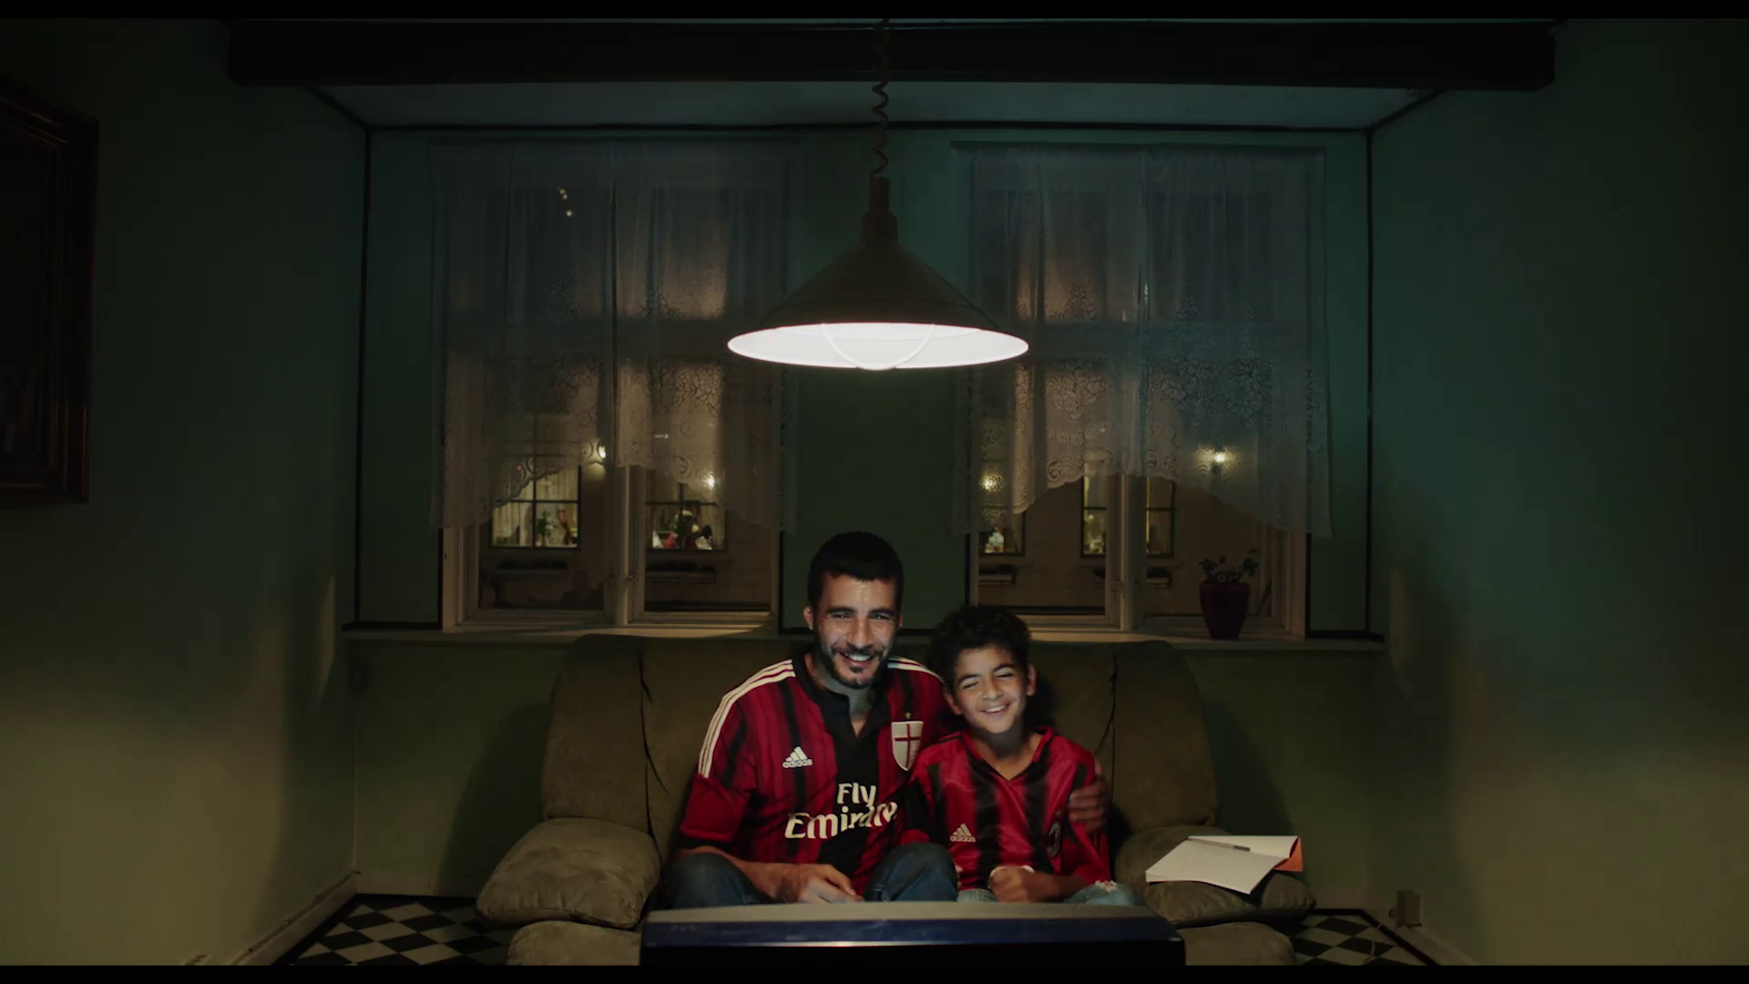
Lesson Plan Two Part One
Analysing Adnan’s Father
Dir. Sylvia Le Fanu, 2017

Slide 2
Lesson Plan Two
Cinema Issues: The Places of Adnan’s Father

Slide 3
The Apartment
Being the centre of intimacy and family, the home where Adnan and father Sayid live is the most relevant space in Adnan’s Father. The living room is small, has a checkered pattern floor, with black and white squares, and two large windows from which the front neighbours can be seen. A hanging ceiling light, placed in the centre of the frame, illuminates the room.

Slide 4
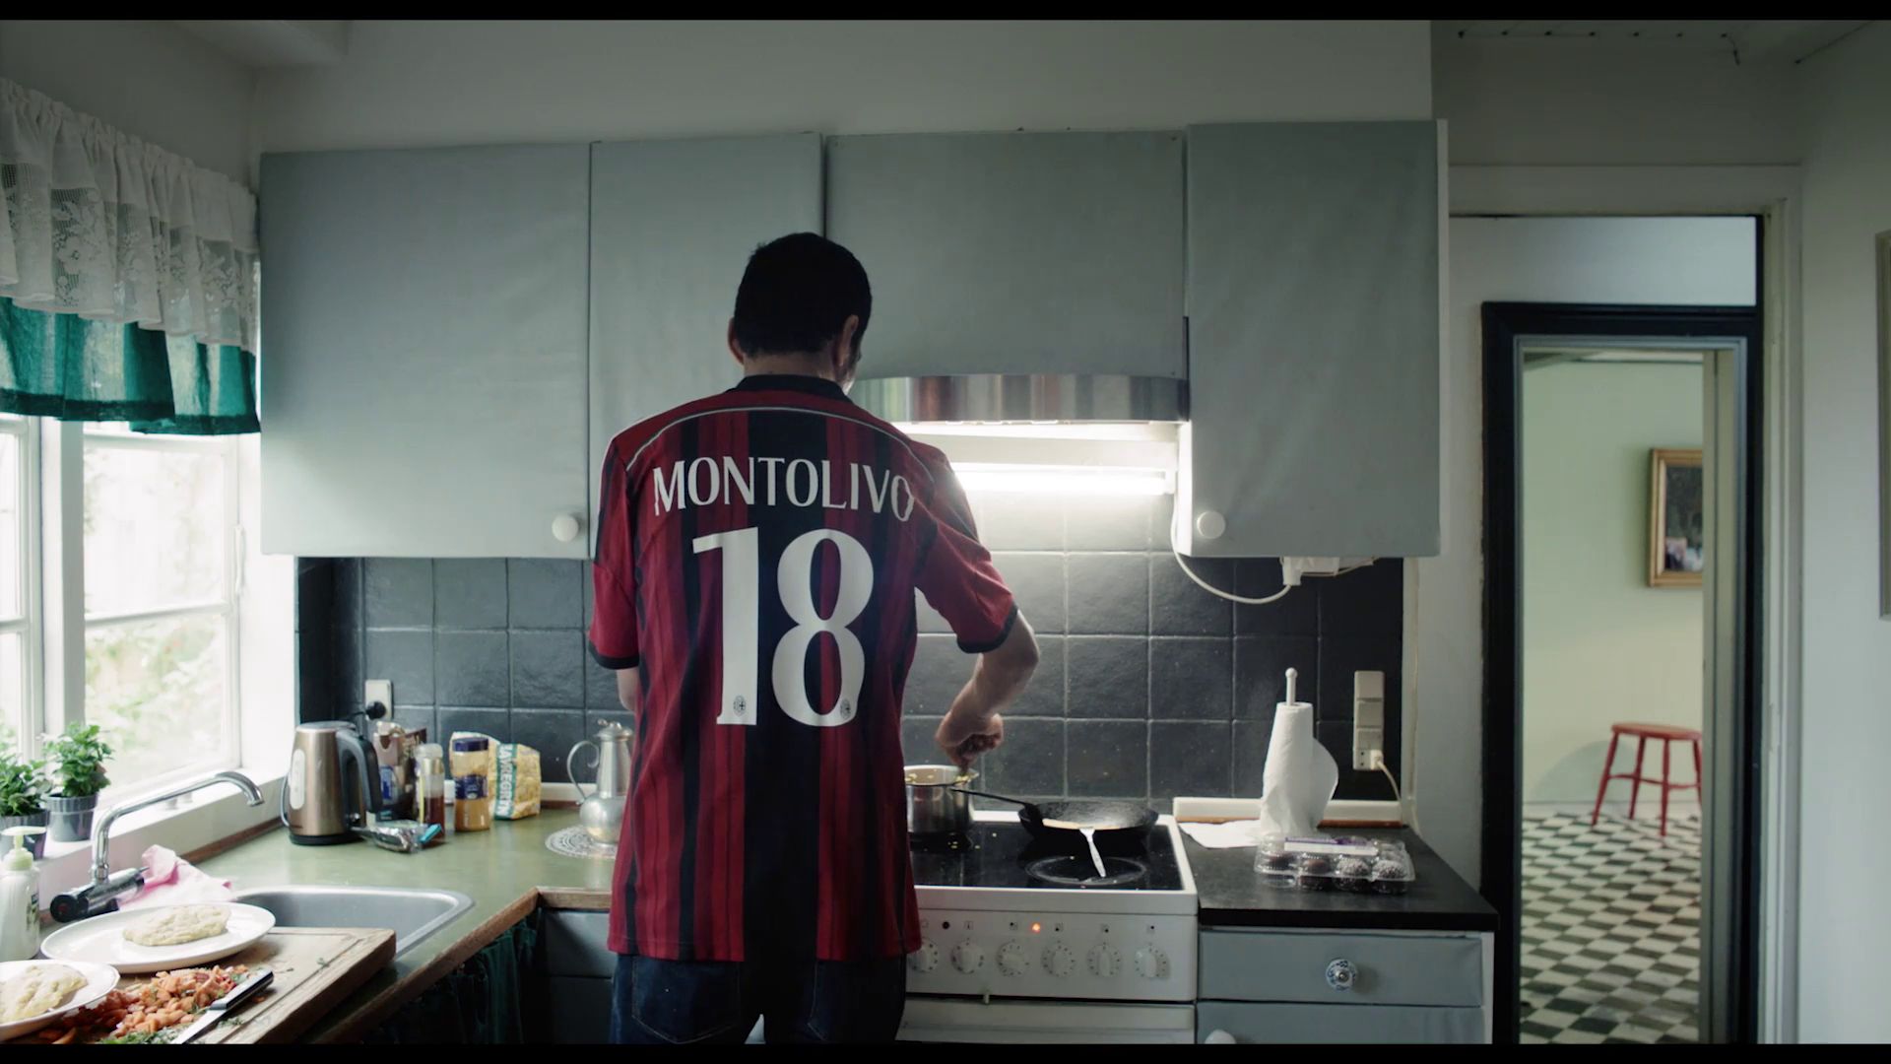
In a later scene, in which the father bakes a cake for his son's school party, we see the kitchen. Like the living room, it is modern, but small, and decorated with black tiles and white furniture.
On the left, there is another window overlooking the outside, on whose parapet are small vases with plants. Significantly, in one of the shots in the kitchen, we can also see a part of the room, in the background, giving us a clear sense of the house spatially.

Slide 5
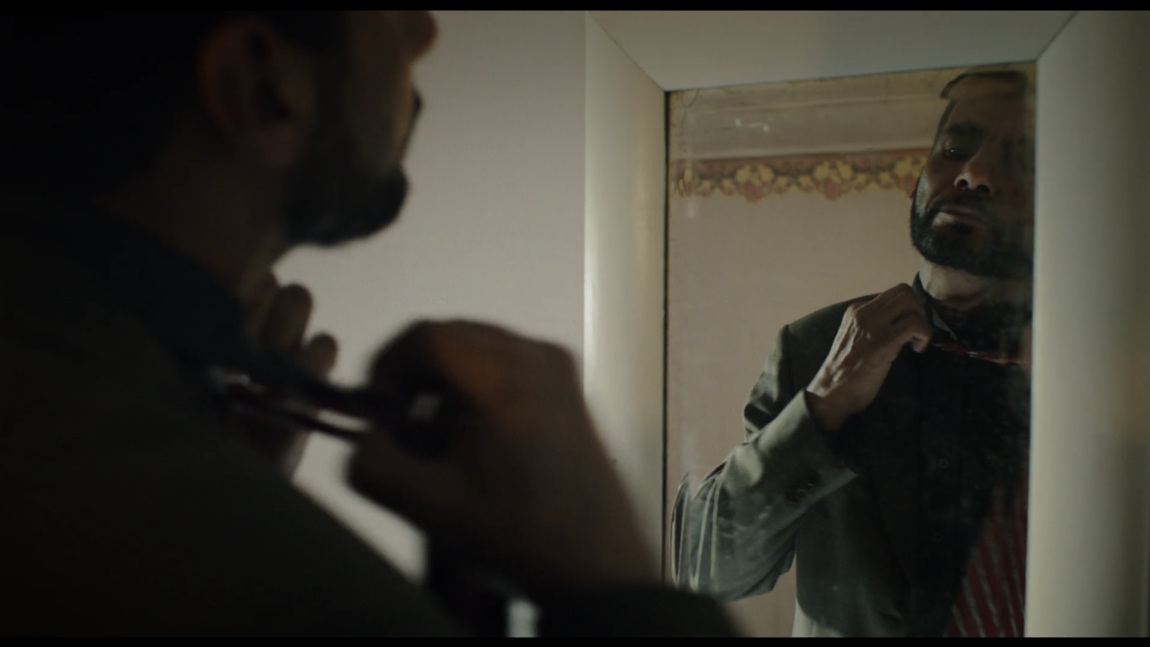
Finally, the apartment contains a single room, which we see in two scenes. In the first, which only lasts a few seconds, the father prepares for the meeting with his son's teacher. We see Sayid's reflection in a white-framed mirror, with a very dirty reflective surface, as he tries unsuccessfully to do up his tie.

Slide 6
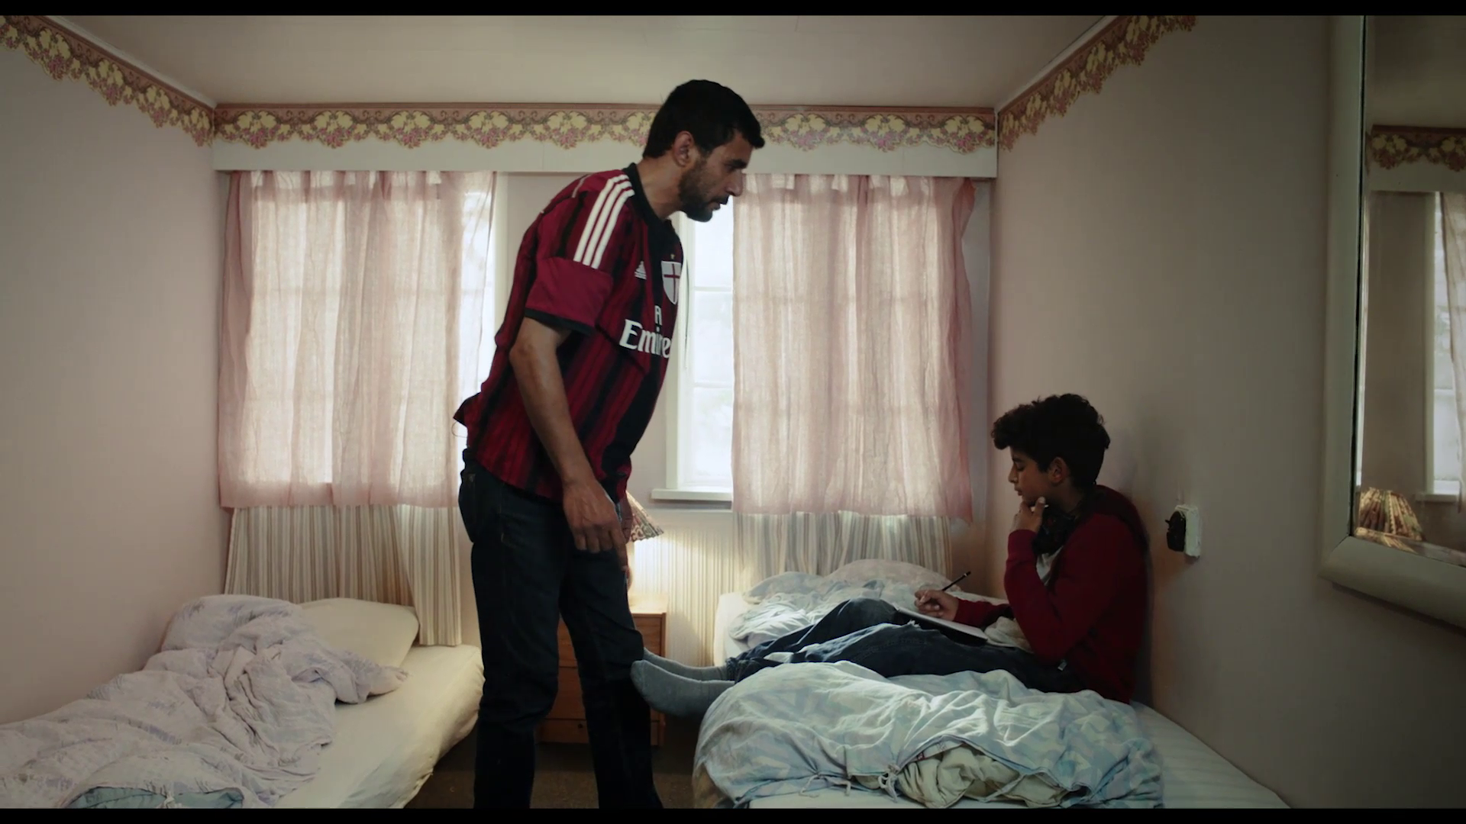
In the second scene, when the father he chases his son to the bedroom and confronts him, the room is presented as a kind of refuge for Adnan. In addition to the mirror on the wall, the room has a vase of pink flowers next to the ceiling, two beds (here visibly unmade), a single bedside cabinet in the centre, with a crooked bedside lamp on it, and two windows veiled with thin, translucent pink curtains.

Slide 7
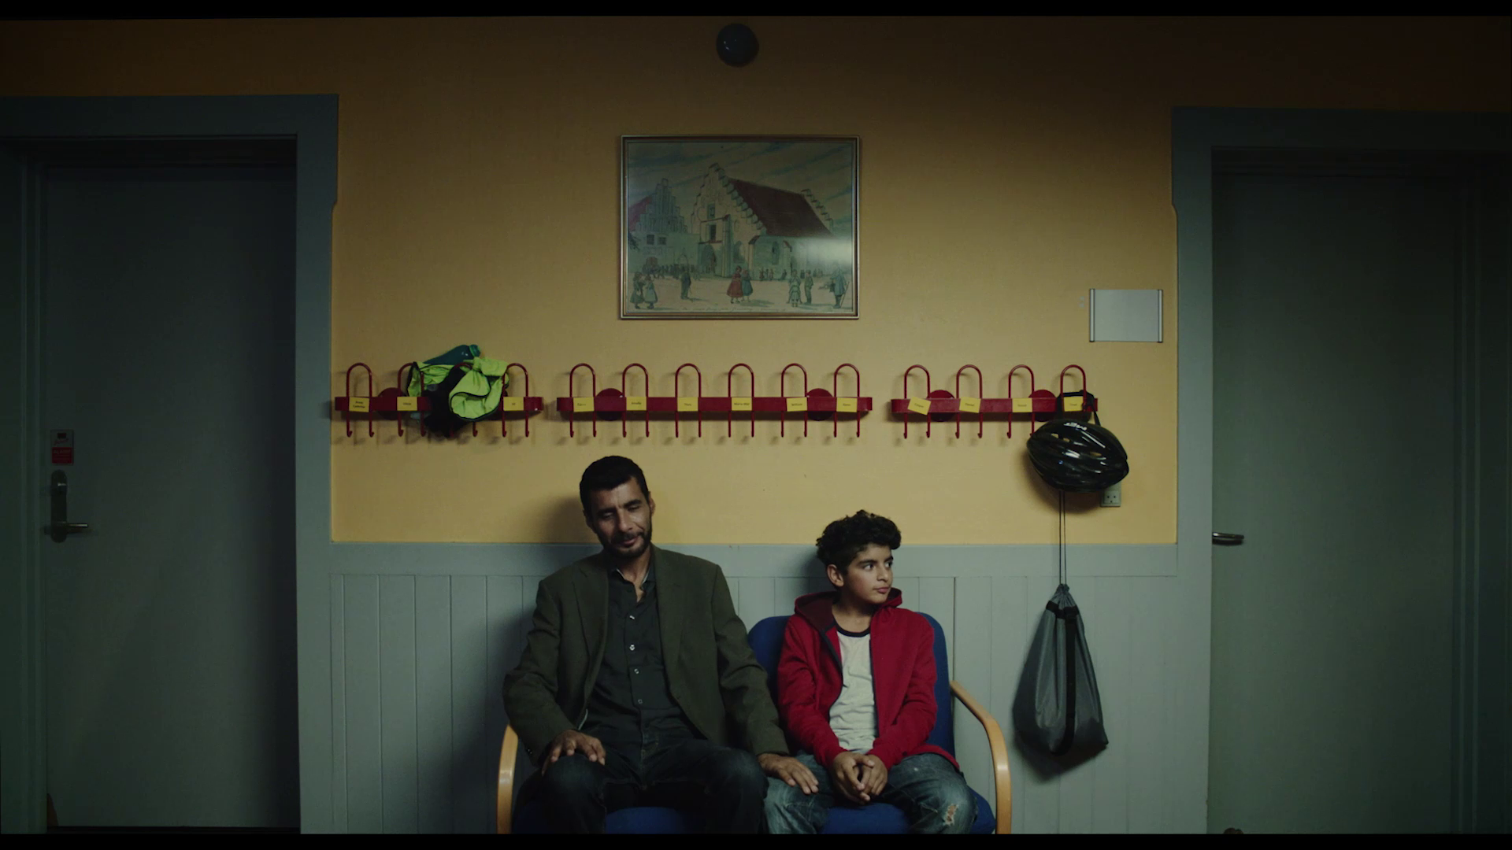
The School
Several scenes take place at the school, a space primarily associated with Adnan. We first see a room where Adnan and Sayid are waiting to be called to the teacher meeting. In a symmetrical composition, two pale green doors flank the plane. In the centre, the yellow wall contains a picture with a painting that represents, perhaps, a school and playground. Attached to the wall are a series of red hangers, with yellow papers that we can assume are the students' names.

Slide 8
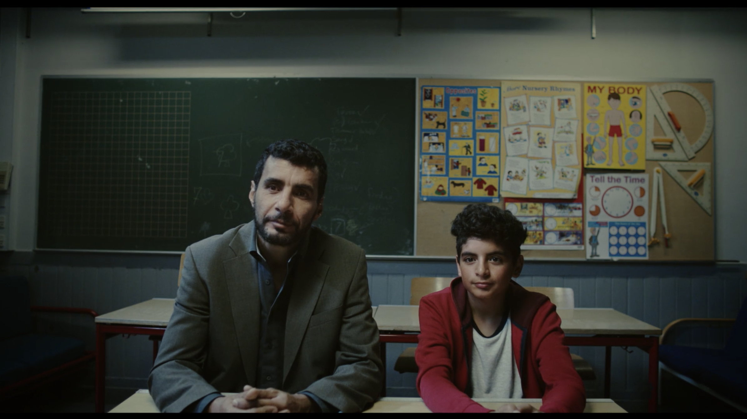
Contrary to most of the spaces shown in this film which, as a general rule, are relatively spartan, the classroom where the meeting takes place is cluttered and disordered. We see the students' tables and chairs; blackboards with unintelligible things written in white chalk; two panels containing different posters, including one on the human body and another on the telling the time; geometry instruments, such as a compass, a protractor and two set-squares.

Slide 9
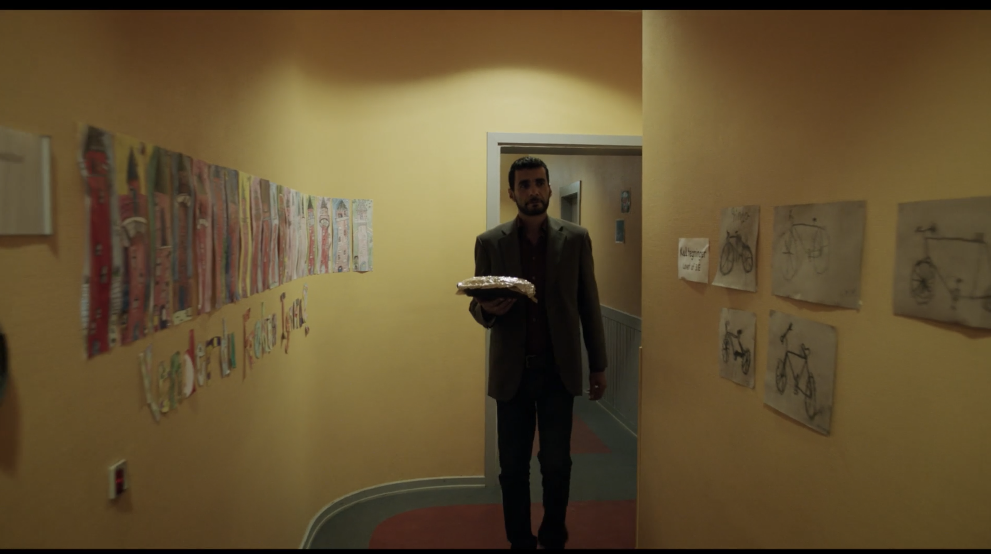
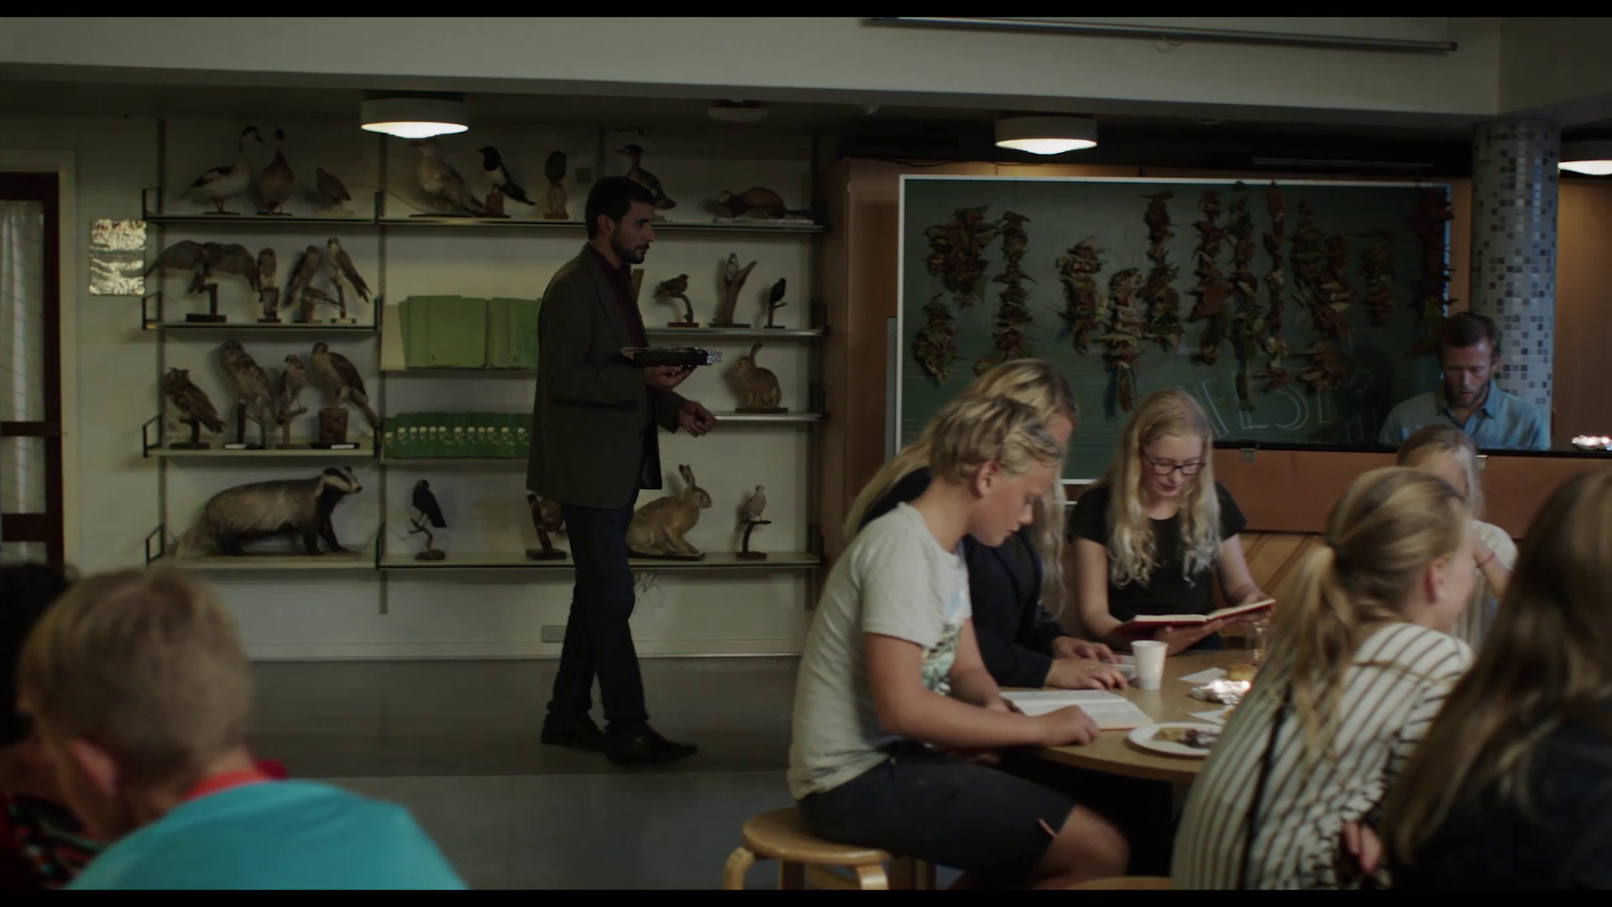
Towards the end of the film, when Sayid takes his cake to school, we see him walking down a long corridor with yellow walls, which are covered with drawings made by the students.
Finally, he enters a large room, where students gather around tables and the teacher plays the piano. In this room, we can glimpse countless stuffed animals arranged on shelves, such as different birds, a weasel and a hare.

Slide 10
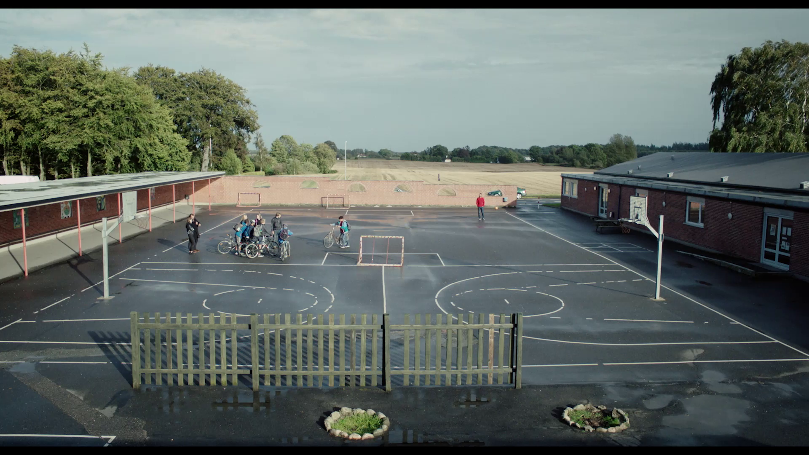
Finally, we also get to know the school's outdoor space on the day of Adnan's bike ride. The tarmac surfaced area is subdivided into two space - a small soccer pitch and a small basketball course. A wide shot allows us to see some of the school's surrounding space, revealing that it is not in an urban space but is instead close to a wooded grove and a wide empty field.

Slide 11
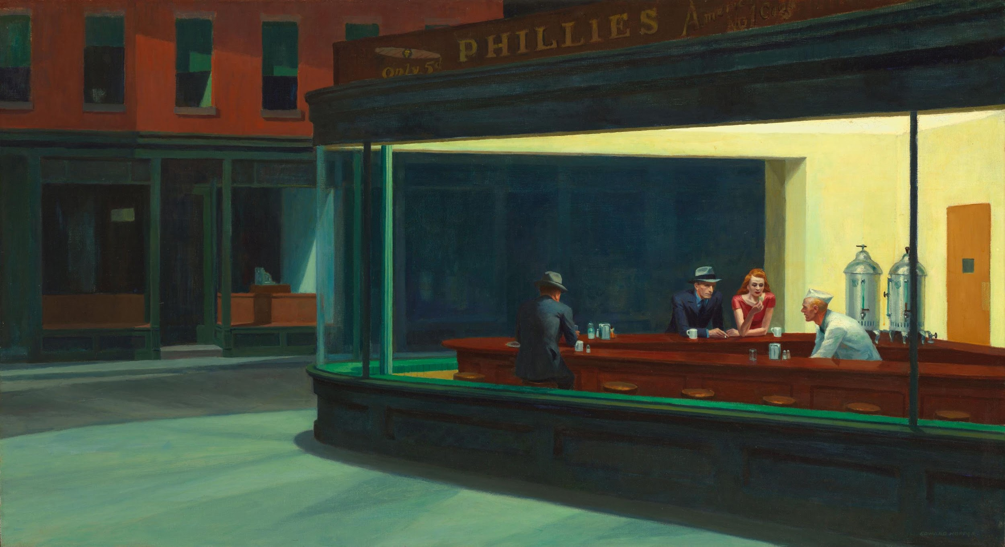
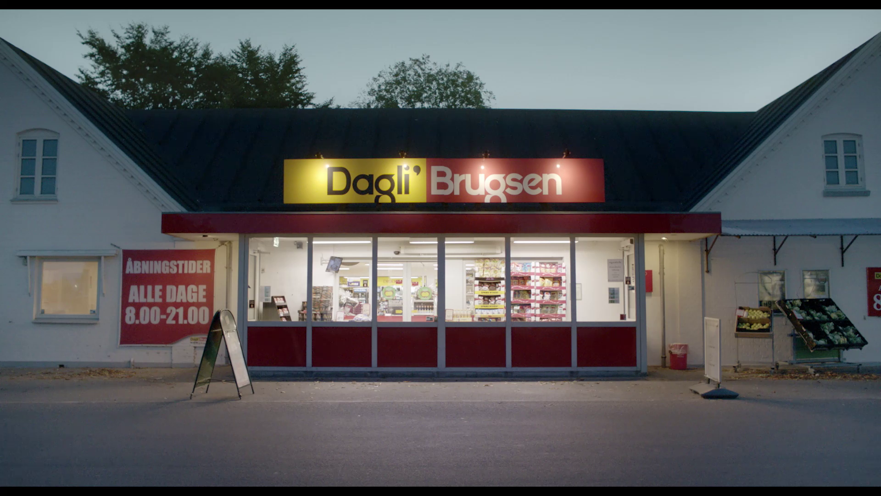
The Supermarket
The supermarket is the place where Sayid works and, as such, is primarily associated with this character. The space is presented to us in a manner that feels reassuringly familiar. At first, we see it from outside (Hopper painting - see below), at dusk, topped by the inscription “ Dagli' Brugsen ”.

Slide 12
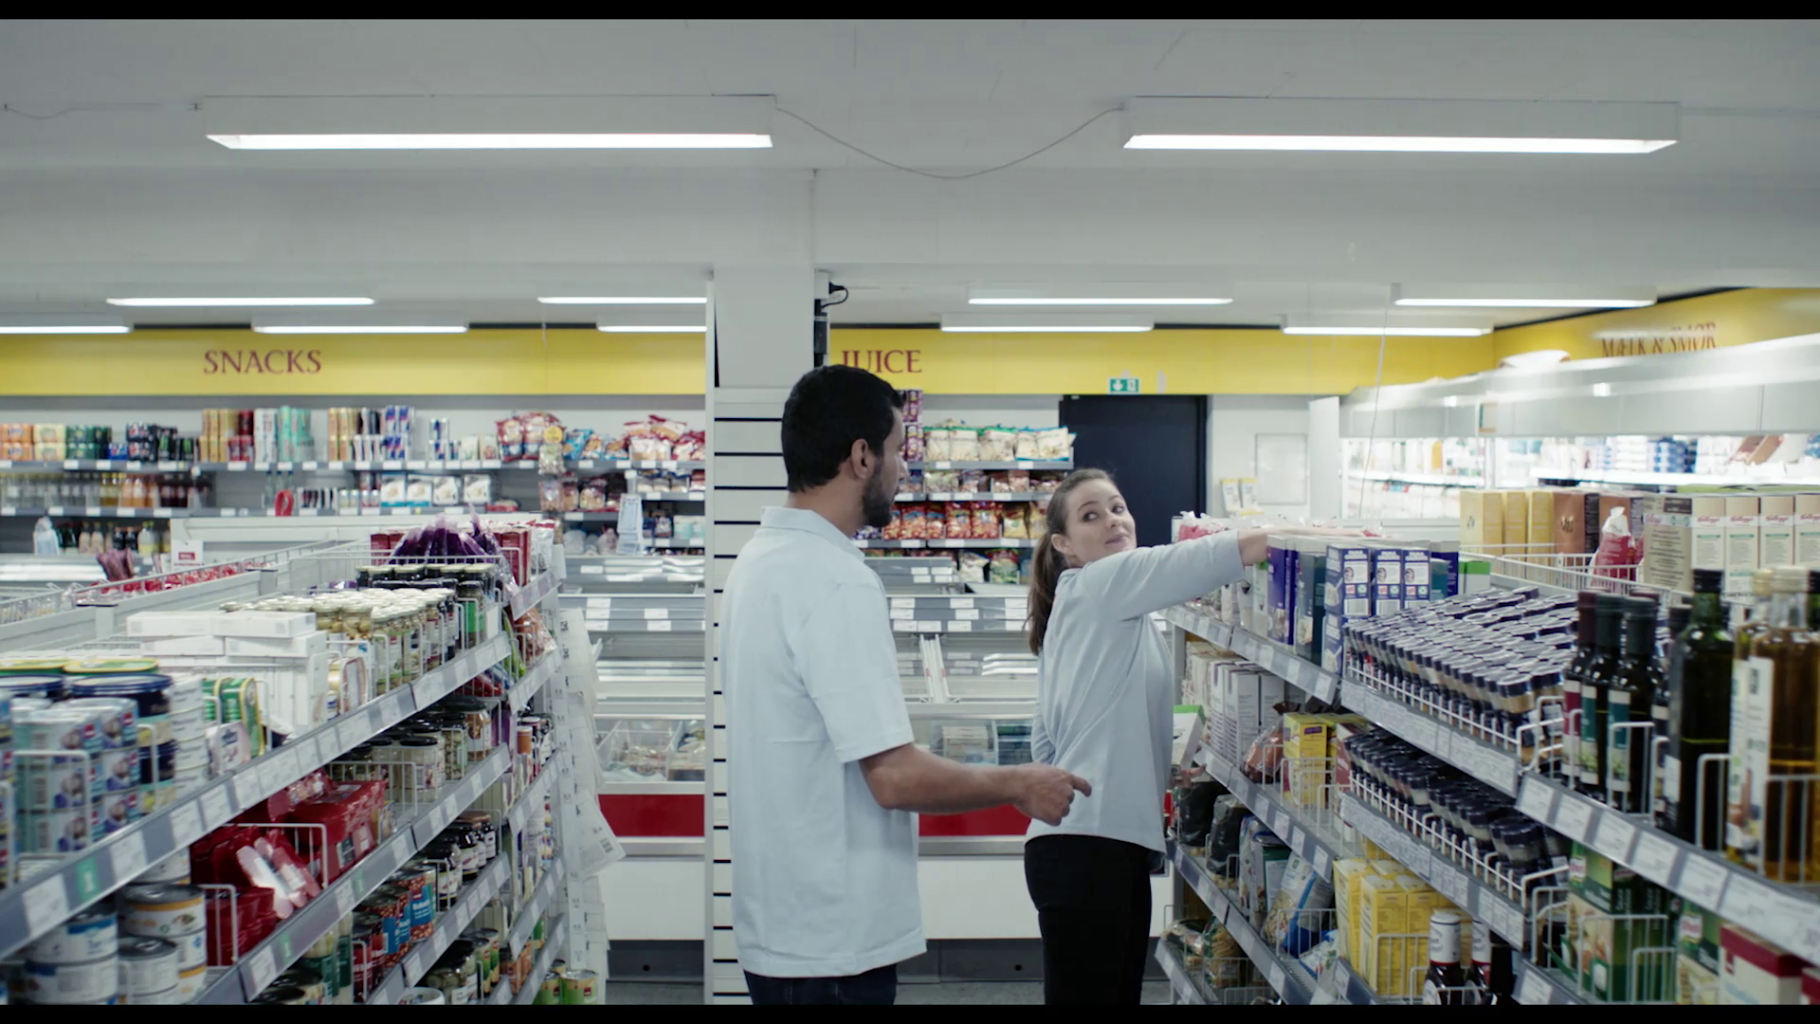
Inside, artificial lighting casts a strong, white light on people and things, underlining the artificiality of this place. In the aisles, we see everyday food items, such as canned food, drinks, and condiments.
In a brief scene, Adnan's father and a co-worker talk in a small room adjacent to the supermarket, which red door reads “FROKOSTSTUE” (dining room). This is a section of the store inaccessible to customers, where employees can take breaks.

Slide 13
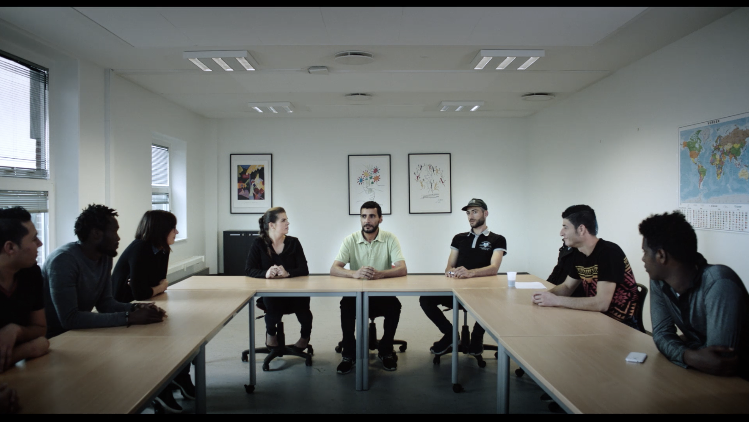
Other Interior Spaces
In an early scene, we see a kind of class that takes place in a large white room, with tables arranged in a rectangle. The students appear to be a diverse group of adults of different races and ethnicities. There is a large map on one of the walls. We can assume that this class is dedicated to activities of social inclusion of immigrants (See section: The Past and the Present) and, particularly, the learning of the Danish language.

Slide 14
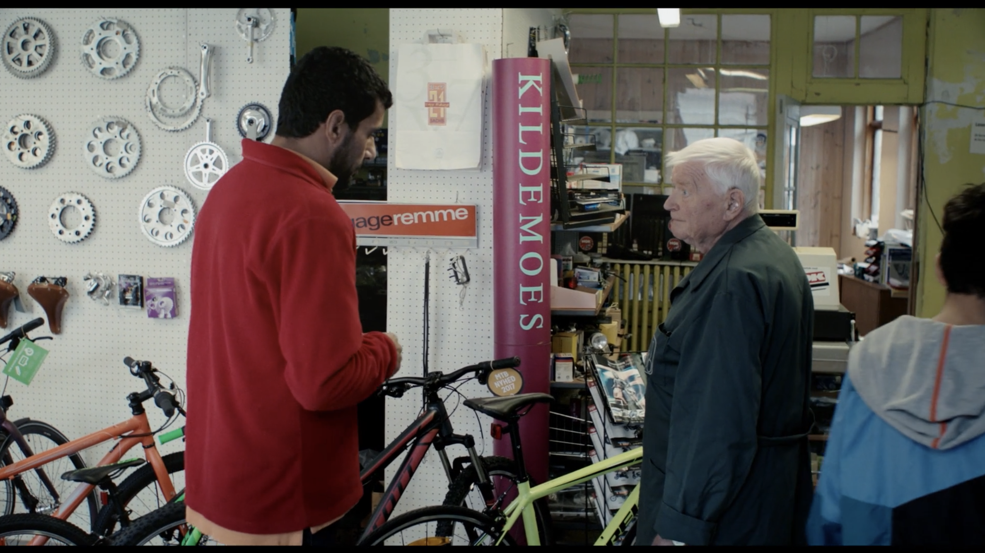
Another interior space where a brief scene takes place is the bicycle shop, which has a red sign that reads ‘KILDEMOES’. This appears to be an old store, with the appearance of a small warehouse, slightly untidy, and presenting for sale several bikes and loose parts, such as saddles and handlebars.

Slide 15
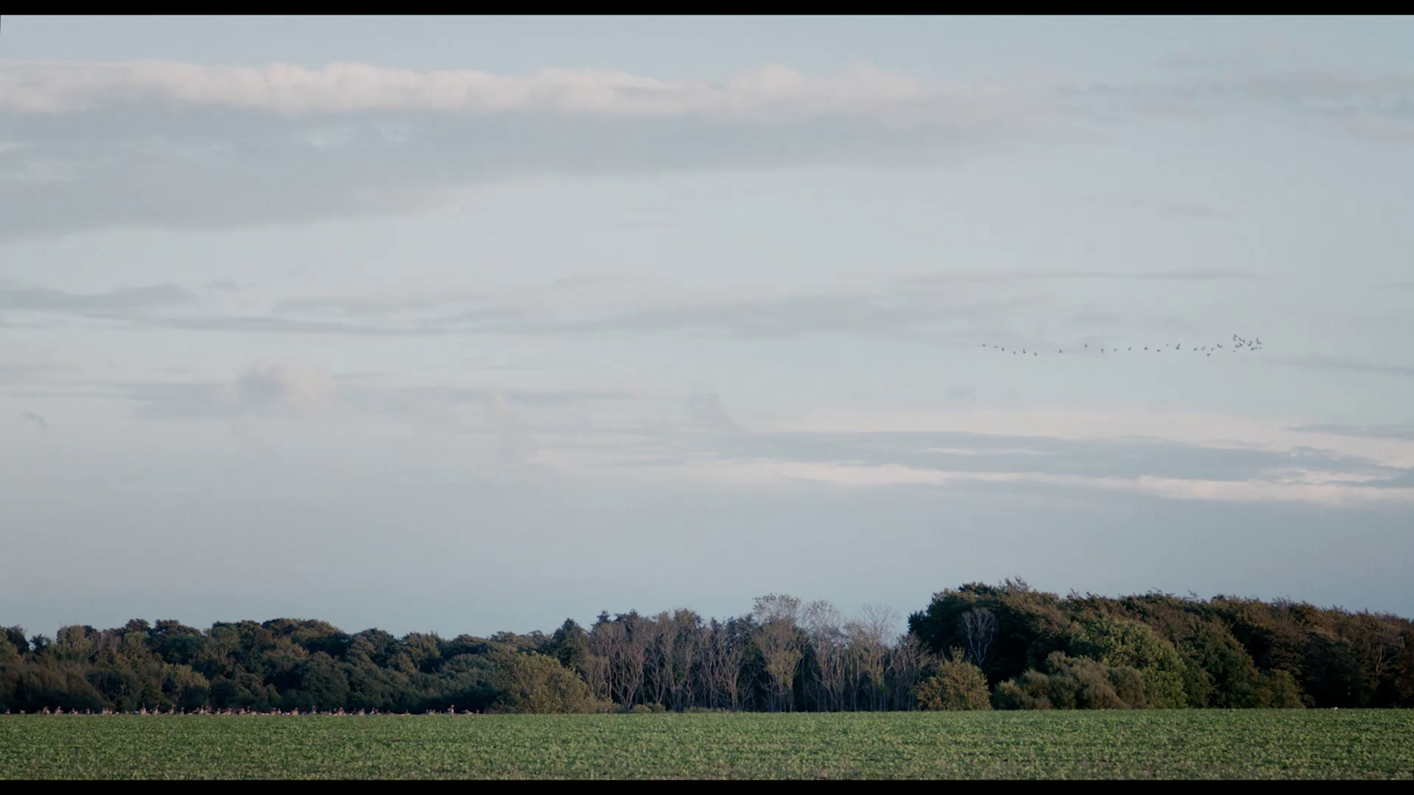
The Exteriors
The various outdoor scenes allow the viewer to get a visual impression of the small Danish town that the Syrian father and son now inhabit. The spaces are wide, there is usually vegetation visible in the frame, and the houses and commercial establishments are low, sometimes with small garden areas outside. The image conveys to the viewer the idea that this small and peaceful city is not markedly industrial, and that, on the contrary, it fits organically into the surrounding nature.

Slide 16
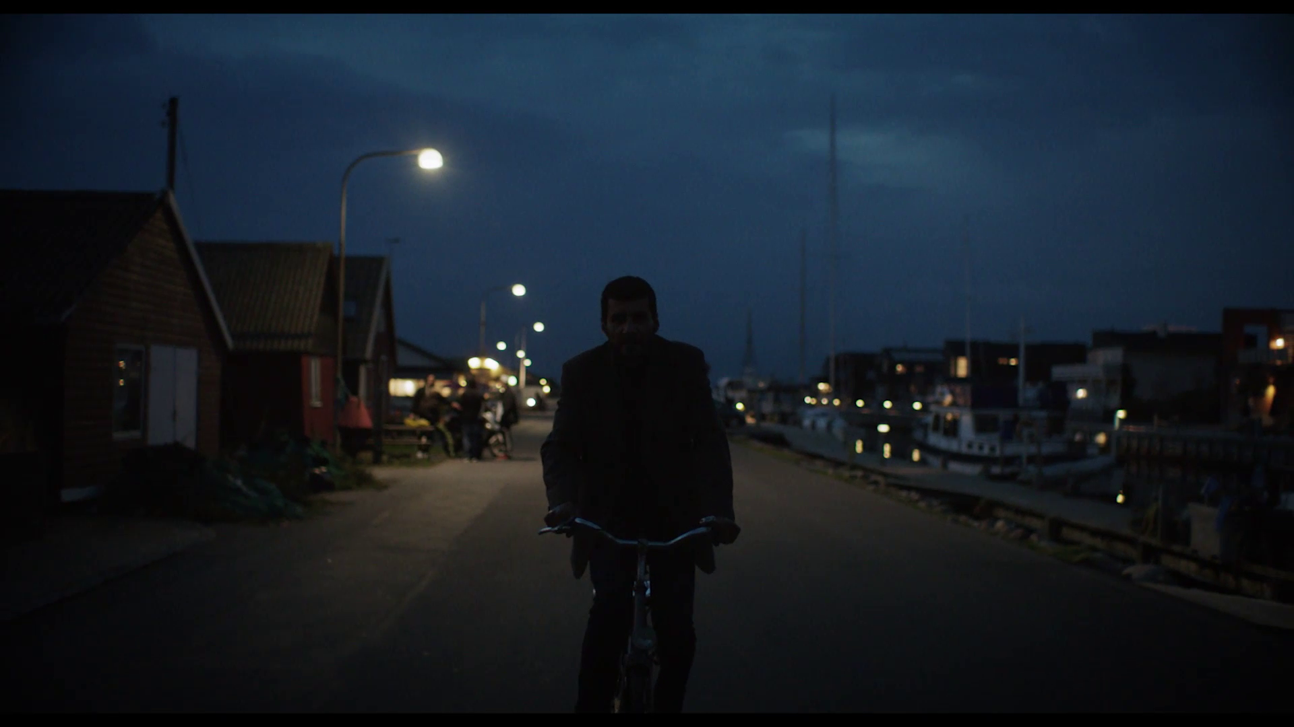
Finally, in a night scene in which the father travels on Adnan's bicycle, we can still glimpse, on the right, boats moored in a small marina. This scenic detail tells us that this is also a coastal city.

Slide 17
The Past and the Present

Slide 18
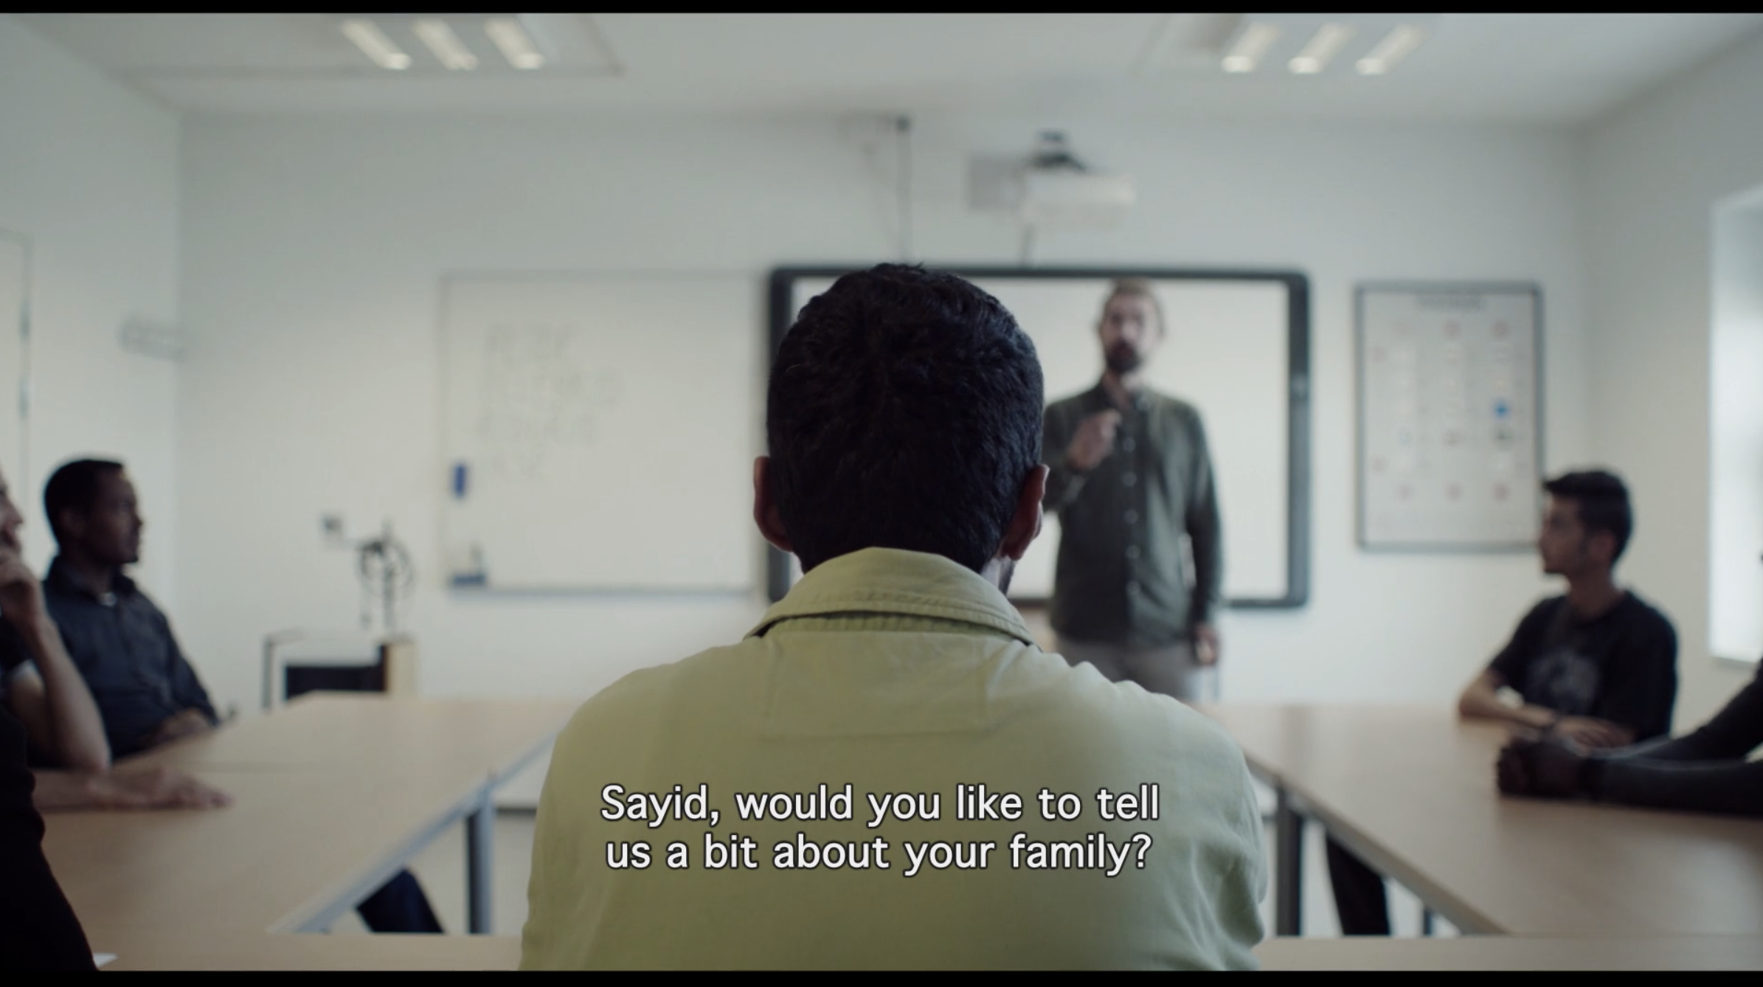
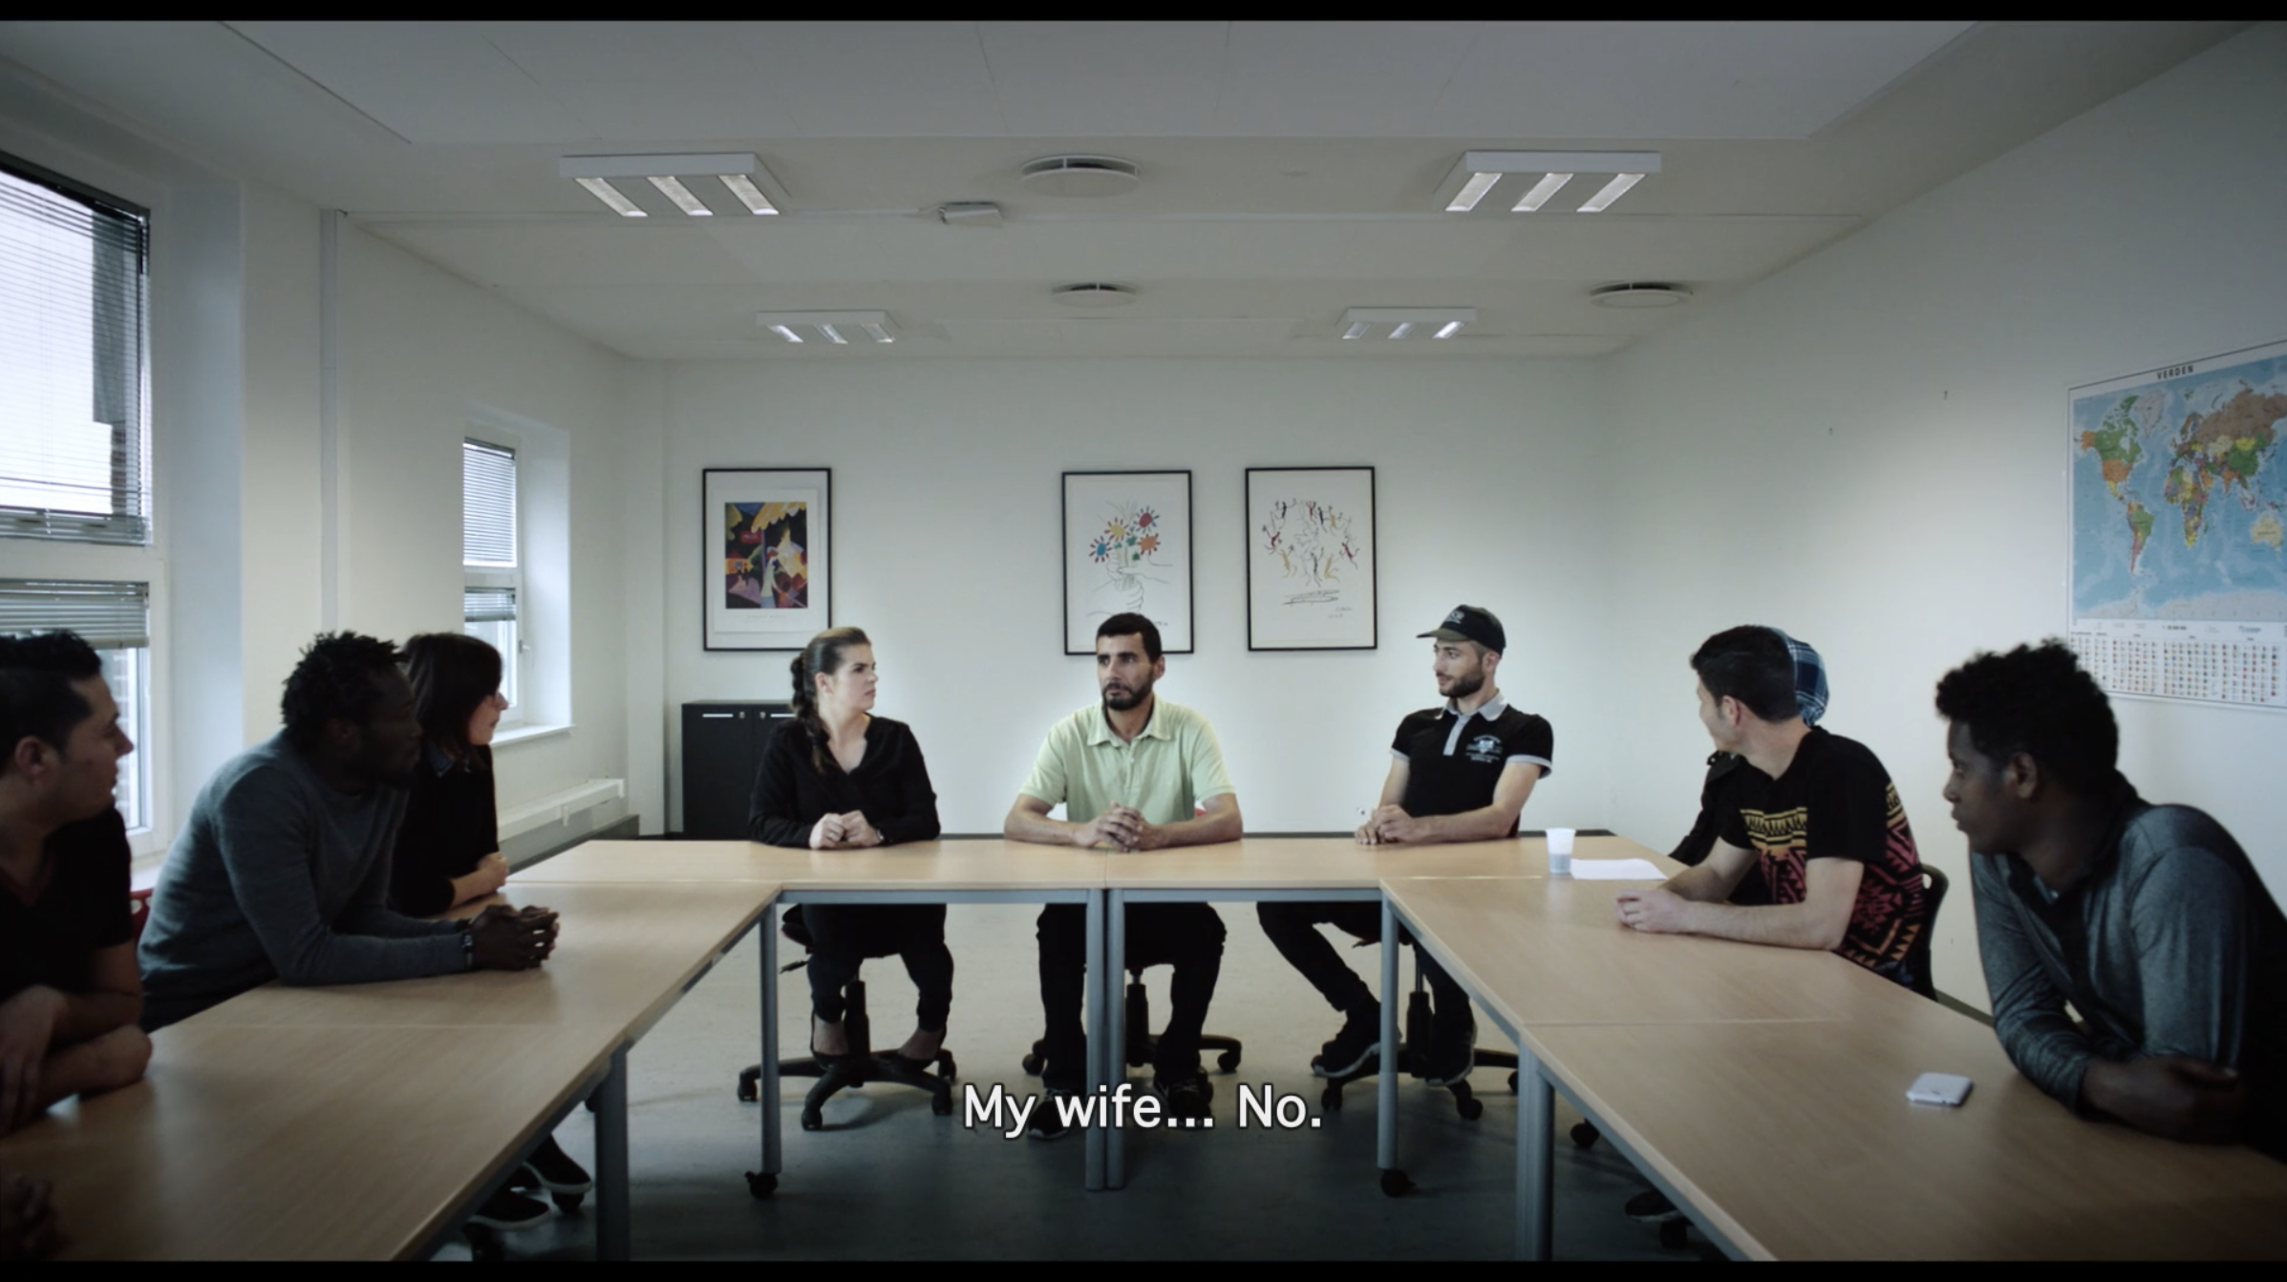
In one of the first sequences, Sayid finds himself in a room with people who we assume were originally - like him - from other countries. The tutor (seen out of focus in a shot where the focus favours Sayid) asks the Syrian if he wants to introduce his family to the group, and he only answers that he lives with his 12-year-old son. The tutor asks, "What about your wife?", and Sayid replies: "My wife ... no."
As no point in the film are we given any more information about Adnan’s mother. Given that Adnan and Sayid are from Syria, they are almost certain to have come to Denmark as war refugees. The mother may have passed away, or perhaps she was unable, for some reason, to make the trip to Denmark.

Slide 19
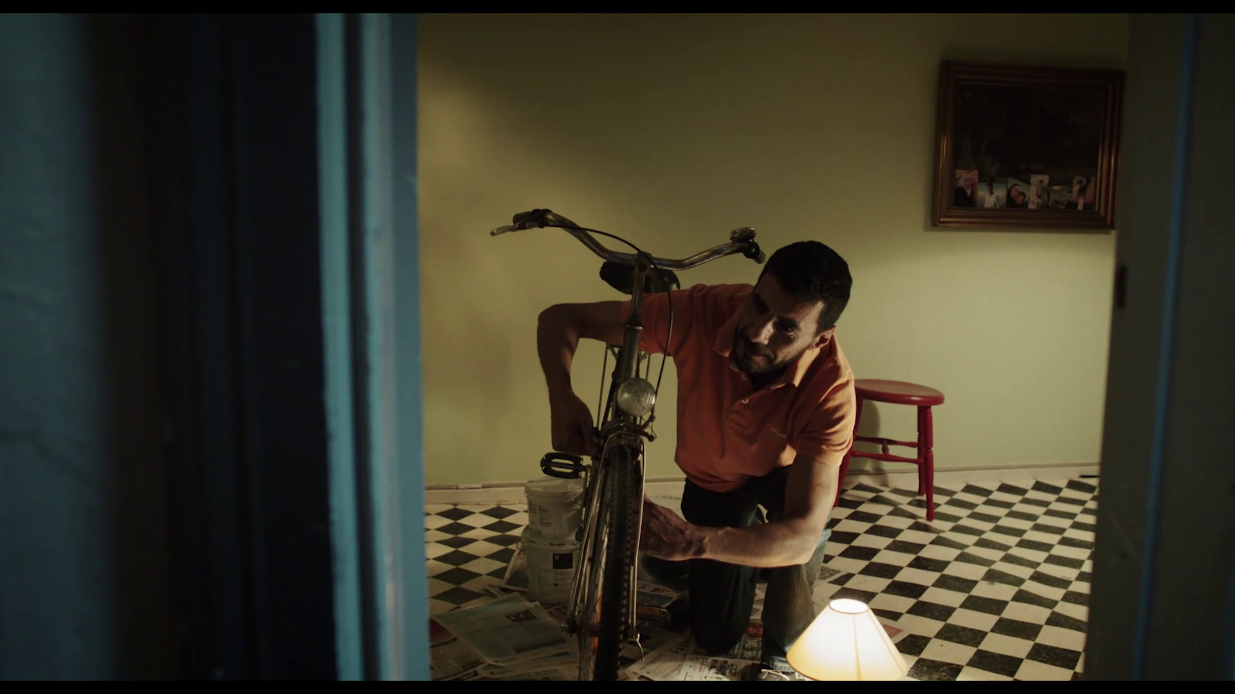
However, this absent maternal figure retains a subtle, but important, presence in the film; at the moment when Adnan's father repairs the bicycle on the floor of the room, we can also see, in the upper corner of the plane, a set of photographs arranged in the painting hanging on the wall. In these photographs, we can see a female figure in a hijab, presumably Adnan’s mother.

Slide 20
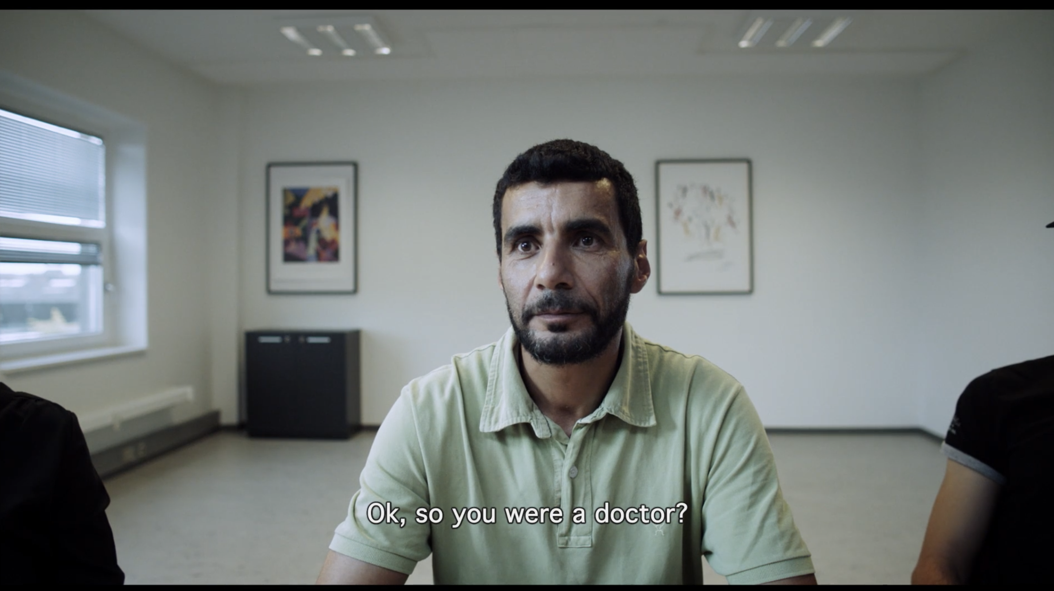
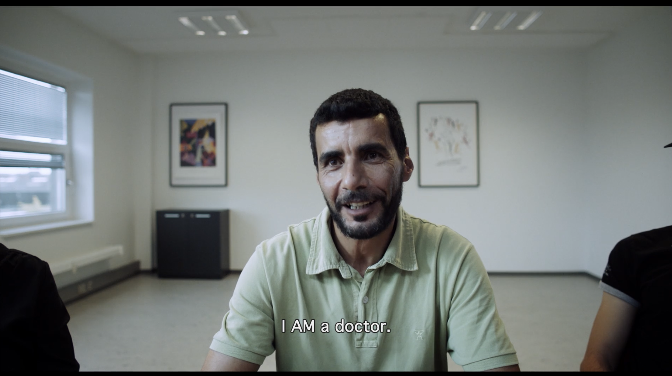
Still in the scene around the table, the father explains that he is a doctor in Syria. The tutor asks, "Okay, so you were a doctor?” Sayid clarifies, ”I am a doctor." This disagreement of temporalities is associated with a spatial disagreement. The tutor involuntarily establishes a split between the past and the present of this refugee: according to the tutor's implicit reasoning, it would be said that in the past, in Syria, this man was a doctor, whereas in the present, in Denmark, he is no longer .

Slide 21
However, Adnan's father corrects that idea, stating that, despite the socio-political circumstances of his country having forced him to take refuge elsewhere, he is still a doctor, regardless of whether he now works in a supermarket. Thus, through the subtleties of language and implicit meanings, the film exposes existential difficulties with which refugees are forced to confront in their new homes.

Slide 22
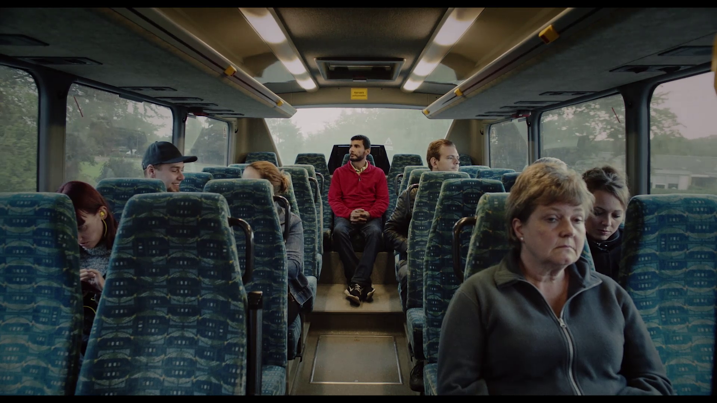
Moving Figures
In this film about migration – that is, of transition from one space to another – there are several scenes that show the act of motion of the characters. This shot is designed so that the human figures are surrounded by the windows of the bus, through which we can see the landscape in motion. The protagonist himself looks thoughtfully through the glass, contemplating the city outside. Interestingly the camera – like the characters – is fixed, and the only thing that moves is the vehicle.

Slide 23
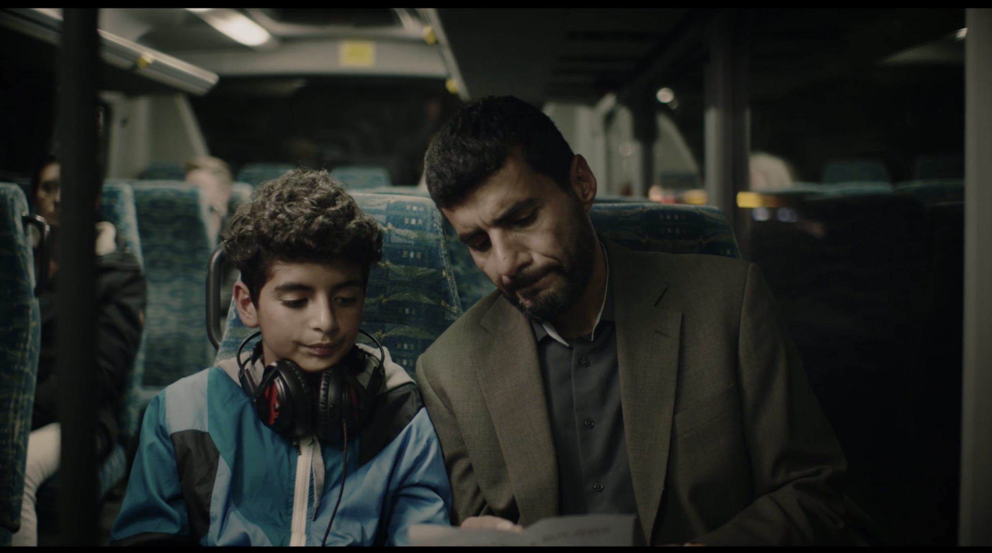
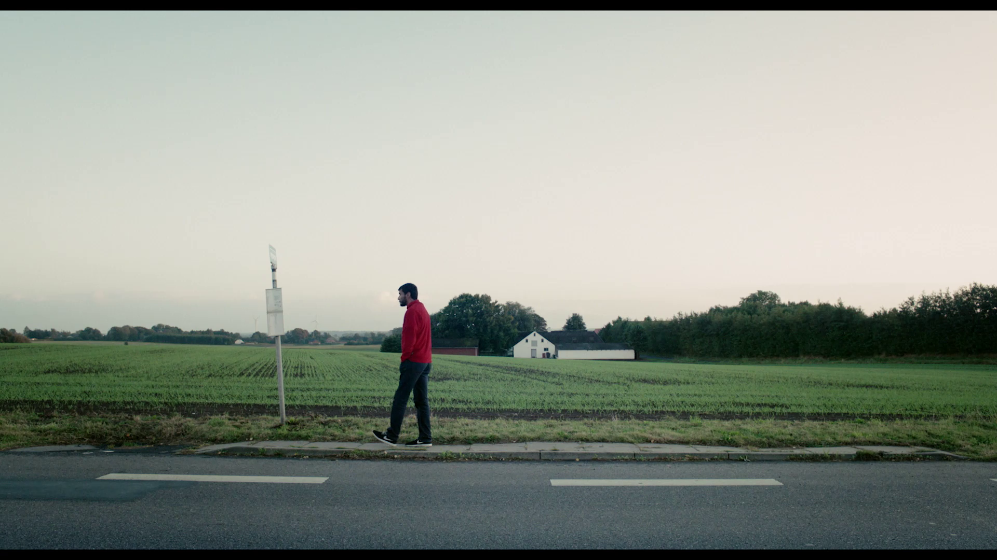
There are other scenes in the film that take place on buses, for example, a night scene in which father and son return home after the school meeting, and another sequence in which the father, looking out the window of the bus, sees his son on a new bicycle.
At other times, the characters move around on their own feet. At the beginning of the film, the father and son walk the streets with the sofa, towards their new home (See Section 1 - Analysis of a frame). In another moment, we see the father at the side of the road, next to the bus stop, waiting.

Slide 24
Finally, it is important to highlight the importance of the bicycle, not only as an element with an important symbolic function ( See section 4 - The symbolic function of objects ), but also as a means of transition. In one shot Adnan's father rides towards the camera as it tracks backwards, the movement of the tracking shot parallels that of the bicycle and we get a sense of motion and freedom.

