Slide 1
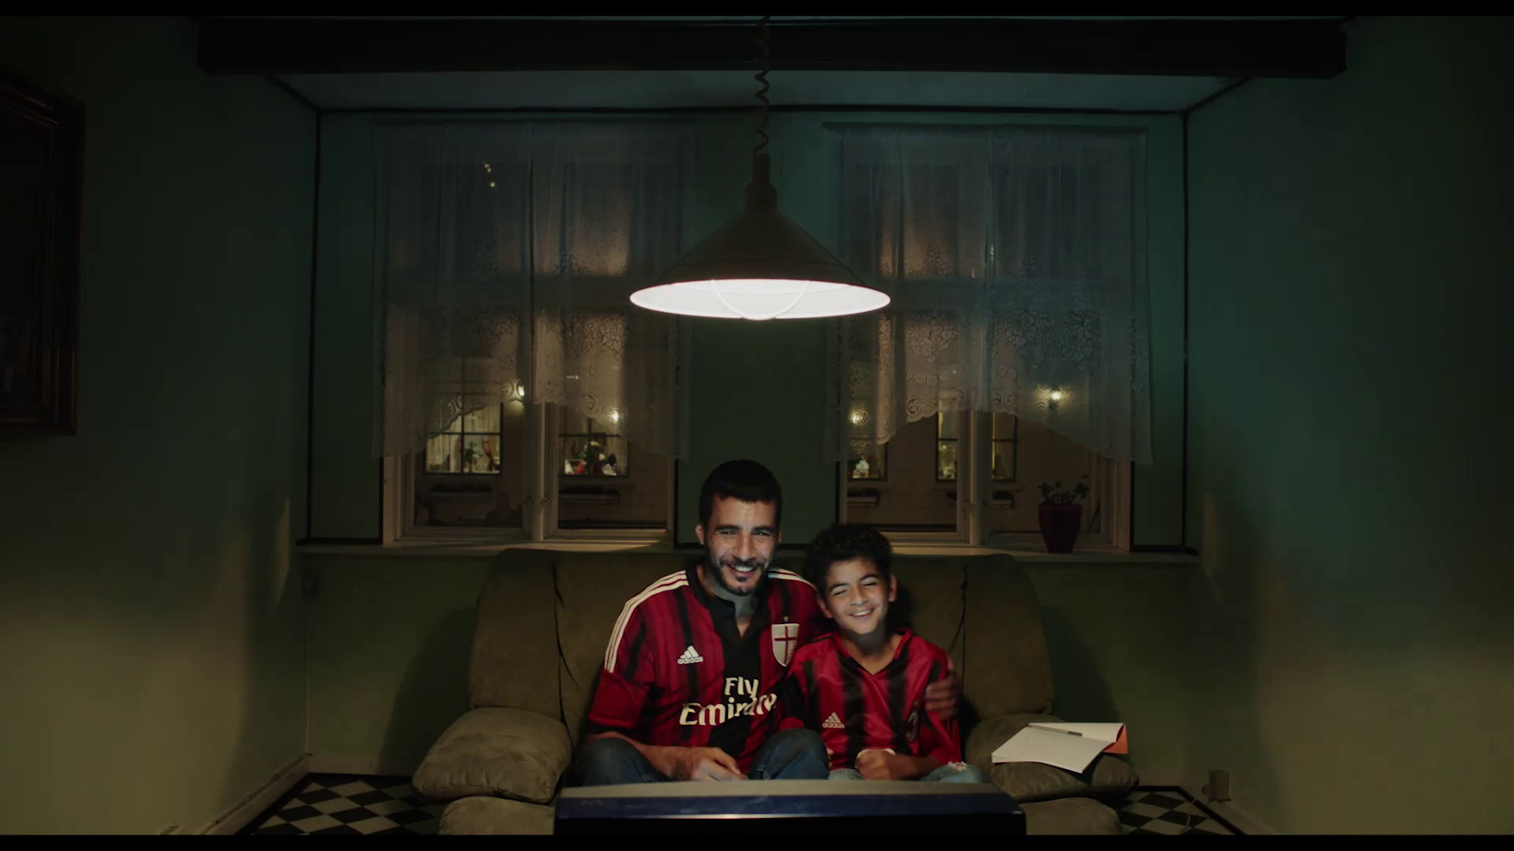
Lesson Plan Two Part Two
Analysing Adnan’s Father
Dir. Sylvia Le Fanu, 2017

Slide 2
The Symbolic Functions of Objects

Slide 3
The television they watch the football match on is the first such object. At the beginning of the film, both are dressed in AC Milan jerseys, signalling a shared fondness for a football team. That shared interest is further highlighted when they both celebrate a goal scored by that team. However, in the same scene, another object disrupts this harmony - the exercise book in which Adnan does his homework. After the goal, the young man stops looking at the television and starts looking at the notebook (See section: Analysis of a Sequence).

Slide 4
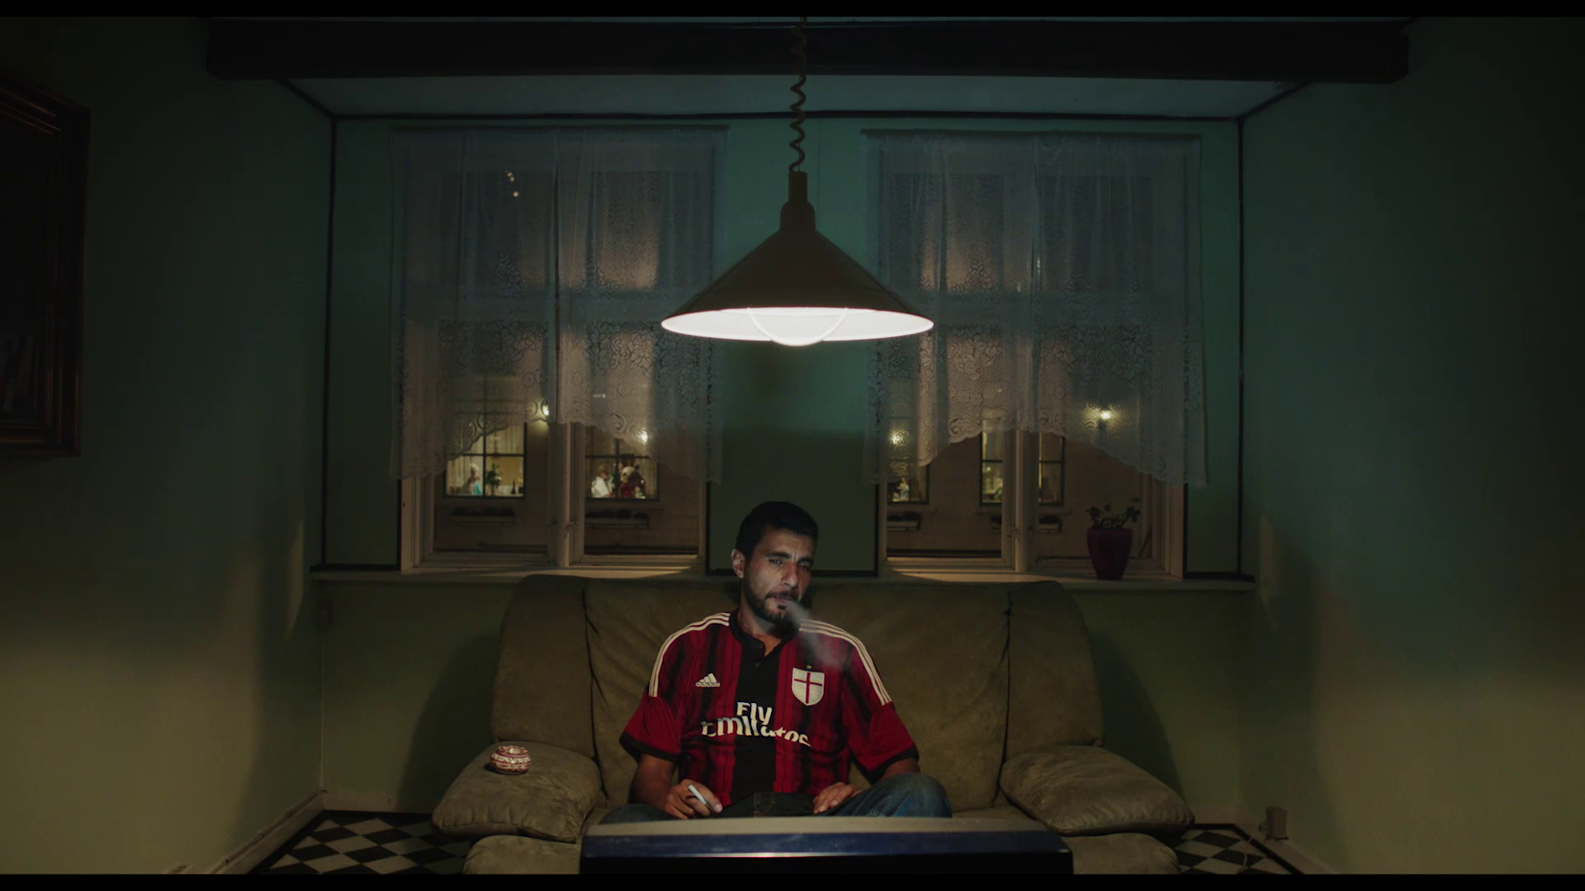
The sofa also symbolically reflects the state of their relationship. At first, both join forces in transporting the sofa through the streets (See Section: Analysis of a frame). Then, we see them in the scene described above, sharing the small sofa while watching the football match. In a later scene, after the discussion in the bedroom, we see the sofa from the same camera position as before. However, in this new variation on the previous shot, the father is already alone watching the football game.

Slide 5
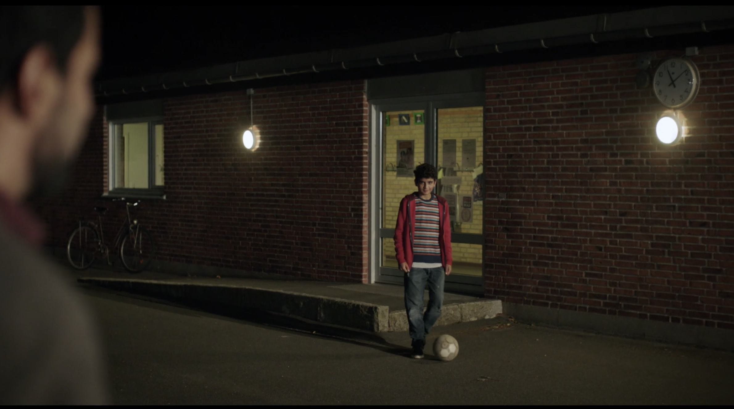
In the playground scene that concludes the film, football acts as a bridge between father and son. First, the son kicks the ball towards the father, and the father, in turn, responds by returning the ball to Adnan. Thus, football, which initially symbolized their bond, once again fulfils the same function.

Slide 6
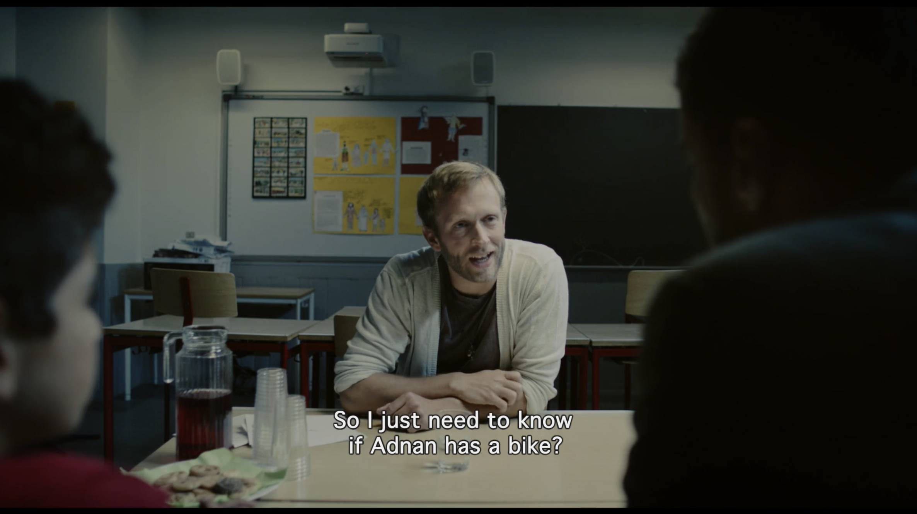
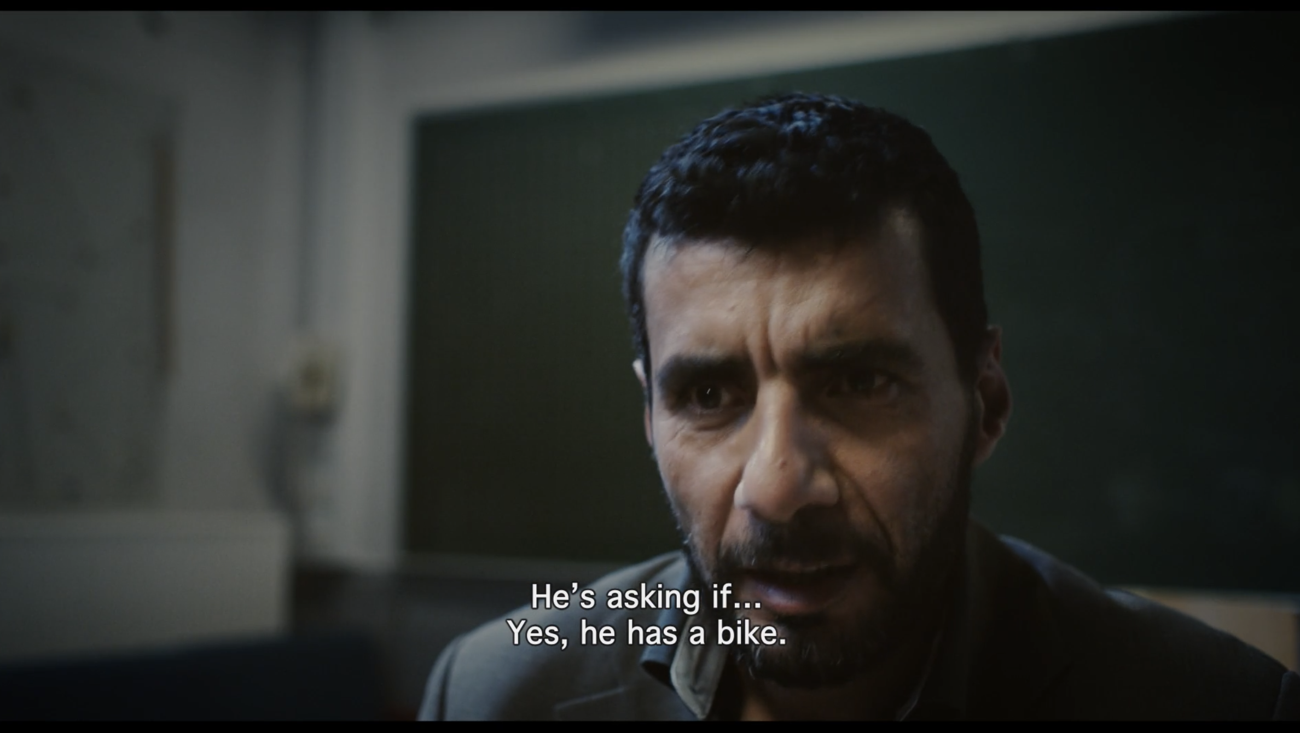
The object with the most important narrative function in the film, however, is the bicycle. During the meeting with the teacher, the teacher announces that the class will be taking a bike ride soon, and asks his father if Adnan has one. The father lies, saying yes. In a bicycle shop Adnan finds bike he wants but Sayid, lacking the funds to buy to tries and fails to haggle its price down. They leave the shop empty-handed.

Slide 7
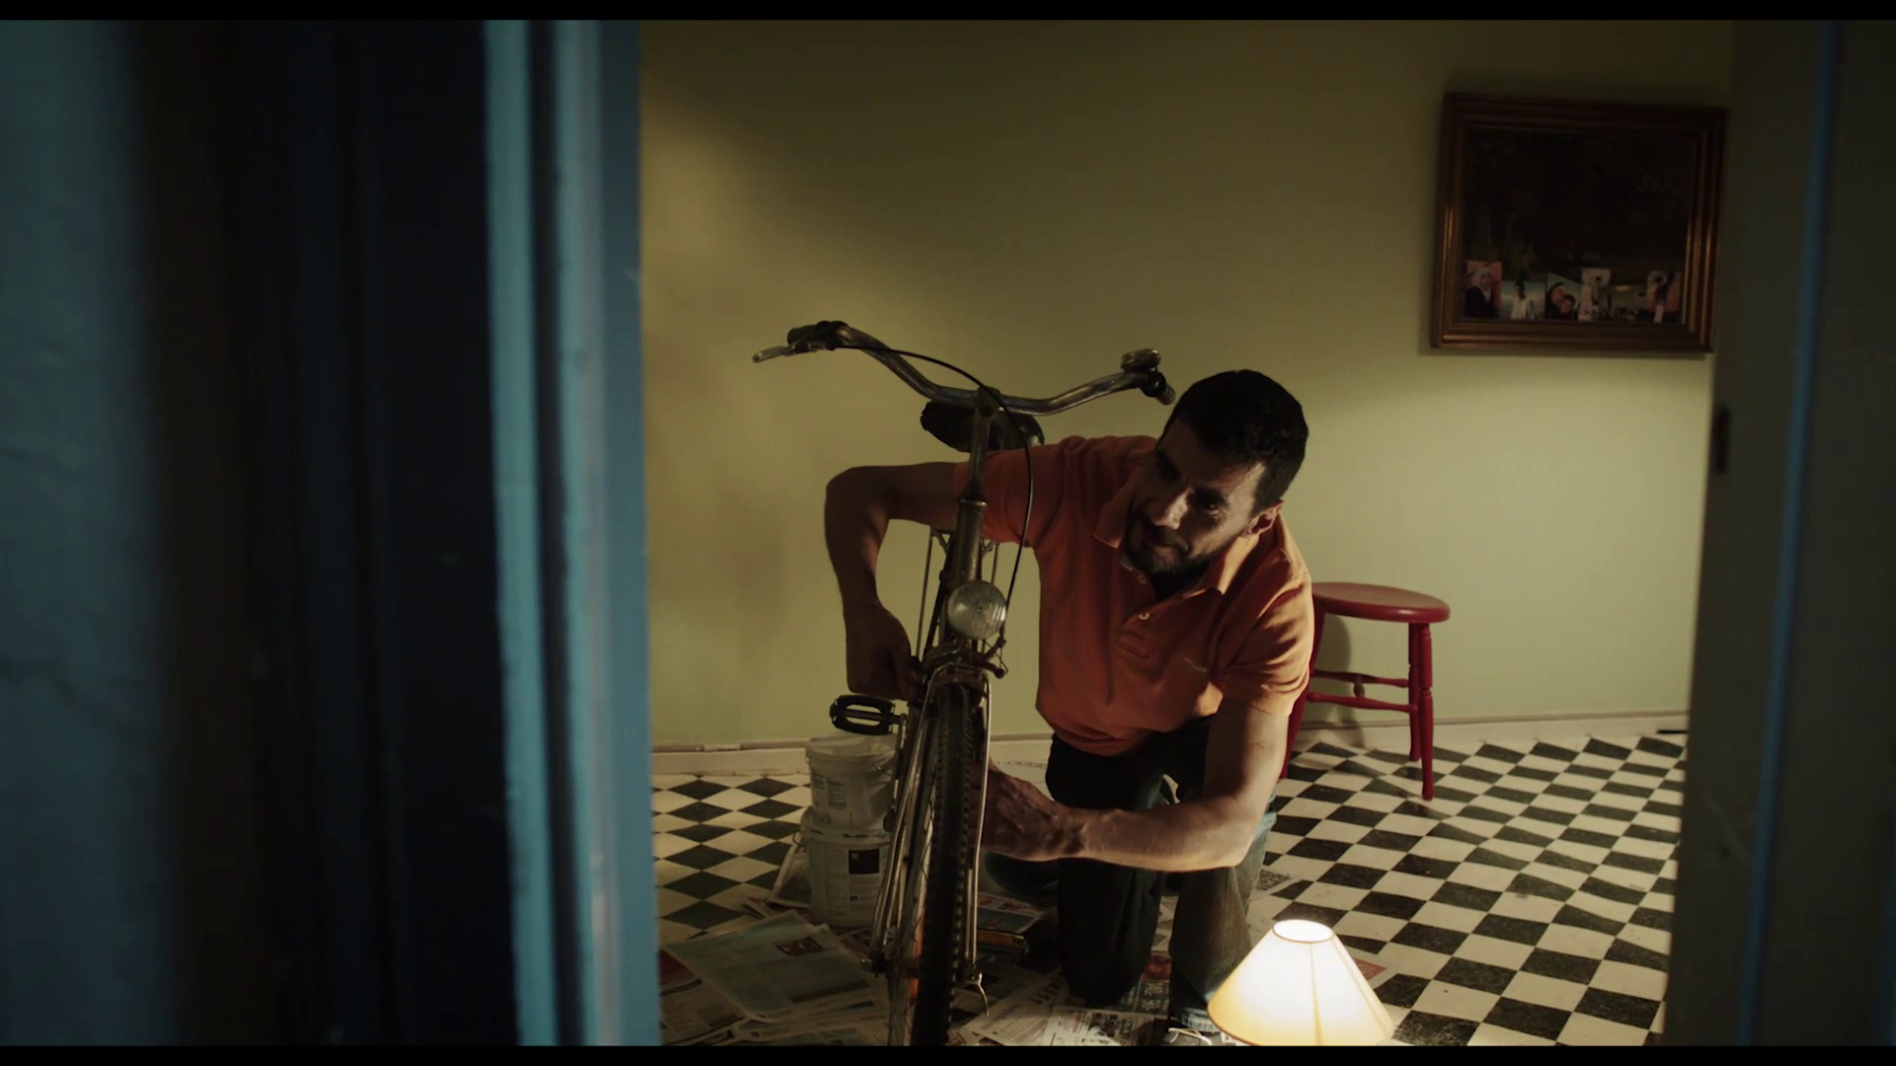
Shortly after, Sayid finds an abandoned bicycle in poor repair and tries to fix it in the living room of his house. Later, he finds his son on the street, with a new bicycle. He then learns that it was borrowed from the teacher, to whom he quickly returns it. Adnan ends up taking the school excursion with the old bicycle, now restored by his father. By repairing the bicycle Sayid proves to Adnan and himself that work and dedication make it possible to overcome insurmountable problems.
Projekt współfinansowany
w ramach programu Unii Europejskiej
„Kreatywna Europa”

Slide 8
The Sounds of Adnan’s Father

Slide 9
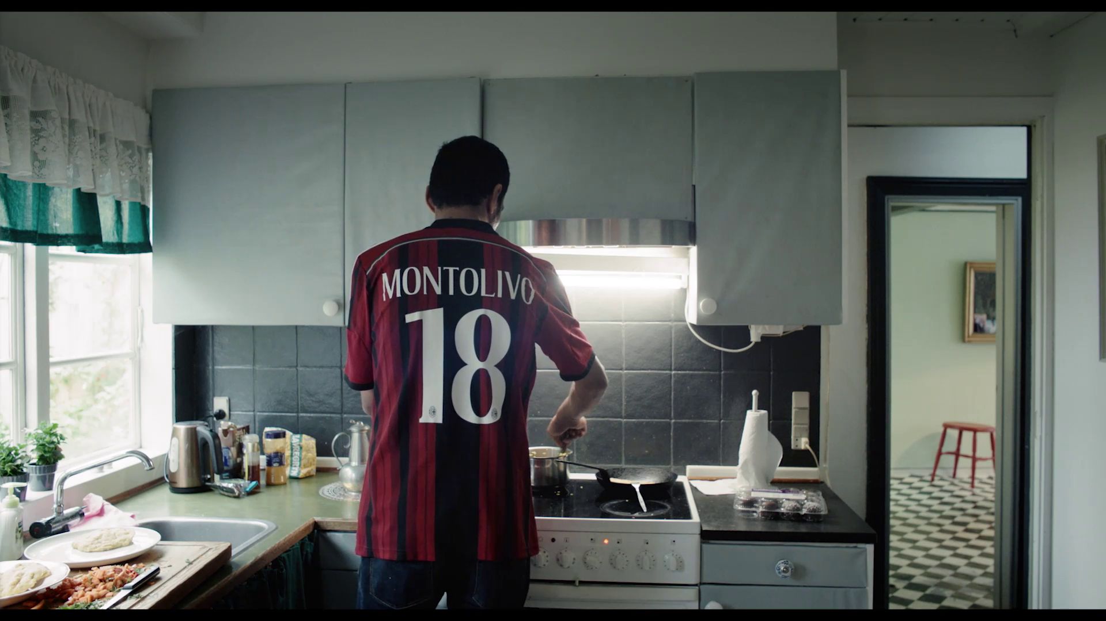
Throughout the film, the scenes in which the characters speak are not, as a general rule, accompanied by non-diegetic music, whereas scenes in which there is no dialogue usually have a musical accompaniment in the background. However, there are some exceptions to this rule. In the scenes where the father repairs the bicycle and cooks the cake, Arabic music is heard; these songs are diegetic (that is, they comes from within the world of the film) and were probably selected by Sayid himself.

Slide 10
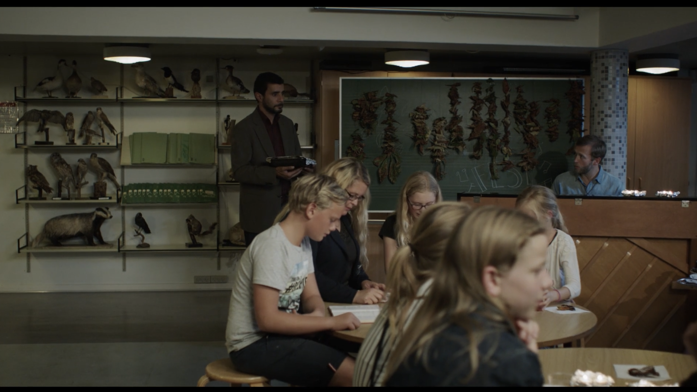
At the end, the father visits Adnan at school, the teacher plays the piano and the young people sing a song in unison; this song is sung in Danish, and as such it clearly differs from Arabic music, signalling the young Adnan's adherence to the customs of the new country.

Slide 11
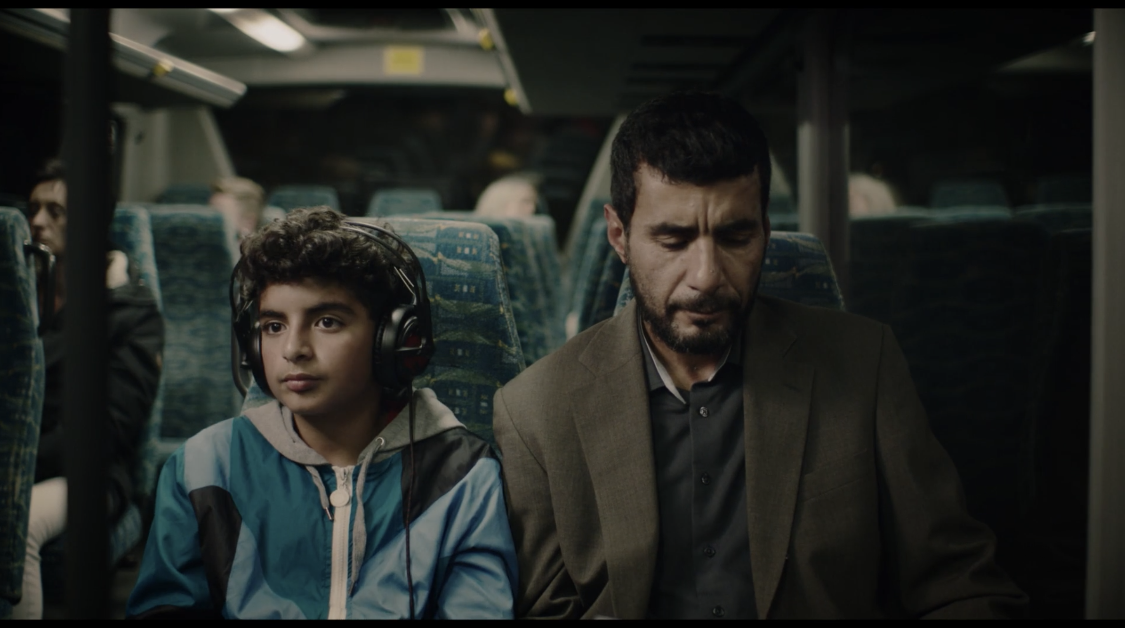
Adnan’s Father also uses moments of silence to highlight communications issues between father and son. On the way home after meeting with the teacher, they talk about the bike ride. When the conversation ends Adnan puts on headphones and listens to a song we, the audience, do not hear. Instead, we remain with his father who, in silence, reflects on the difficult situation he is going through. It is the meditative countenance of the father, as well as the sighs that only we hear (the son being too absorbed by his music), that convey the tension of the moment.

Slide 12
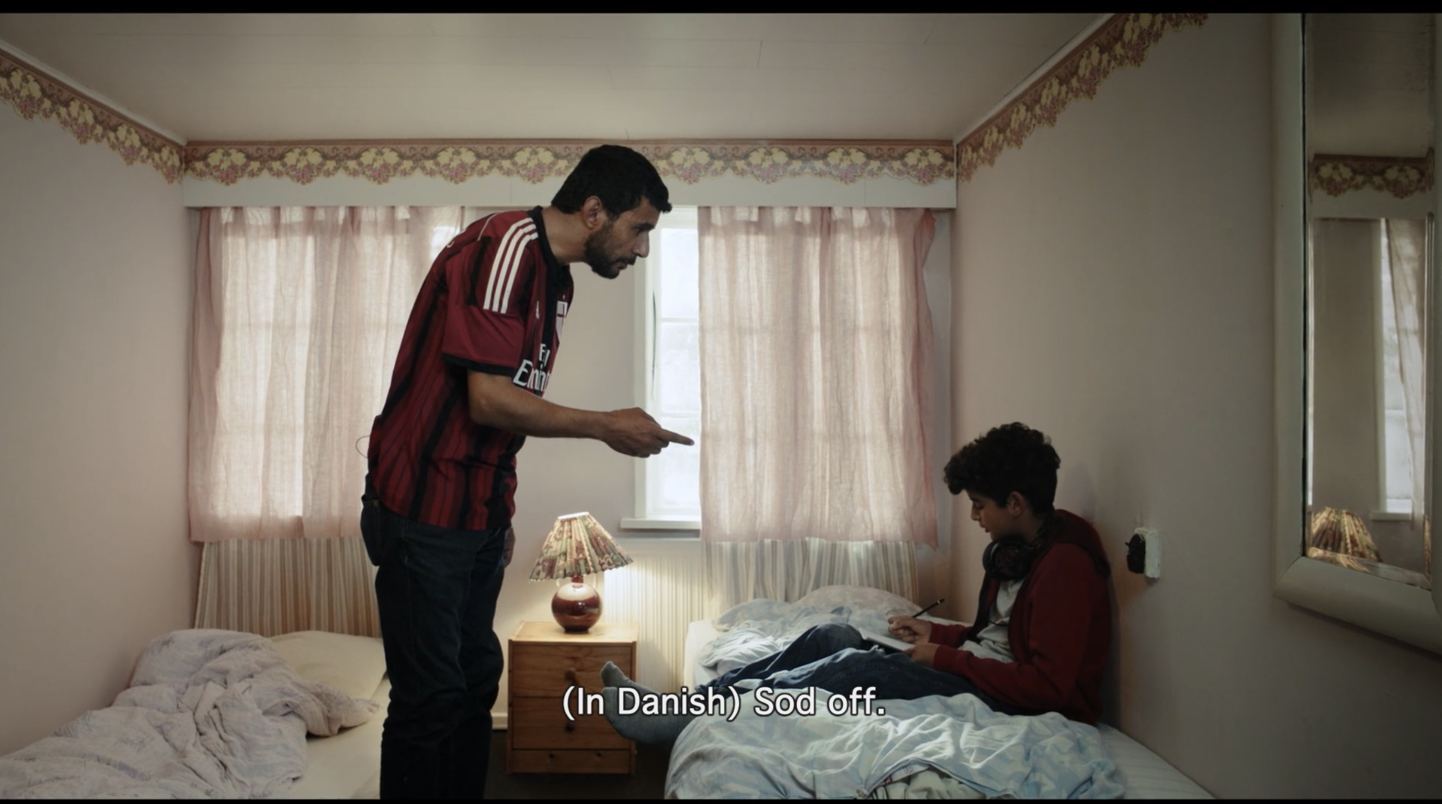
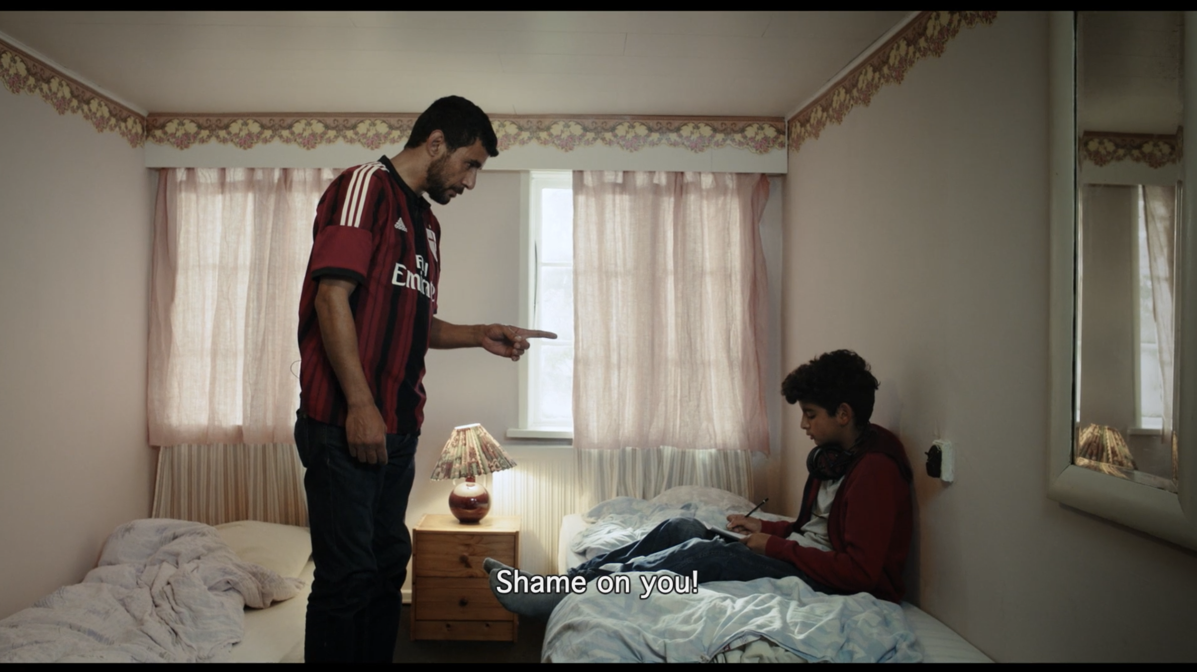
Language also plays an important role. In both humorous and dramatic moments, we witness the communication difficulties between Sayid and the local people, which take place because the doctor still has difficulties in mastering the Danish language. When alone, Sayid and Adnan talk in Arabic. During the discussion in the bedroom, Adnan, irritated with his father, exclaims anything in Danish that his father does not understand (something like: “sod off!”). Scolding his father in a language that he doesn't understand, Adnan points out the ease with which he is getting used to the new reality, while underlining Sayid's difficulty in getting used to that same reality.
Projekt współfinansowany
w ramach programu Unii Europejskiej
„Kreatywna Europa”

