Slide 1
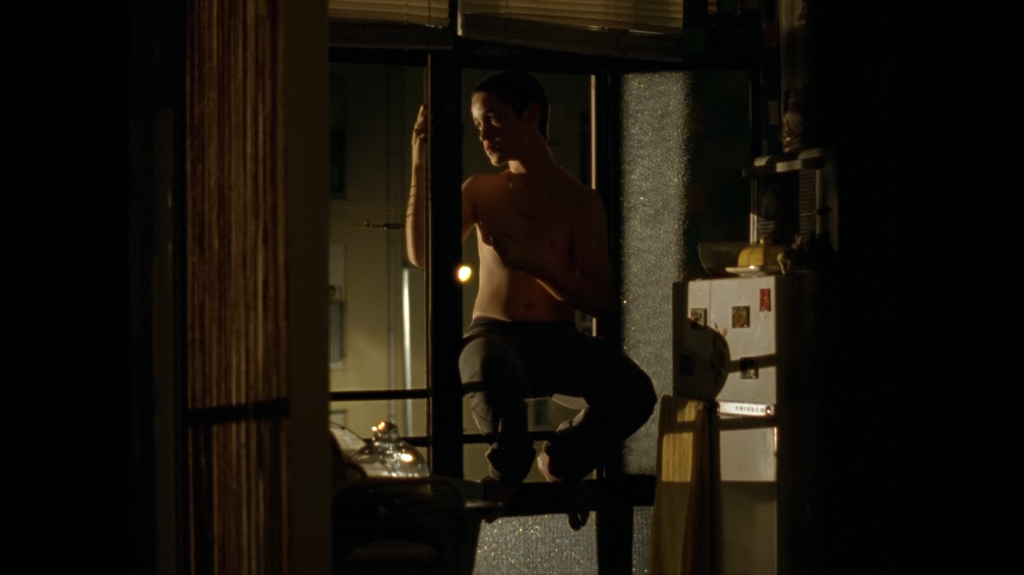
Analysing Rafa
Dir. João Salaviza, 2012

Slide 2
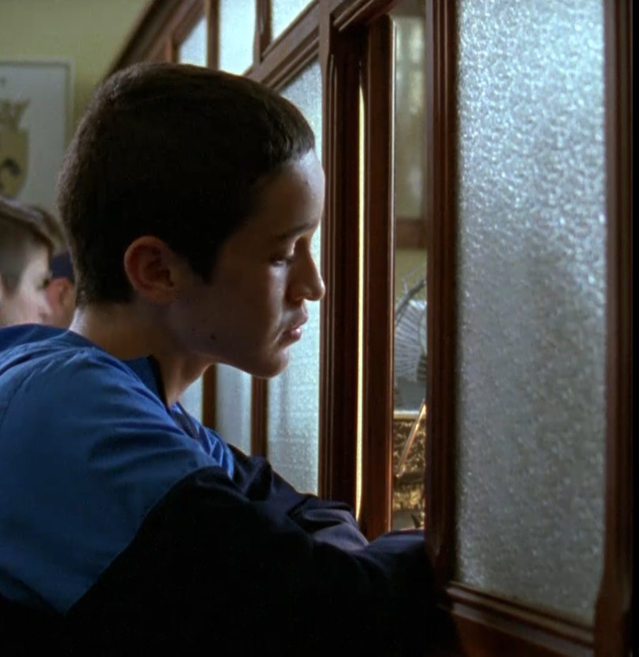
LESSON ONE Frame Analysis

Slide 3
The Frame
A frame is a single unit of cinematographic expression, a static picture composed of even more static elements. Printed on film as fixed images they are called frames. The rapid, successive playback of these frames when a film is projected is what gives the illusion of movement.
The term aspect ratio is used to describe the shape of the frame and its proportions. Filmmakers can choose a range of aspect ratios. A western or action movie might use an extremely wide aspect ratio of 1:2.4 to show expansive vistas and fill the frame with spectacle. Modern TV uses the default aspect ratio of 1:1.77.
Rafa uses a narrower more old-fashioned aspect ratio of 1.1.33. The shape of the frame is almost square, which the director uses to convey a sense of confinement.

Slide 5
Waiting
The first image we see in Rafa is full of ambiguity. A young man, bare-chested, perched at a window, peers outside. Will he jump? Ambiguity still brought by the absence of light. It's night - we don't know the time, but we can guess it's late. Only a fraction of a second later we recognise the space. A street lamp, in the distance, seems to have the magical power to lightly illuminate the whole image, leaving the door of a refrigerator visible. We are in a kitchen

Slide 6
The Framework, The Prison
Rafa is in the centre of the frame, his body slightly tilted to the left. The vertical lines of the curtain and the horizontal lines of the grid seem to hold him in place. A frame within the frame.

Slide 7
The director, João Salaviza, gives us, right in the first image of the film, the film’s theme: a prison that reveals itself in multiple forms. Not just the mother's prison – the literal place of confinement – a symbolic prison, the social condition of Rafa's entire family.

Slide 8
The Inside and Outside
Rafa’s bare chest is illuminated by the street lights but the apartment is swathed in darkness. The use of shadows and light in this scene communicate two meanings. It is, simultaneously, a space for whispers, protection and intimacy for a family, but it is also an expression of their existential anguish, of growth, of those who live in that house.

Slide 9
The window also serves as a boundary between the security of the house and the threats posed by the outside world. The window gives access to other worlds, but it is also a frontier space. It separates the inside from the outside, and the private from the public.

Slide 10
Rafa looks outside, attracted by the light, the music and the sparse sounds of the night in his neighborhood. Salaviza shows us, in this first image, a literal depiction of his protagonist’s core dilemma.

Slide 11
He will have to leave his interior space – his house, his neighbourhood – and he will have to expose himself to what lies beyond, to the outside of the cosmopolitan world, the centre of the city of Lisbon. The passage from one space to another is the metaphor of growth that Rafa will have to live to enter adolescence.

Slide 12
The Light and the Shadow
Light seems to be a precious resource in Rafa’s home and the filmmaker uses it sparingly. The magnets on the refrigerator door and what appears to be a towel hanging from that one. Other objects discernible in the gloom seem to include: a butter dish, a glass container, a bowl, an old radio. Beyond that the rest of the house is draped in shadow.

Slide 13
In Rafa's room a faint light form outside pours through a window at the back and is reflected off a mirror. The shadows and the sparse light selectively illuminate the restless faces and bodies of the two brothers, filling the house with a certain emptiness and unspoken secrets.

Slide 14
LESSON TWO
Analysis of a Sequence
Timecode - 06.53 - 07.44

Slide 15
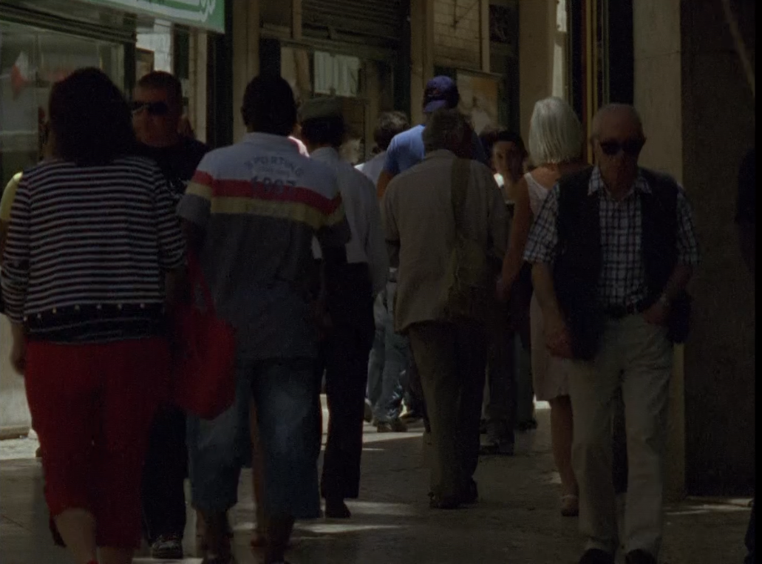
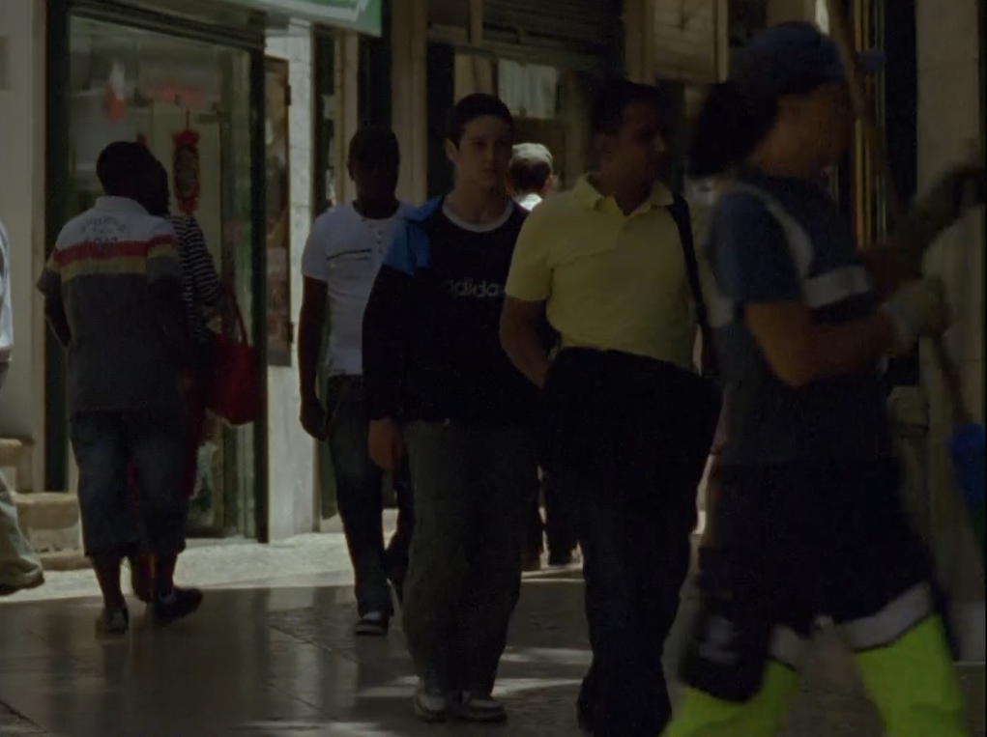
Enter a New World
This is the moment when we see, for the first time, Rafa entering a new world. The one in the city centre, where he will come, alone, to pick up his mother. In these first moments, our hero is almost lost in the crowd. The framing doesn’t favour Rafa and we have to concentrate on the image to follow him as he moves among the other passers-by.

Slide 16
We can hear the hubbub of the city – a busker playing in the street, an occasional whistle, a horn, and the murmur of people speaking. People disperse as the camera pans left and we begin to discern Rafa walking on the street in the direction of the camera.

Slide 17
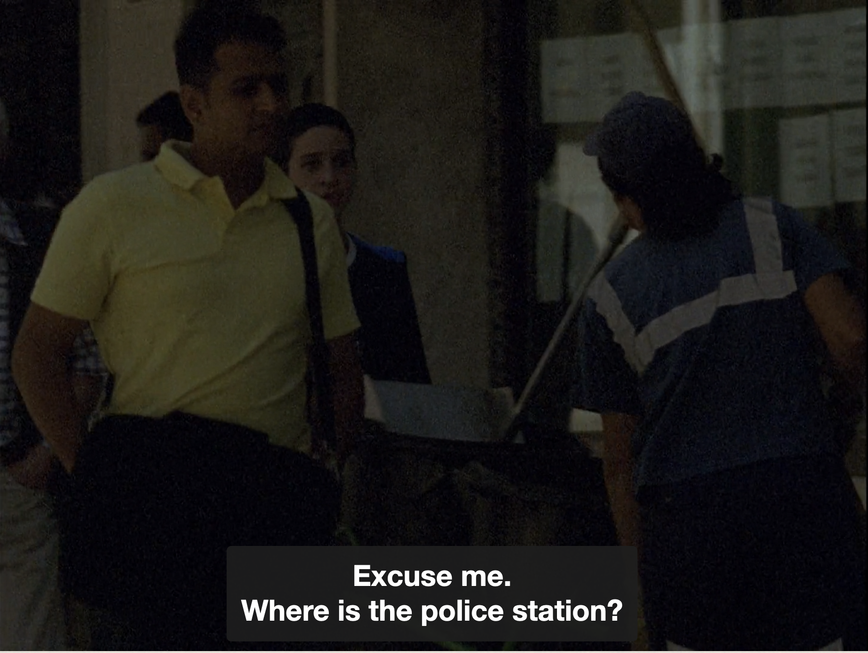
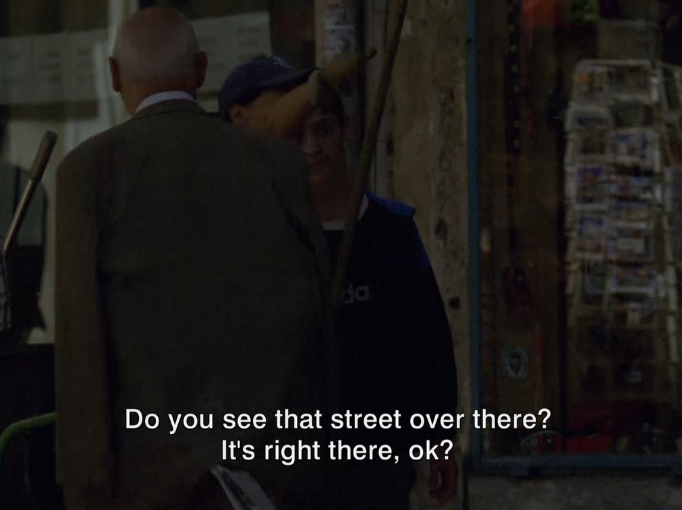
In this new world, Rafa still doesn't know how to orient himself but he knows that others can help. As the camera continues panning he approaches a street cleaner to ask her if she knows where the police station is.

Slide 18
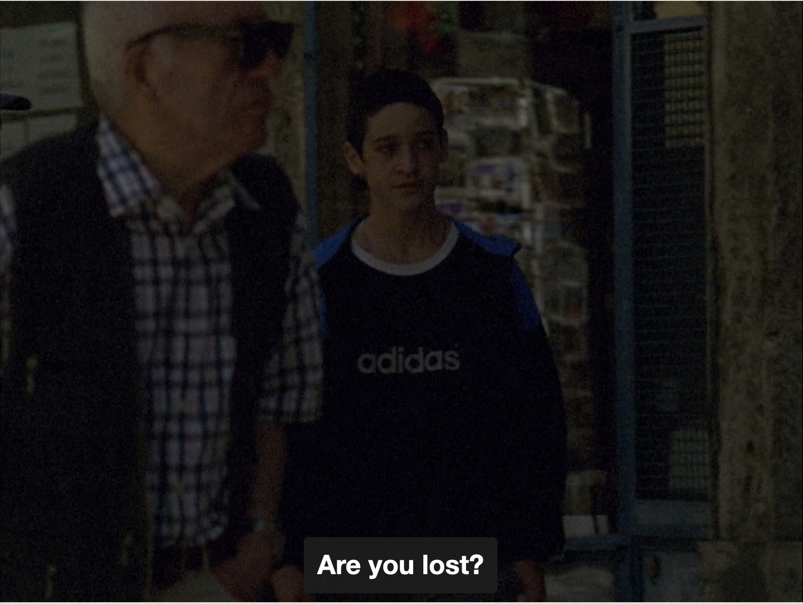
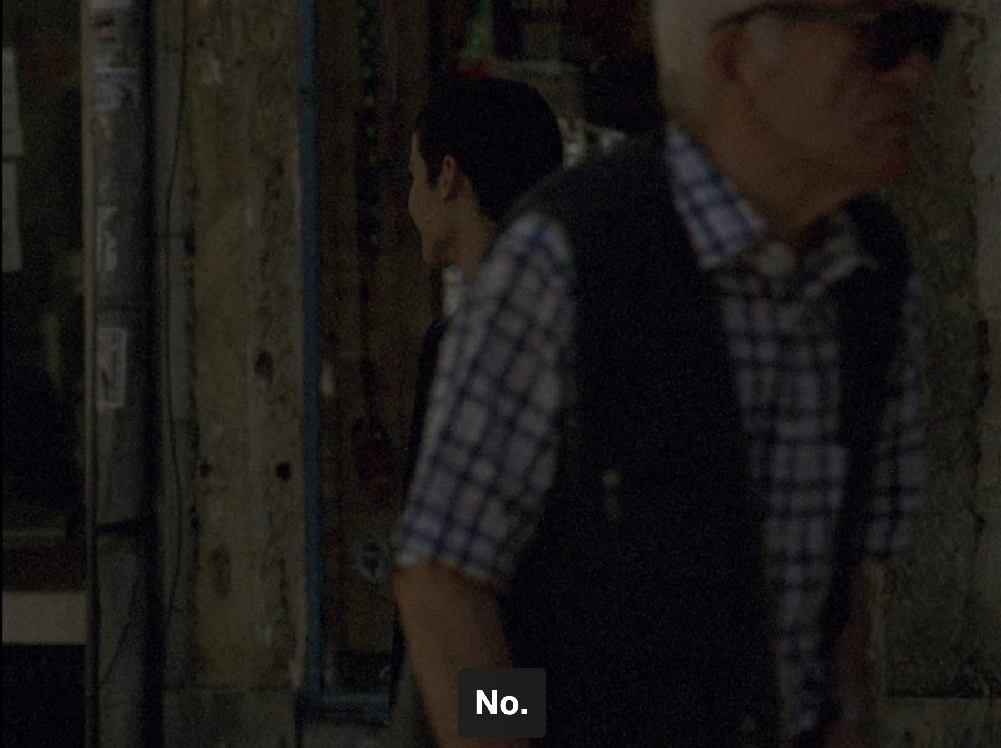
After giving him the necessary instructions, she asks him if he is lost. He tells her he is not and continues walking. The camera pans furthers to the left until now, instead of walking towards us we are now watching him from behind, his back to us as he walks towards a town square.

Slide 19
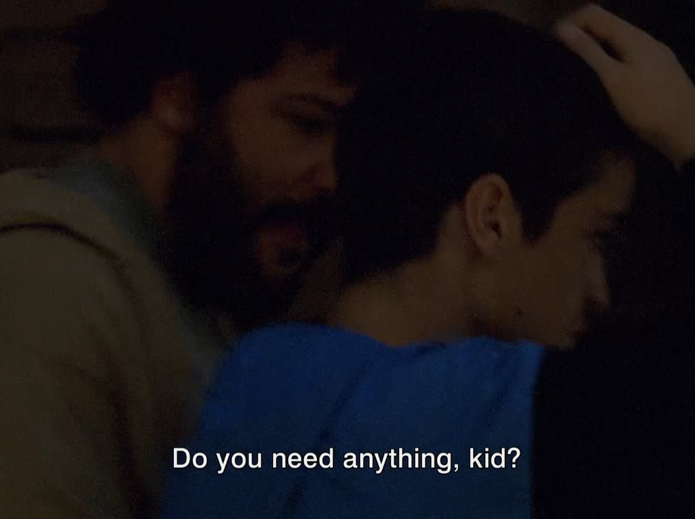
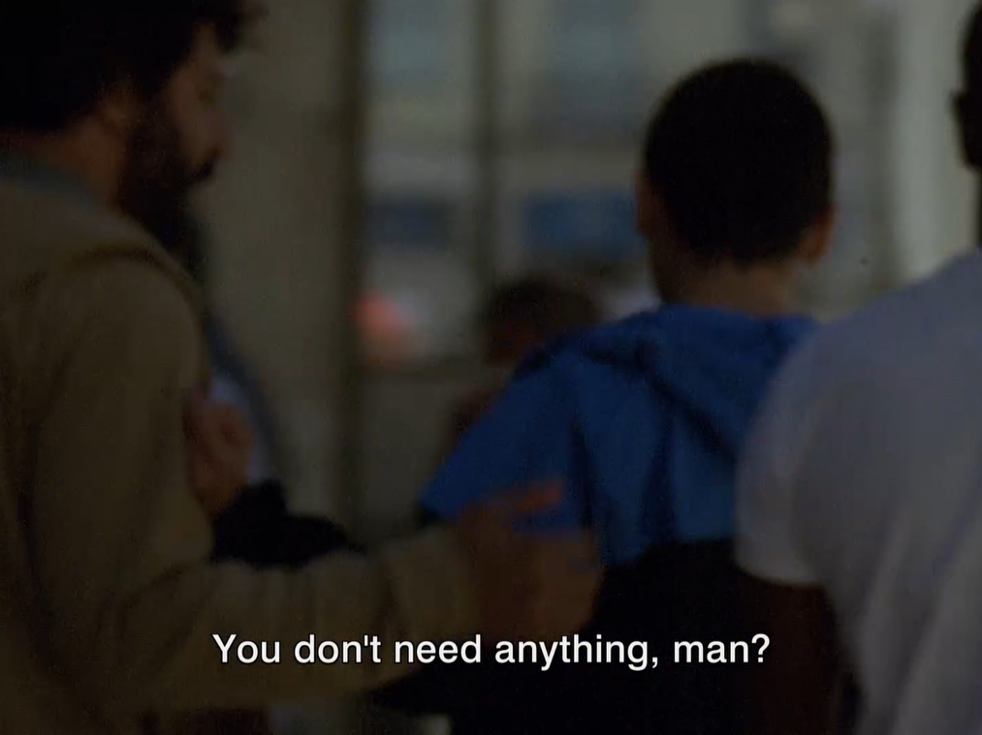
The City also Hides Danger
As Rafa approaches the town square a bearded man approaches him and, placing his arm around Rafa, asks him is he needs anything. Rafa shakes the man off and, without answering him, continues on his way. By the end of this shot Rafa is fleeing not just the unknown but is also moving away from the camera.

Slide 20
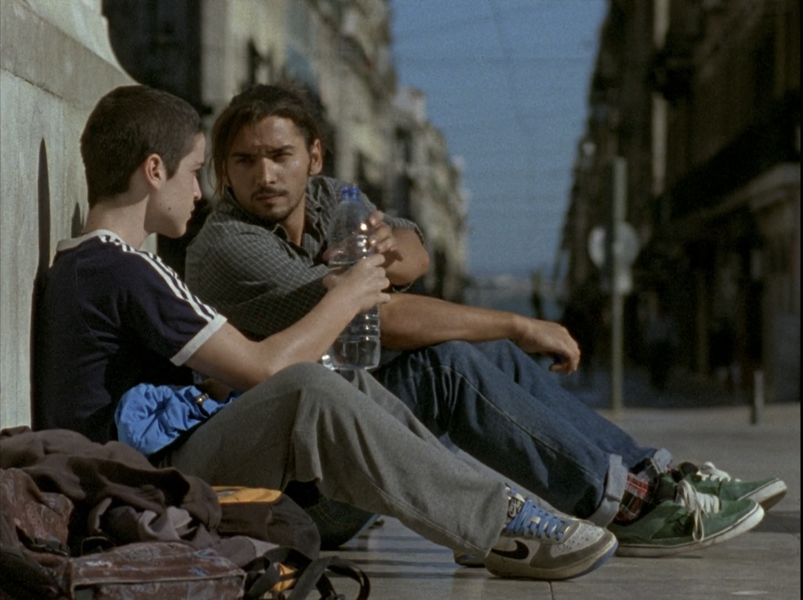
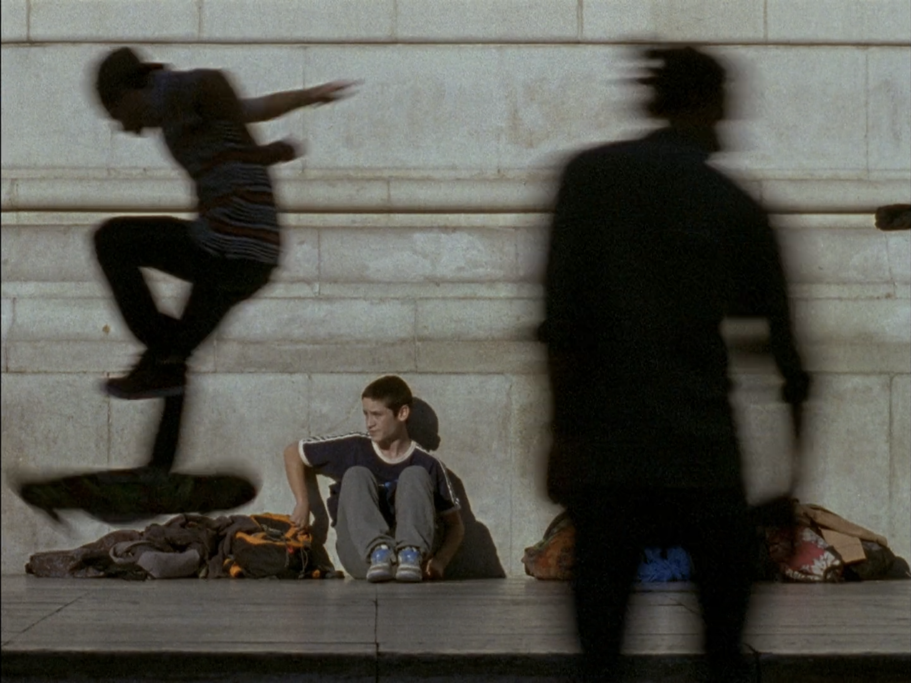
When sitting in the square Rafa has an exchange with a young man who shares his water with him and makes polite conversation. It is unclear whether the man is benign or has sinister motives. When he wanders off Rafa slides his hand into one the bags resting against the wall.

Slide 21
Salaviza does not explicitly mention drug dealing at this point but already it’s already implied. The shot of Rafa stealing from the bag is framed in a wide shot – at this stage it’s impossible to say what he’s actually stolen.
Later, however, he’s recognised by some skaters who accuse him of tampering with their bags and retrieve a small packet from him.

Slide 22
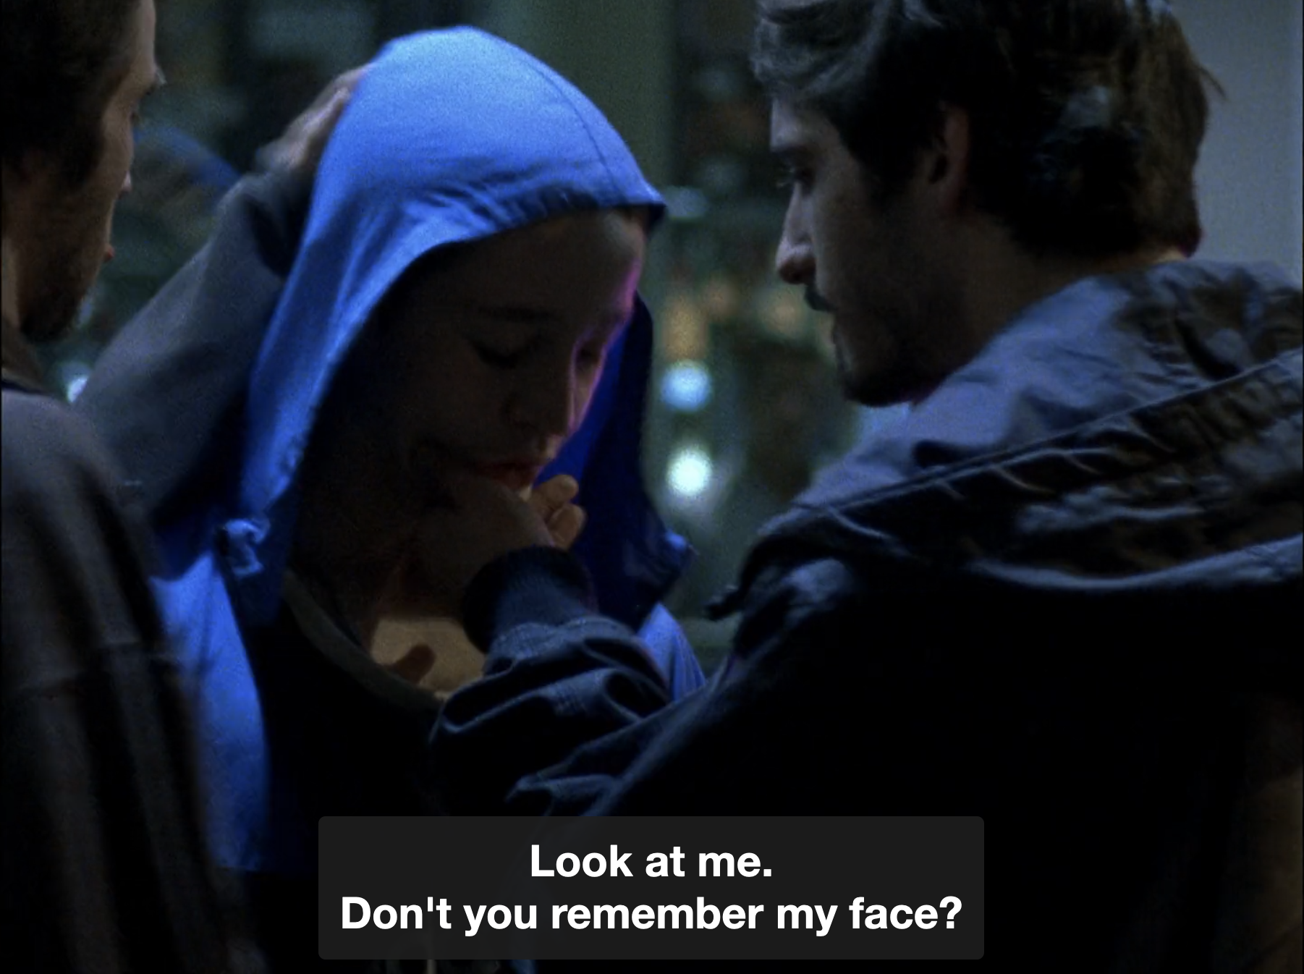
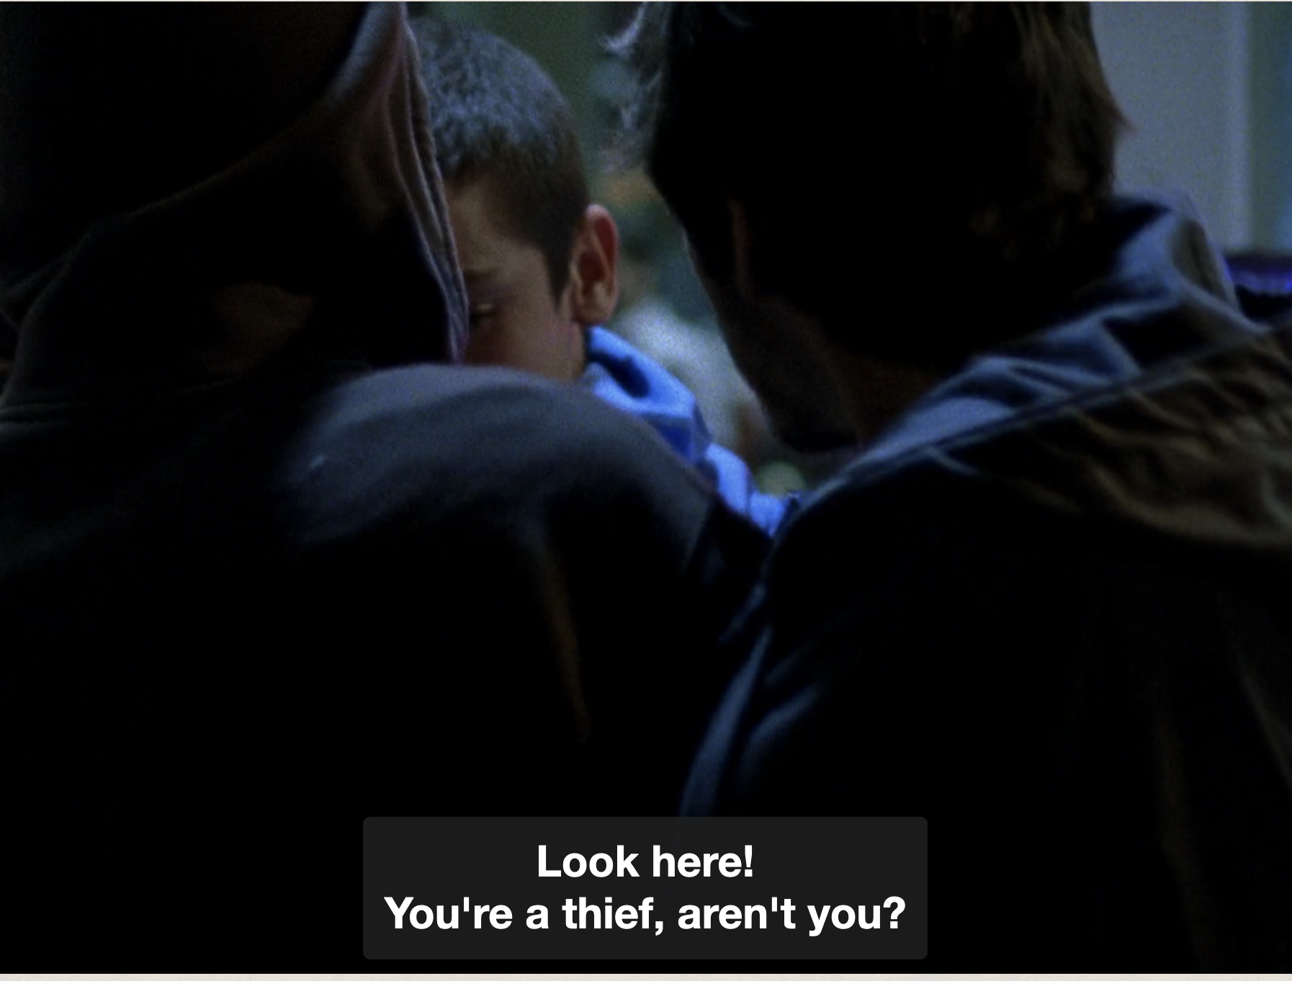
This idea of escape is important in Rafa, since part of his character arc will involve learning to leave the spaces that confine or threaten him: he will leave his house, without telling his sister; ask to go to the bathroom to escape the police station; and, without seeing how, Rafa escapes from the group of skaters he stole money from.

Slide 23
Character Growth, Character Movement
In a single sequence, Salaviza shows us the essentials of young Rafa's growth. This implies moving in a microcosm of different people, and knowing how to distinguish allies (in this case, the lady who gives you directions), from enemies (the man who approaches you).

Slide 24
The different moments of this small crossing are reinforced through the movement of the camera. At first it seems to be waiting for Rafa to come, still lost in the crowd. When he approaches, the camera moves, following his movement to the right. It will then stop again, lingering for a while as Rafa asks about the police station, then follows the young man's movement again.

Slide 25
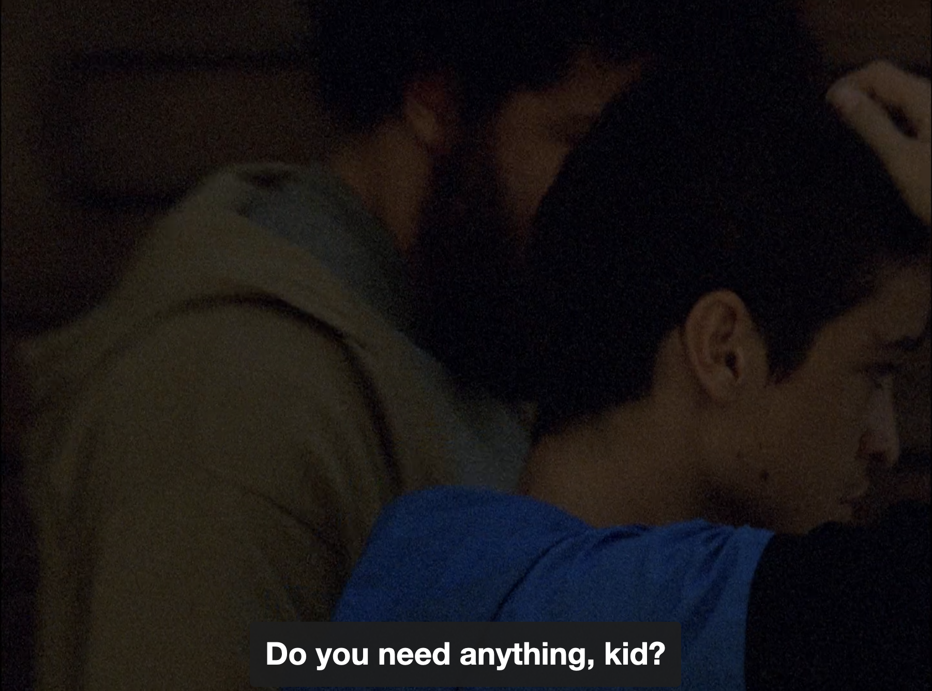
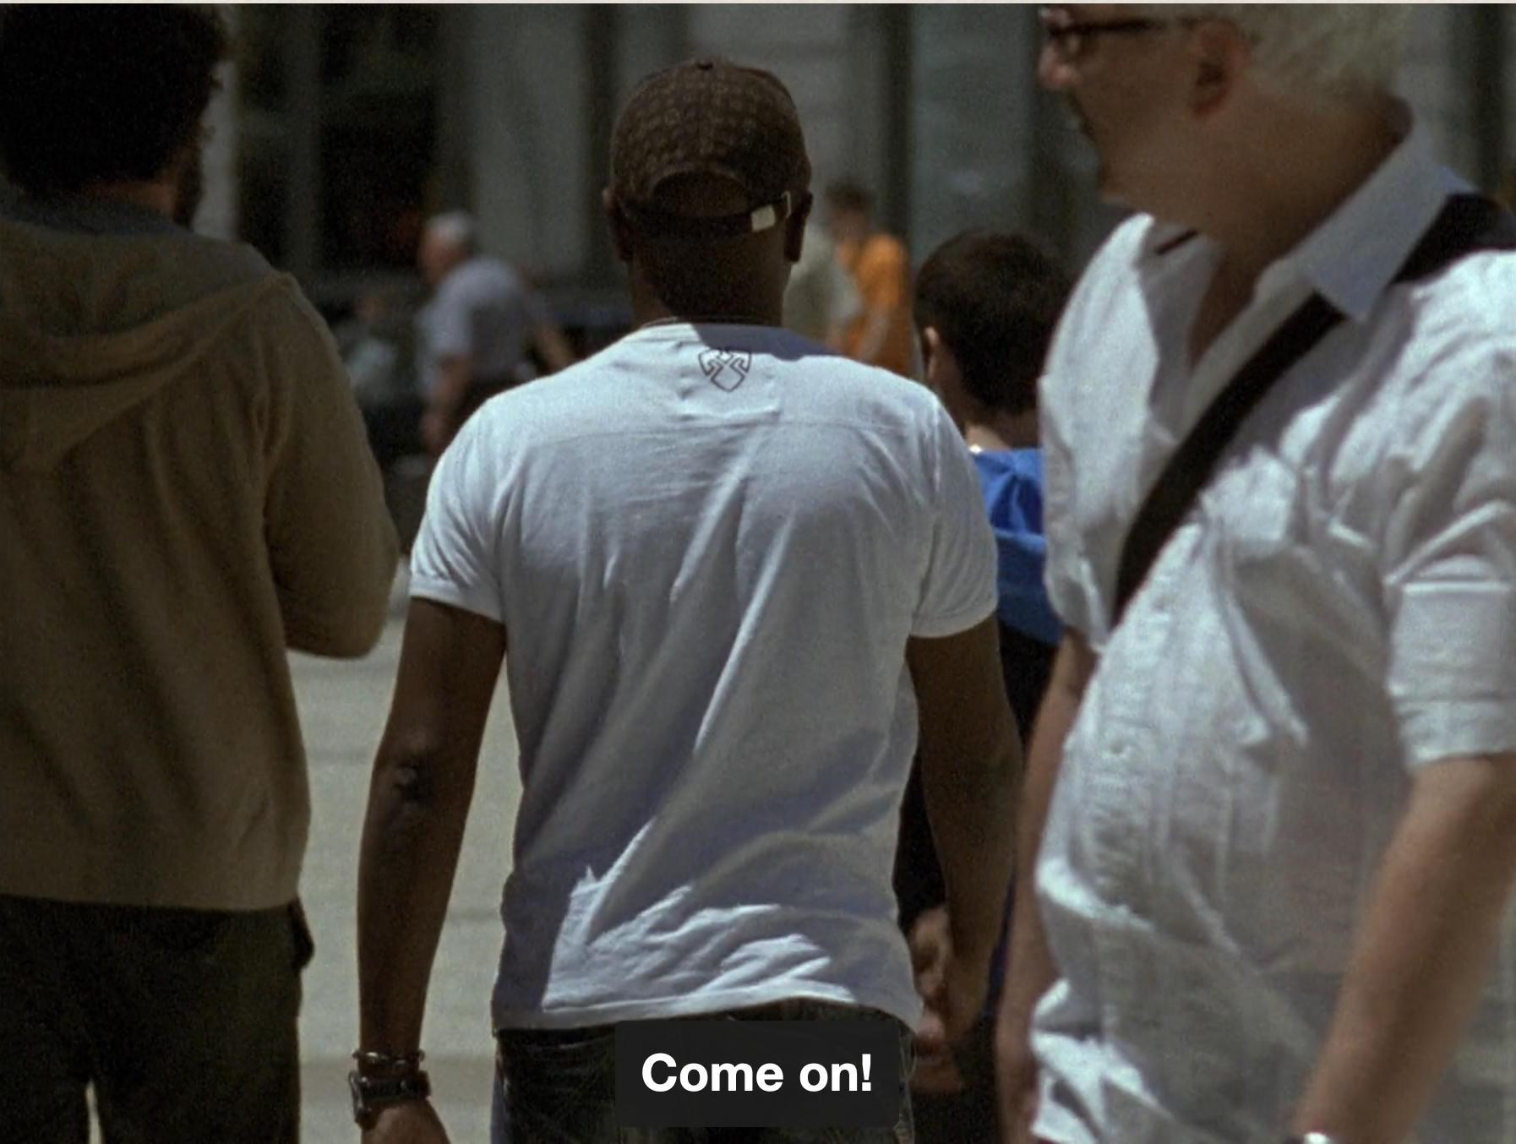
Rafa goes on his way and the camera too. It is important to note that the moment when Rafa gets closer to the camera, corresponds to the moment of greatest tension in the plane: the stranger seemed to have been waiting for him and tries to approach him. In that instant, the sudden movement and the proximity practically blur the face and chest of the man.

Slide 26
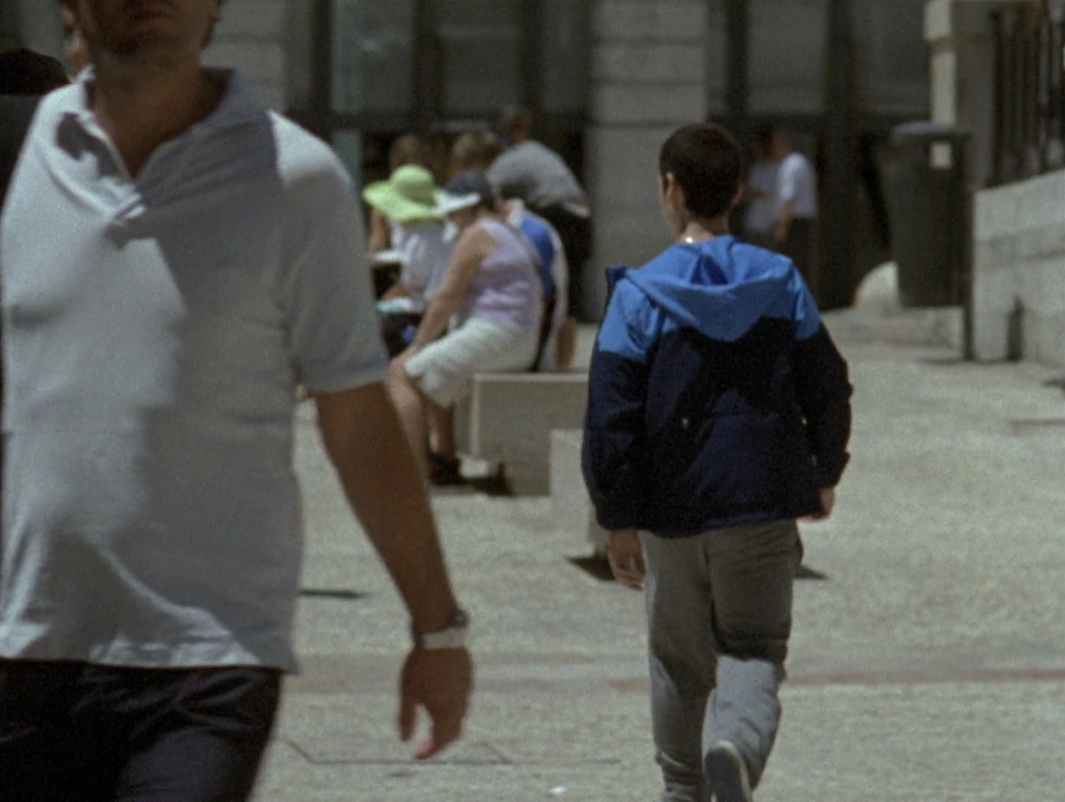
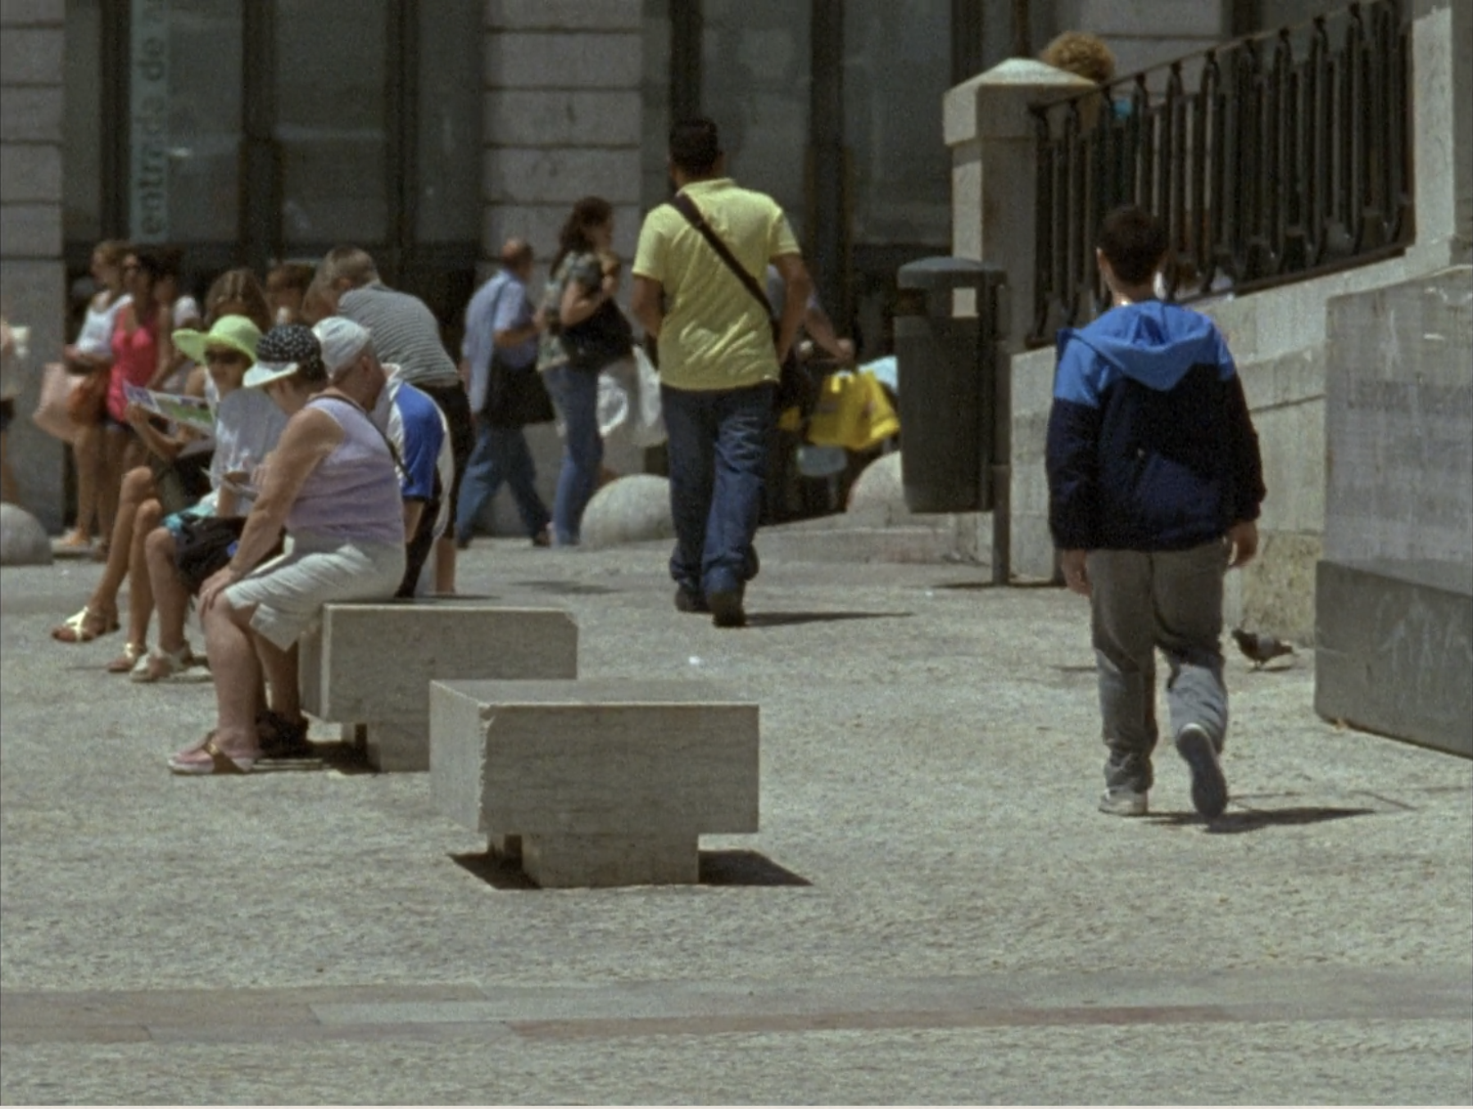
After overcoming that moment of tension, the camera can see Rafa moving away, resuming the relaxed posture he had at the beginning. The camera movement, pivoting to follow Rafa – pausing when he pauses and moving faster when urgency is called for – reflects our hero’s mood and emotions.

Slide 27
The World Invades Cinema
The shot of Rafa wandering towards the town square shows the film’s realist leanings. Rafa is presented almost incidentally at first and is not framed the way a Hollywood film might present its protagonist.

Slide 28
As he moves through the street people pass in front of the camera and our view is sometimes obscured. This is justified narratively – our character is searching for his place in the world –seeing him wander a real street in an extended shot reinforces that meaning.

Slide 29
The choice of location gives the film a sense of documentary like realism. This is a real street and the bulk of the people in frame are real passers-by. Like Rafa they too are trying to navigate the real world. By placing Rafa among them the director anchors his story to a reality we can all recognise.
Projekt współfinansowany
w ramach programu Unii Europejskiej
„Kreatywna Europa”

