Slide 1
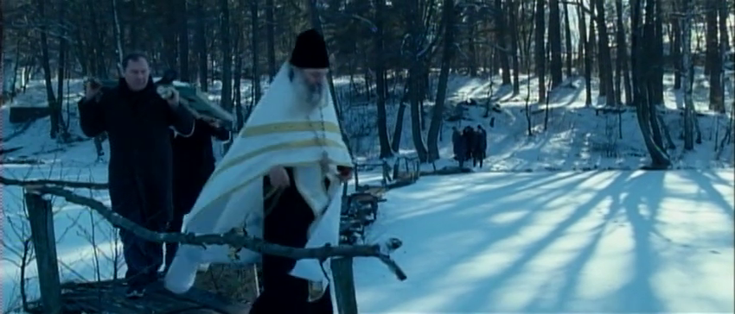
Dir. Juanita Wilson, 2008
‘THE DOOR’ SHORT FILM
DIR. JUANITA WILSON 2008
Projekt współfinansowany
w ramach programu Unii Europejskiej
„Kreatywna Europa”

Slide 2
LESSON ONE
FILM ANALYSIS
Notes:
Pytania do dyskusji:
1. O czym opowiada film „Drzwi”
2. Co wiesz o tragedii w Czarnobylu? Z jakich źródeł czerpiesz wiedzę?
Materiały dodatkowe:
https://pl.wikipedia.org/wiki/Katastrofa_w_Czarnobylskiej_Elektrowni_J%C4%85drowej

Slide 3
THE PLACES OF ‘THE DOOR’

Slide 4
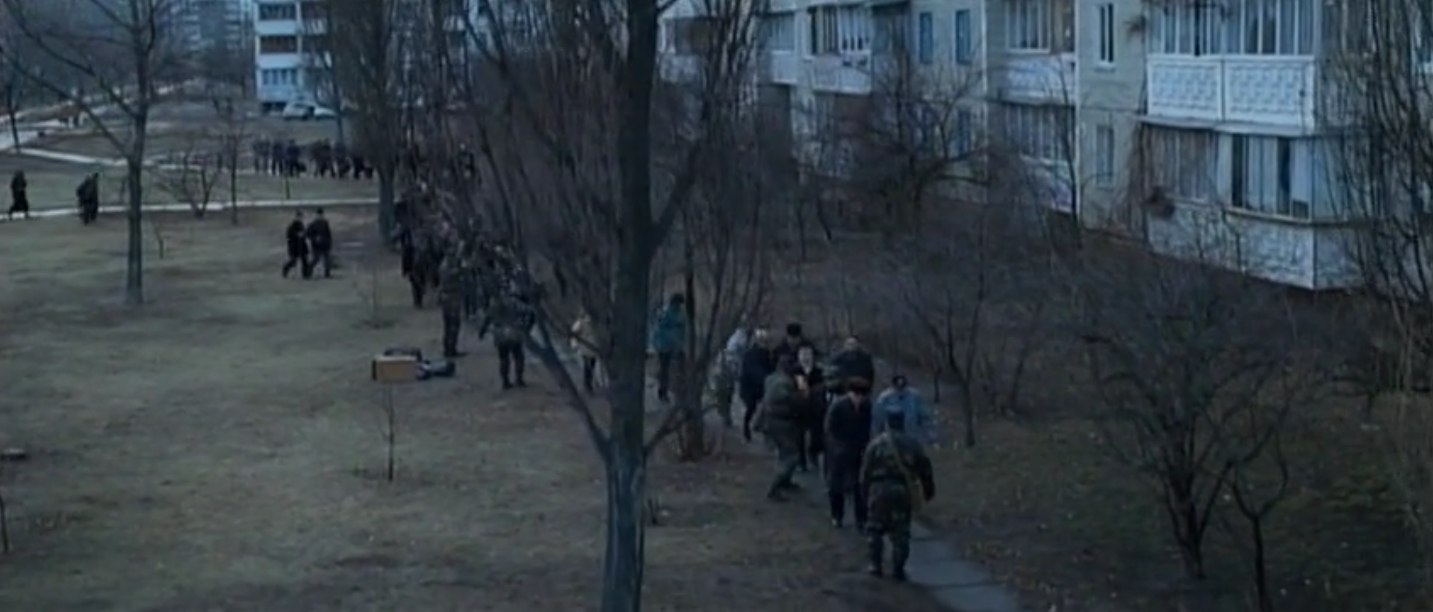
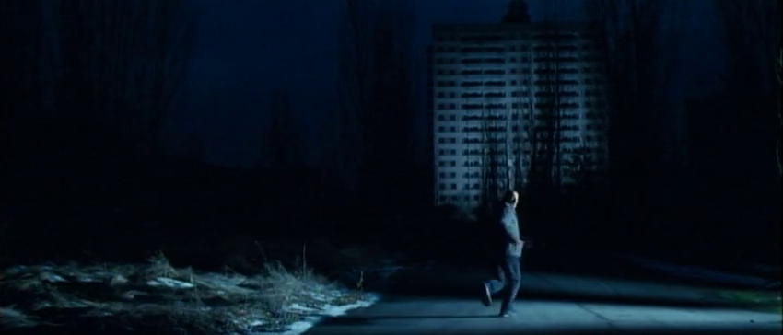
The Cities
The Door begins in an unnamed city. Throughout the film the city is shown in two distinct temporal moments: before and after a nuclear accident. In one moment, it’s still populated. In the other, it’s barren and devoid of inhabitants.
This change is reflected in how the space is depicted onscreen. Before the evacuation, there are human figures in frame and ambient daylight. After the evacuation, scenes are filmed at night. The city has taken on a ghostly, supernatural feel. It is more of a tomb than a town.

Slide 5
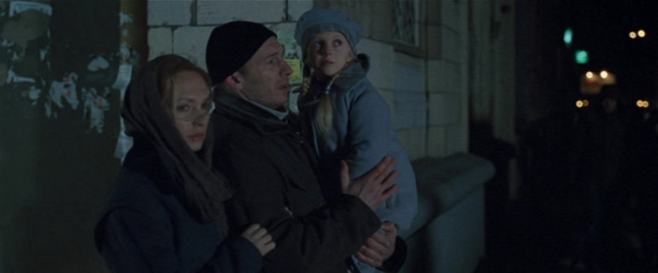
After the evacuation, the family are moved to another city. Upon arrival we see them in a street, under an arch, lost and apprehensive.
Their sense of disorientation contrasts with the apparent ease of the locals who walk by. In a strange city that they do not recognise as their own, the family feels lost and uncomfortable.

Slide 6
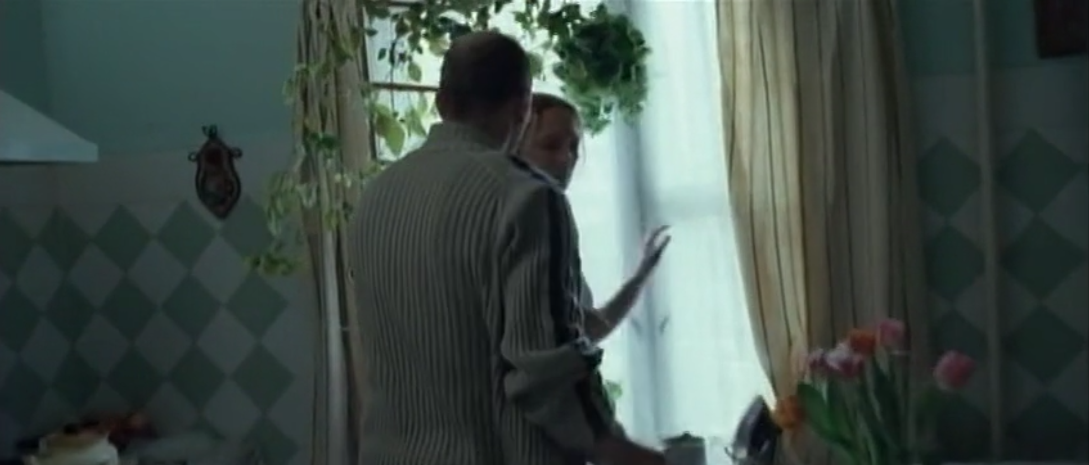
The Apartment
During The Door, the family lives in two homes. The first is their original apartment, which – like the city – is presented differently before and after the accident. Before the evacuation, it’s decorated and filled with daylight. Later, when the father returns, it’s dark and inhospitable.
As with the city itself, director Juanita Wilson makes the same location look and feel like two starkly different places, symbolised by the houseplants. Pre-evacuation they are on the window sill, alive and healthy. Post-evacuation they sit abandoned and withered.

Slide 7
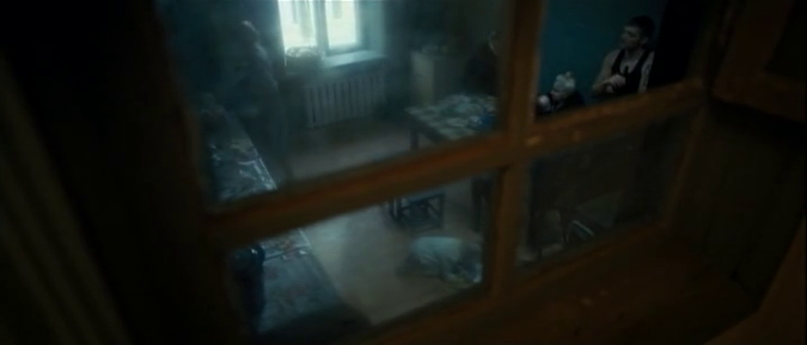
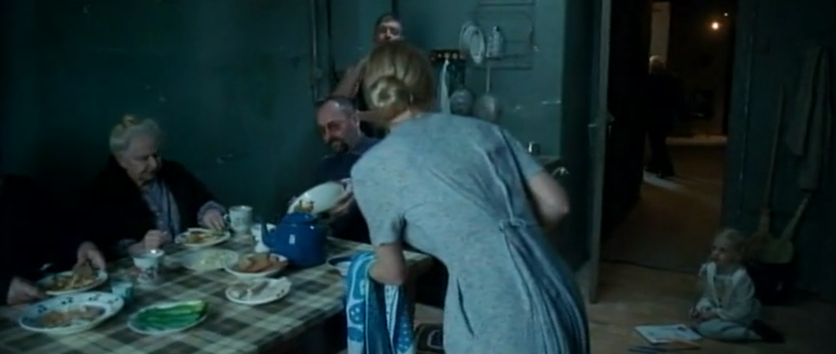
The other living space seen in the film is where the family is placed after the evacuation. Where they once had an entire apartment to themselves, they now share communal lodgings. This loss of privacy signifies a crucial change in their way of life.
Significantly, the first shot of the new lodgings views the characters through a four-paned window frame that recalls both a wooden cross and the bars of a prison. The high angle of the shot emphasises the prison-like atmosphere; our vantage point is like that of a security camera.

Slide 8
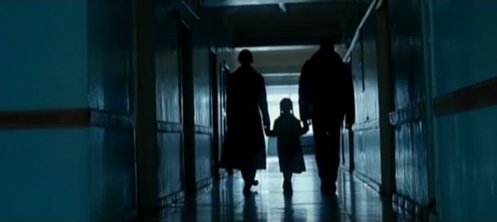
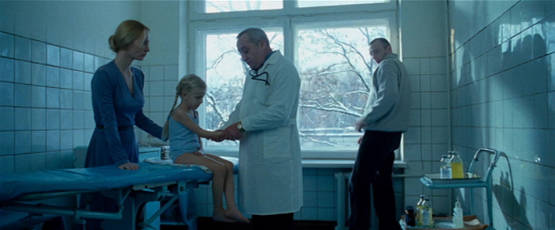
The Hospital
Unlike the apartments, places designed for long-term habitation, the hospital in The Door is an impersonal space where characters pass through. It is in this clinical setting where the parents learn that their daughter is sick, upending their lives and sending the film on a new tragic trajectory.
In the hospital, we see two distinct spaces: a dark, backlit corridor that the three characters walk through, and the doctor's office where the child is examined, which is bathed in white light. However, this light does not carry the same positive associations as the ambient light in their pre-evacuation apartment. Here, the light reinforces the clinical and sterile character of this place.

Slide 9
NARRATIVE: THE TEMPORAL STRUCTURE AND THE KNOWLEDGE OF HISTORY

Slide 10
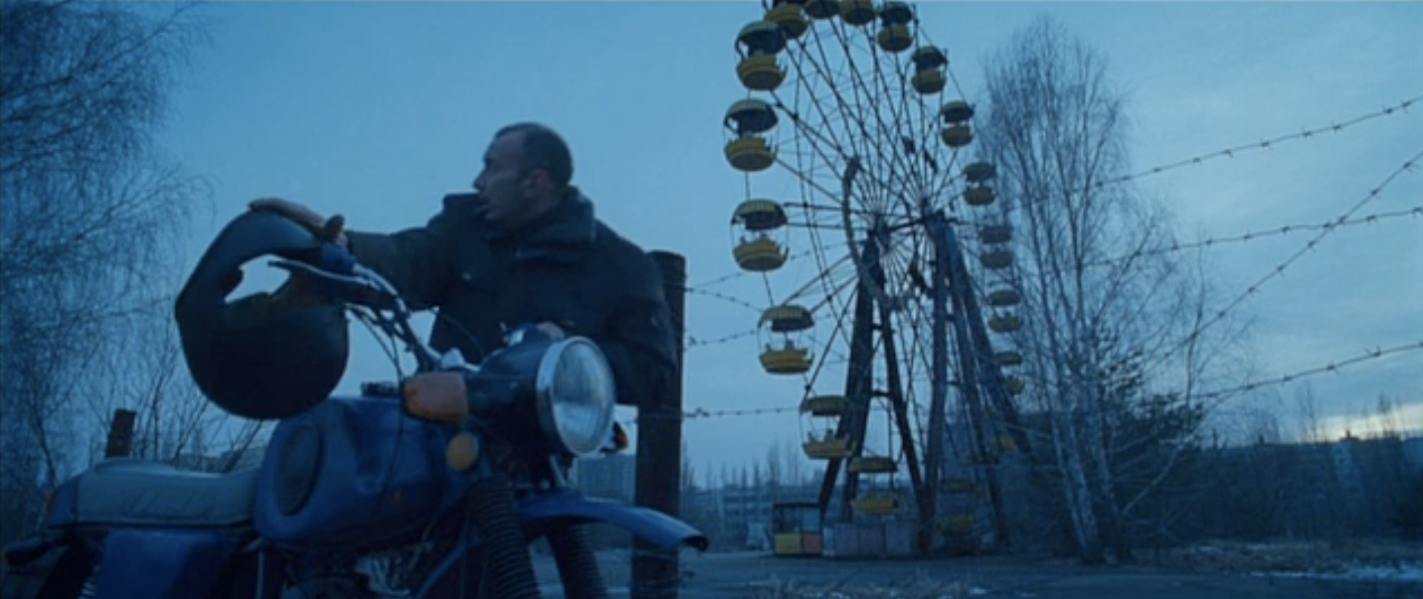
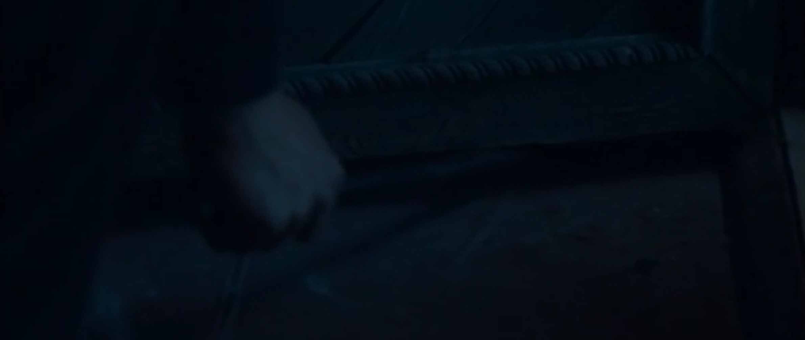
The viewer asks questions
The Door opens in medias res. Action is already unfolding, but the viewer has not been given the context needed to understand the story. As the film progresses, we are given additional information that allows us to fully construct the meaning of the narrative.
When the man forces his way into an abandoned house and removes the door, we are led to consider that he may be a thief. The film’s opening extracts suspense from the man’s actions, but also prompts the viewer to ask a series of questions: who is this man? What is this place? Why does he take the door with him? This fosters a desire to keep watching.

Slide 11
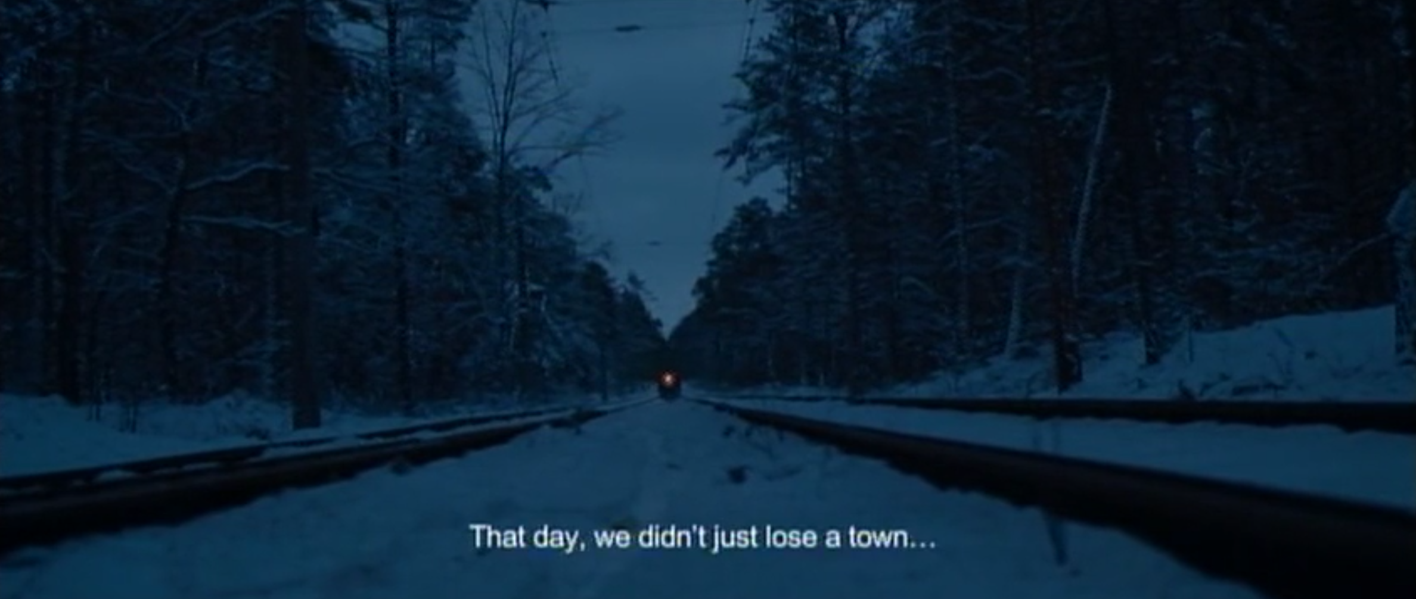
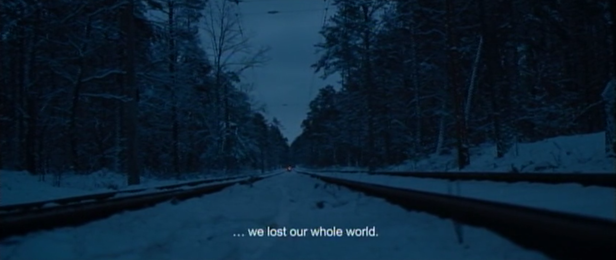
Back to the past
Opening with a furtive and possibly criminal character fleeing the law and moving through a world of shadows is reminiscent of 1940s and 1950s film noir. Such characteristics of this genre are beginning the narrative in medias res (“in the middle of things”), and the use of non-linear techniques such as the flashback to reveal secrets.
The Door uses a similar narrative structure. At the end of the initial sequence, we see the protagonist fleeing the city, driving a motorcycle on which he carries the door. We hear a voiceover, referring to a certain day in the past, and the flashback begins.

Slide 12
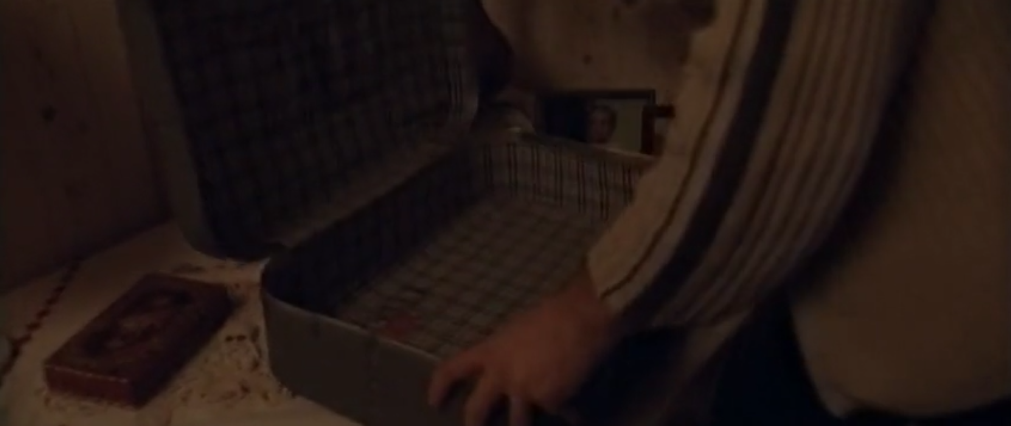
The voiceover is a bridge that links the two temporal moments. The flashback moves us to the past where, finally, we can begin to answer some of the questions posed by the opening.
For example, we learn that the building the protagonist enters at the beginning is his own home, a place he was forced to abandon following an accident. By taking us to the past the flashback helps us to better understand the film’s present day.

Slide 13
THE SEEN AND THE UNSEEN

Slide 14
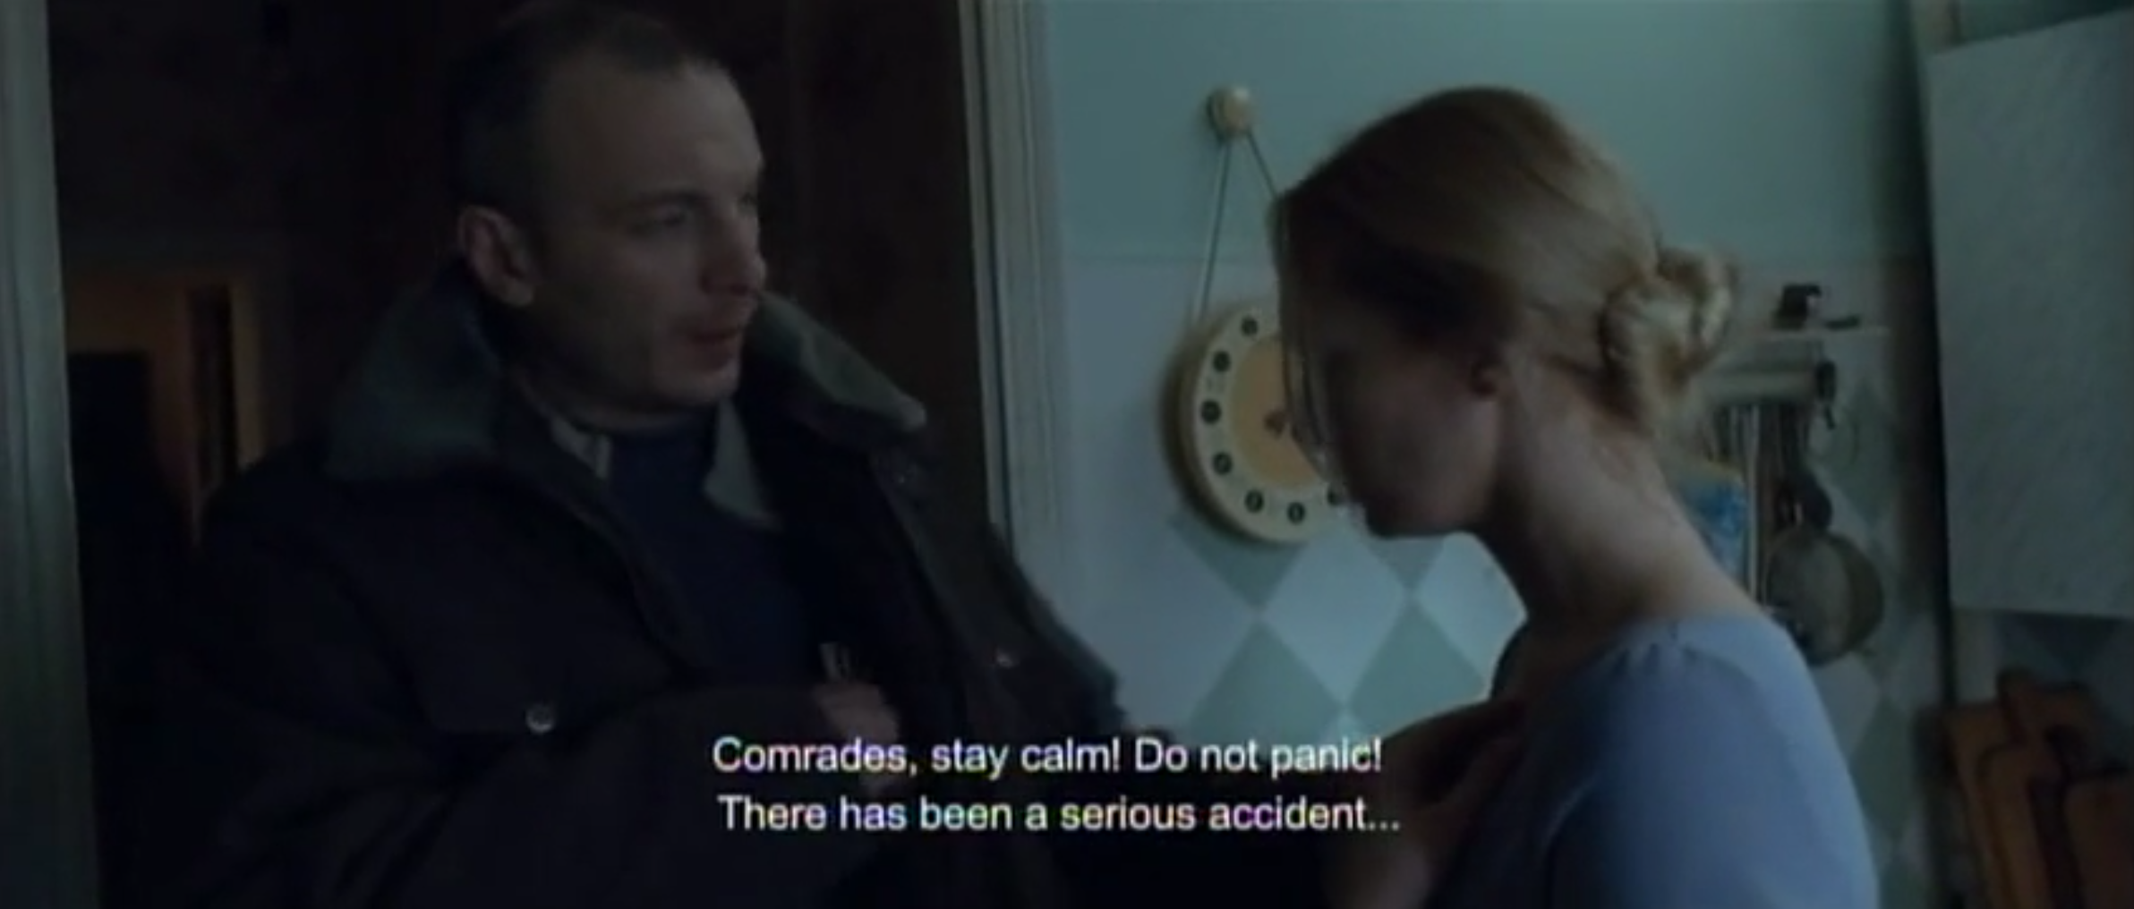
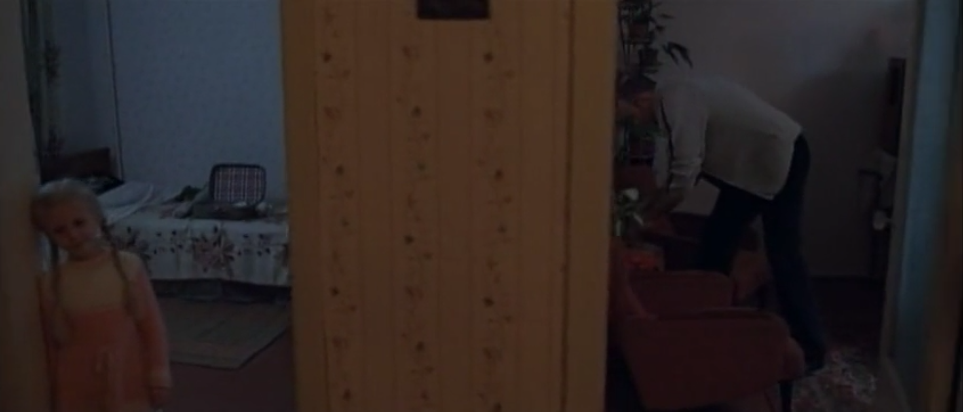
Cinema is, by definition, a visual medium; the camera captures images of the physical world for the audience to view. However, the core threat in The Door – nuclear radiation – cannot be detected by the human eye. How, therefore, can filmmakers convey this invisible danger? Director Juanita Wilson deals with this quandary creatively.
Although the narrative is set in motion by the nuclear accident, we never see the accident itself. Instead, we see the family inside the apartment, preparing to abandon it, over the sound of wailing sirens and the sound of a radio broadcasting evacuation instructions.

Slide 15
THE SAID AND THE UNSAID

Slide 16
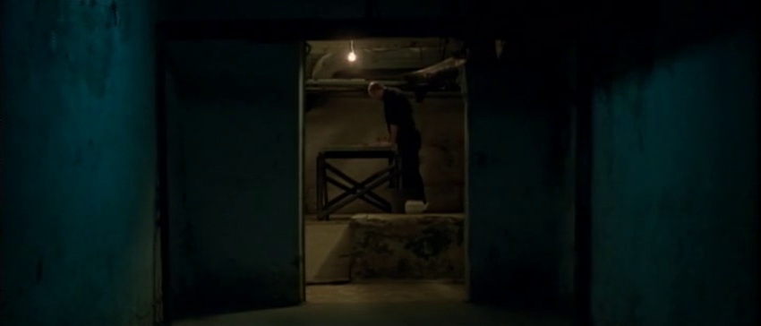
The Door makes startling and emotive use of silence, and dialogue is used sparingly to enhance its introspective and mournful tone. An exception is the evacuation sequence, where sirens combine with terse radio announcements and the sound of a helicopter to create a frantic sense of panic.
Music is also used sparingly. As the father flees the city with the door sombre notes play. Later, as he sands down the door for his daughter’s funeral, we hear melancholy piano music. In both instances this non-diegetic music conveys an aching sense of grief that the characters themselves cannot fully express.

Slide 17
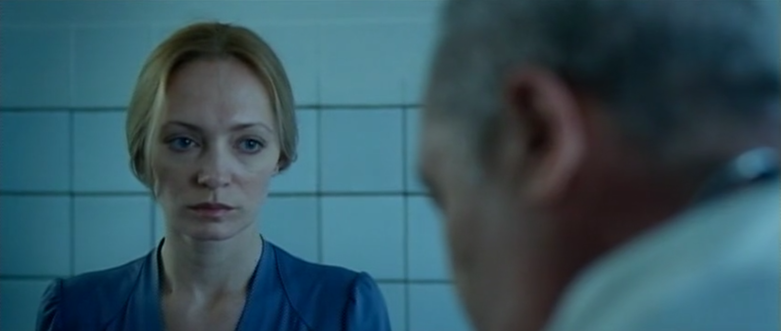
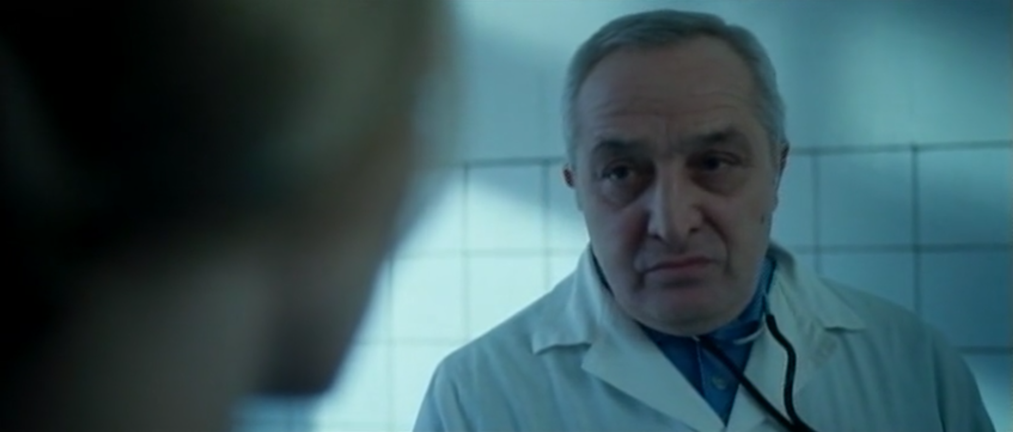
Wilson also uses silent, wordless gestures to convey the emotional weight of the hospital sequence. The doctor does not speak the diagnosis aloud, but his silent gestures convey the gravity of the situation. Glances between the parents further cement the meaning.
Instead of using verbal exposition Wilson uses Pure Cinema techniques. Silent glances and wordless gestures carry an emotional weight with an elegance spoken dialogue might not. The sadness is unspeakable and so it seems apt that they not directly speak of it.

Slide 18
THE DRAMA OF BEINGS AND THINGS

Slide 19
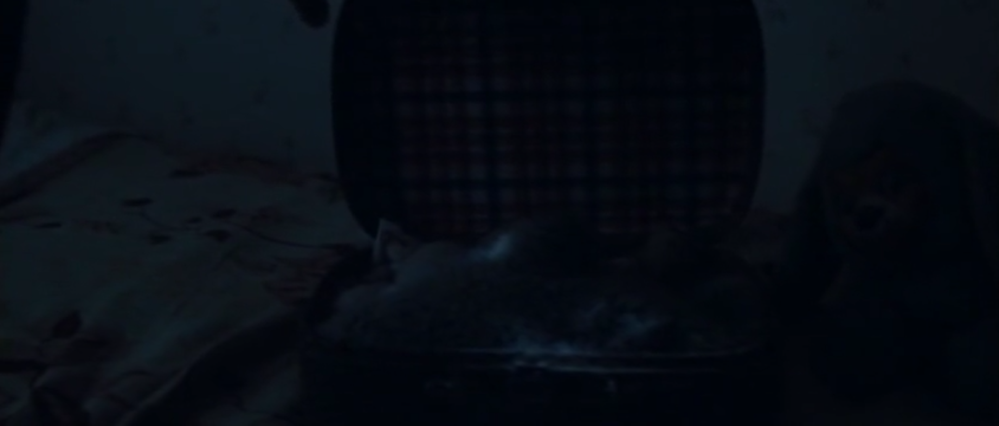
In films about human tragedy, animals and objects play an important role in symbolic economy, highlighting tensions between presence and absence, possession and loss.
Upon arriving at the apartment in the opening sequence, the father examines the suitcase on a child's bed. Later the film will reveal that this abandoned suitcase symbolises everything that the family once owned and was forced to leave behind. At the end of the sequence, when the man flees on his motorcycle, his voice-over notes, “That day, we didn't just lose a city. We lost our whole world.” We see the motorcycle driving into the distance, its small rear light illuminating the snowy landscape as dawn breaks.

Slide 20
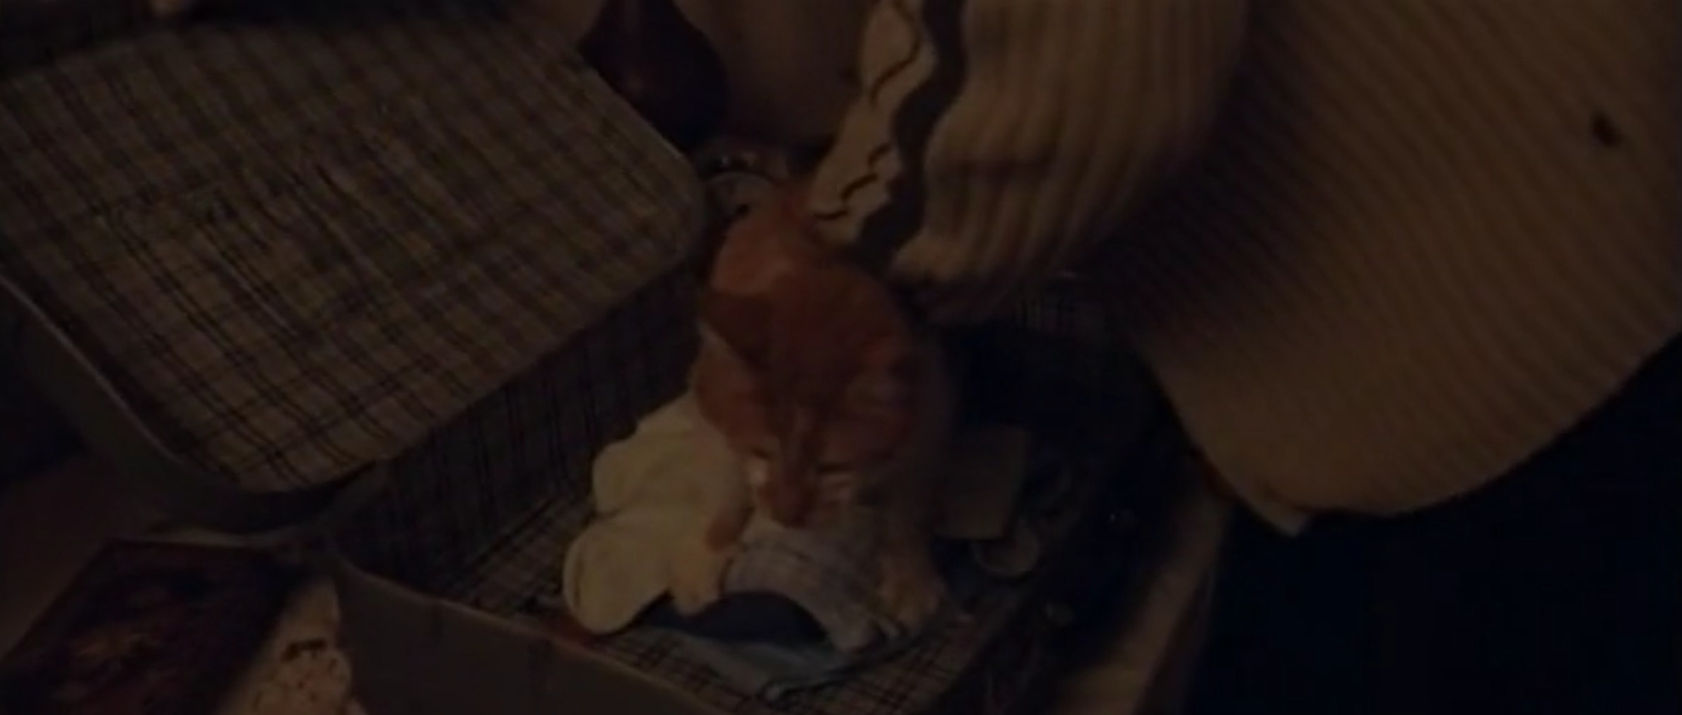
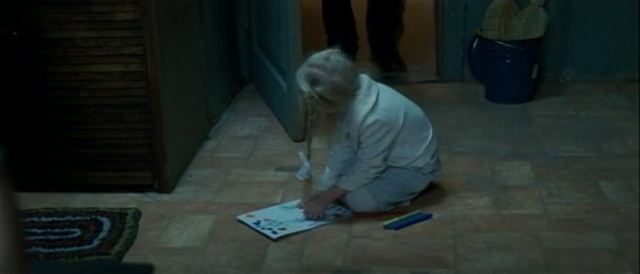
Early in The Door we learn that the family had a cat, Shoush, that the father tries to close in a suitcase, but this proves to be impractical. “Shoush doesn't want to be put in a suitcase," says the child. The father then says that Shoush will have to be left behind.
Shortly thereafter, we hear an official announcement telling the population that they cannot take any possessions. Despite this, the daughter convinces her father to take some of her coloured pencils, which he hides his jacket. Later, we see her using the pencils in the communal kitchen.

Slide 21
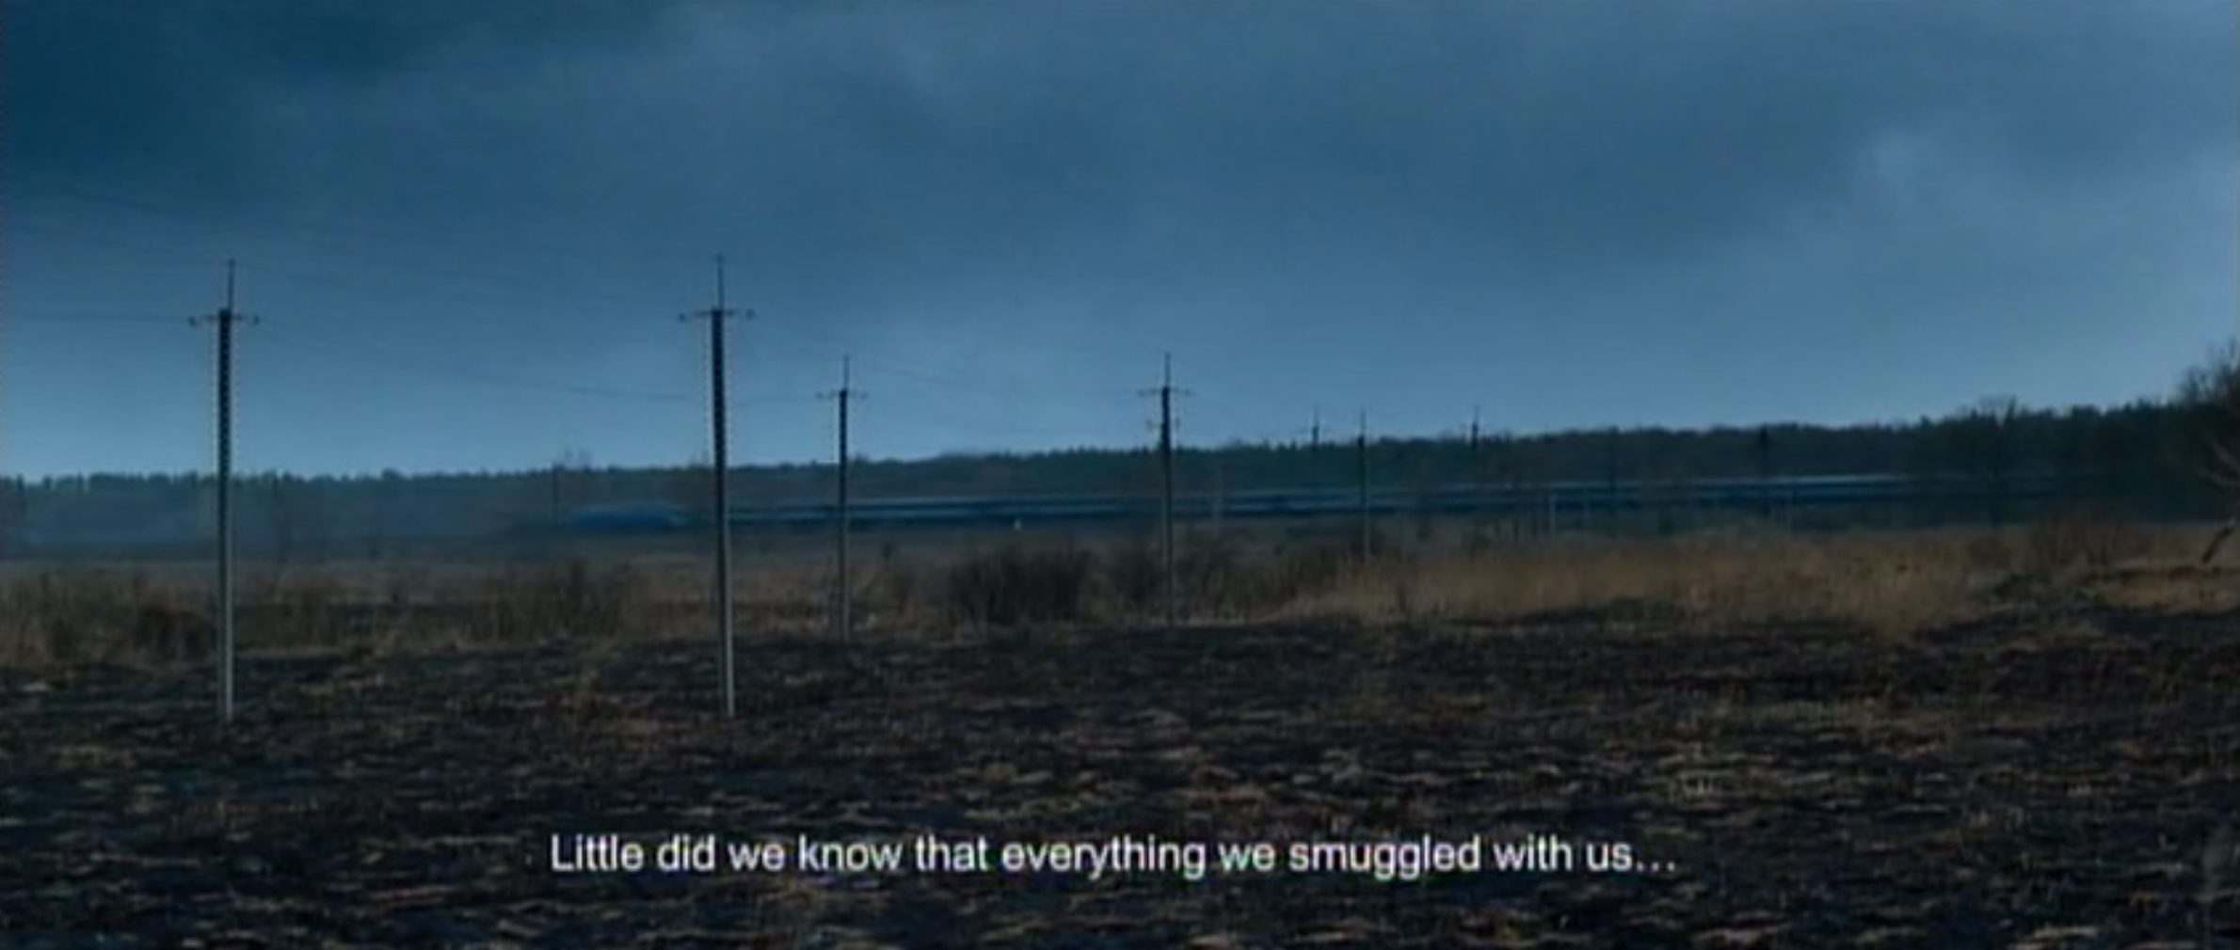
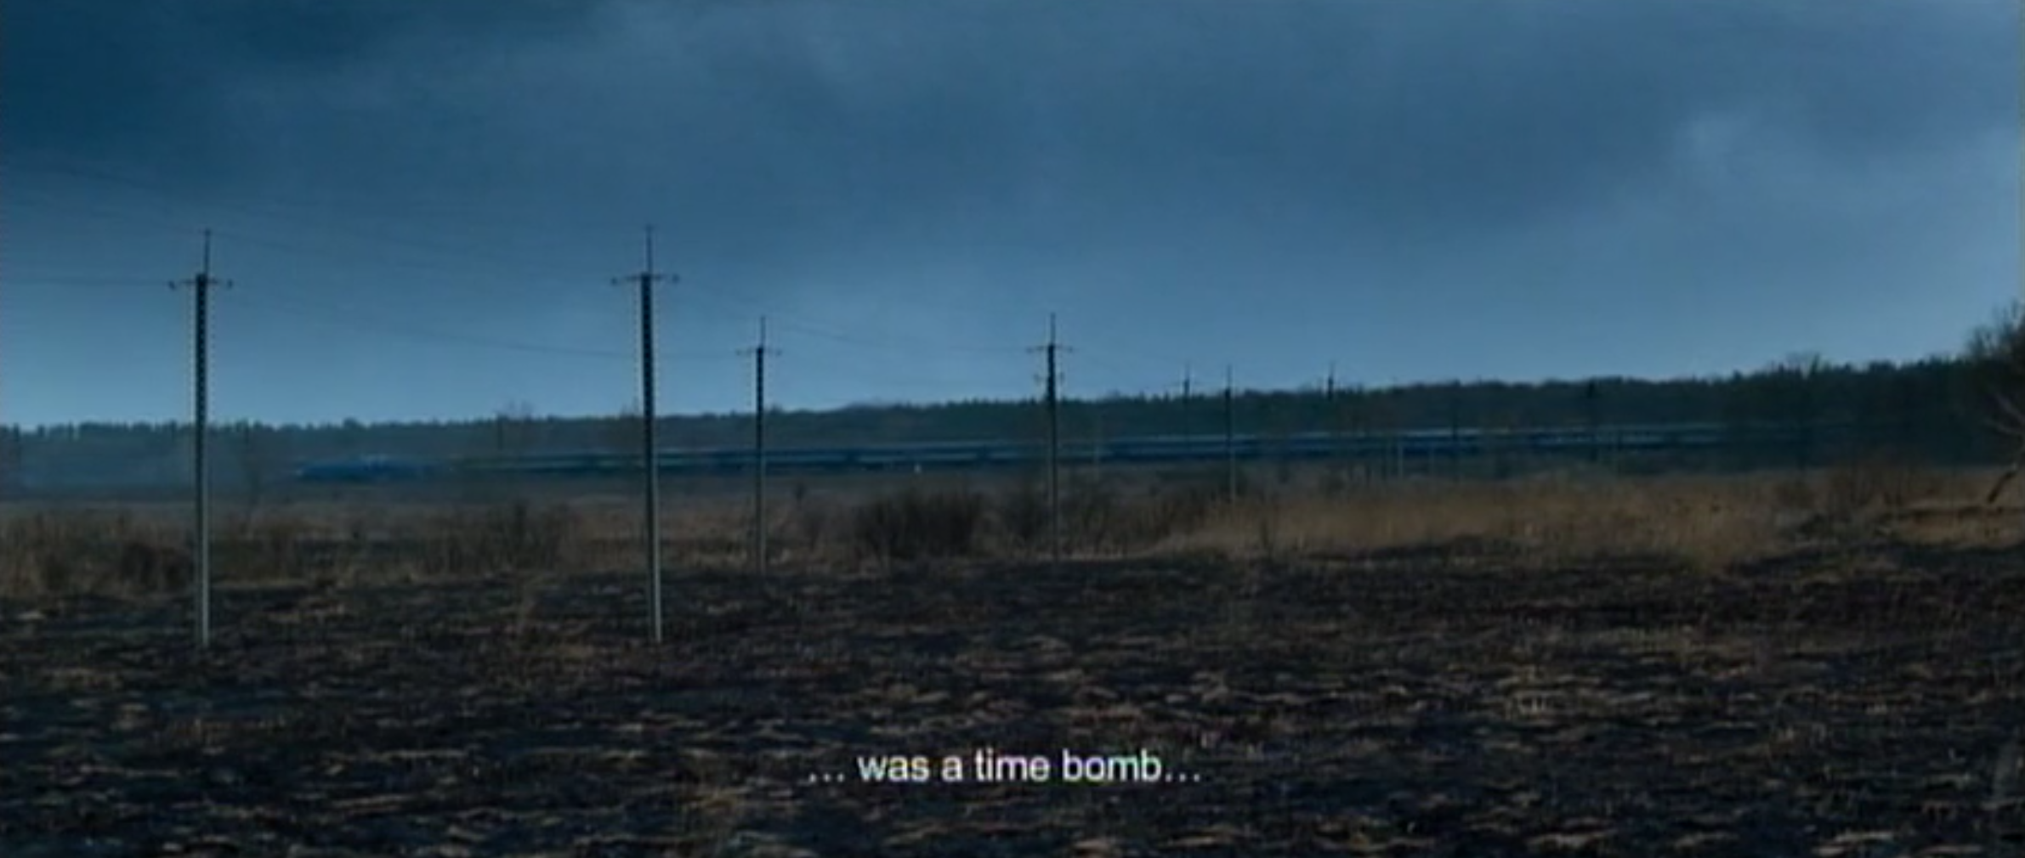
As the father tells us in voice-over, all objects are “time bombs.” We are never directly told that the daughter has radiation poisoning, but the reference to objects as “time bombs” – and the lesion we see on her finger – reinforce that reading. Her pencils, seemingly harmless objects with symbolic links to childhood and innocence, may be directly related to her death.

Slide 22
THRESHOLDS

Slide 23
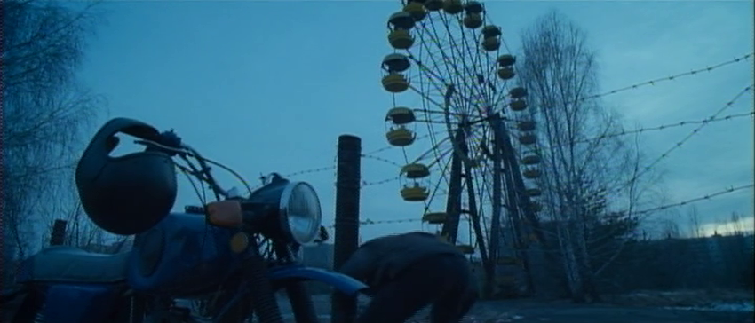
Throughout film history doors have been used to symbolise the crossing of thresholds. For example, Dorothy in The Wizard of Oz (1939), literally opening a door to walk from her sepia-toned world into a colourful, magical realm. In The Door there are several scenes that show borders that are both symbolic and literal.
In the opening scene, when crossing the barbed wire that marks the perimeter of the age, the father is simultaneously returning home and breaking the law – actions that are usually incompatible, since, under normal circumstances, returning home is not a crime.

Slide 24
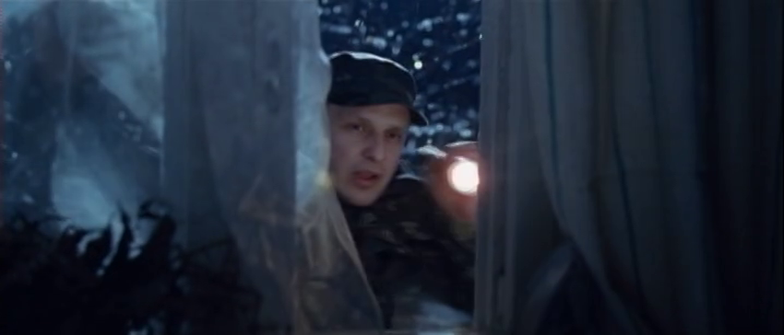
Later in the first sequence a guard breaks the glass in the kitchen window of the apartment, thus violating a space that was once sacred but is now in ruin.
During the flashback one shot reveals both father and daughter framed within the doorways of two adjacent rooms.
Later, when the man prepares the door for his daughter’s funeral, we see him centrally framed within a doorway, the dark and gloomy hallway outside reflecting his sadness and despair.

Slide 25
LESSON TWO ANALYSIS OF A FRAME

Slide 26
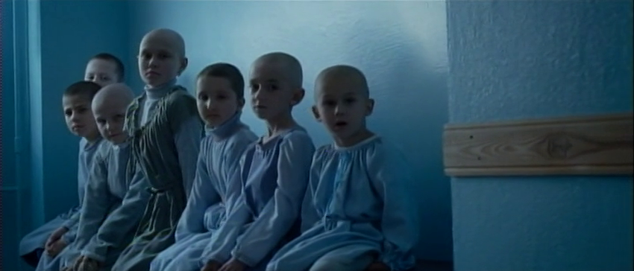
The below frame is from a brief sequence that takes place in the hospital. In the scene immediately before, the father kisses his daughter's hands, but discovers a lesion: a moment of tenderness that signals a tragedy.
Considering the camera placement of the shot seems to be at eye-level with the other children, we can assume that this shot is from the daughter’s point of view.

Slide 28
Though all different, these children share similar characteristics. They are all in the same sitting position, they all wear the same pale and homogeneous coloured robes, they all have shaved hair, and they all have a blank stare that suggests confusion or apprehension. The similarity of their appearance recalls similar presentations of children in horror films e.g. the Grady Twins in The Shining (1980).
All children are still seated with their backs to a wall, and are visually framed between two buttresses. The composition creates a cloistering effect similar to what one sees when the father prepares the door, before the final rites. The children are framed in an alcove, suggesting that movement beyond that point is impossible.

Slide 29
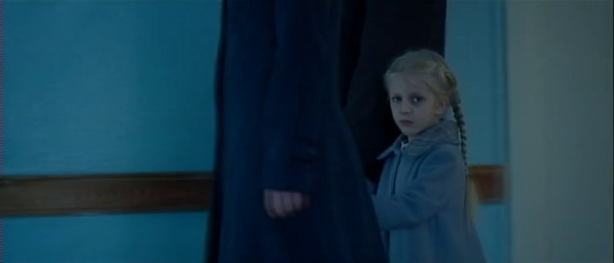
This shot comes after the shot of the children in the hospital, placing us in the position of the children. Though neither the daughter nor the other children appear in the same shot, the juxtaposition of these images creates a linking effect. A connection between her and the other children is implied. Like them, she too is ill.

Slide 30
LESSON THREE ANALYSIS OF A SEQUENCE
(TIME CODE 12:40 - 15:00 )

Slide 31
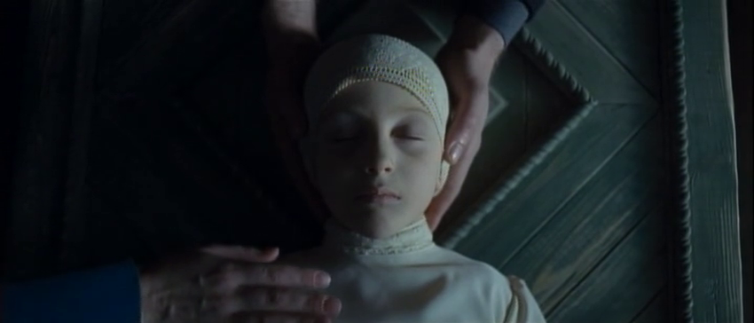
The Child
The final sequence opens with a close-up of the face of the dead child. The lighting of her face - half illuminated, half obscured - suggests she’s in an interval position, between the visible world and the underworld, the world of the living and the dead.
Her face is pale, and she no longer has her long blonde hair, the knitted funeral cap recalls a shaved head. Mise-en-scene choices present her in a way reminiscent of the sick children in the hospital.

Slide 32
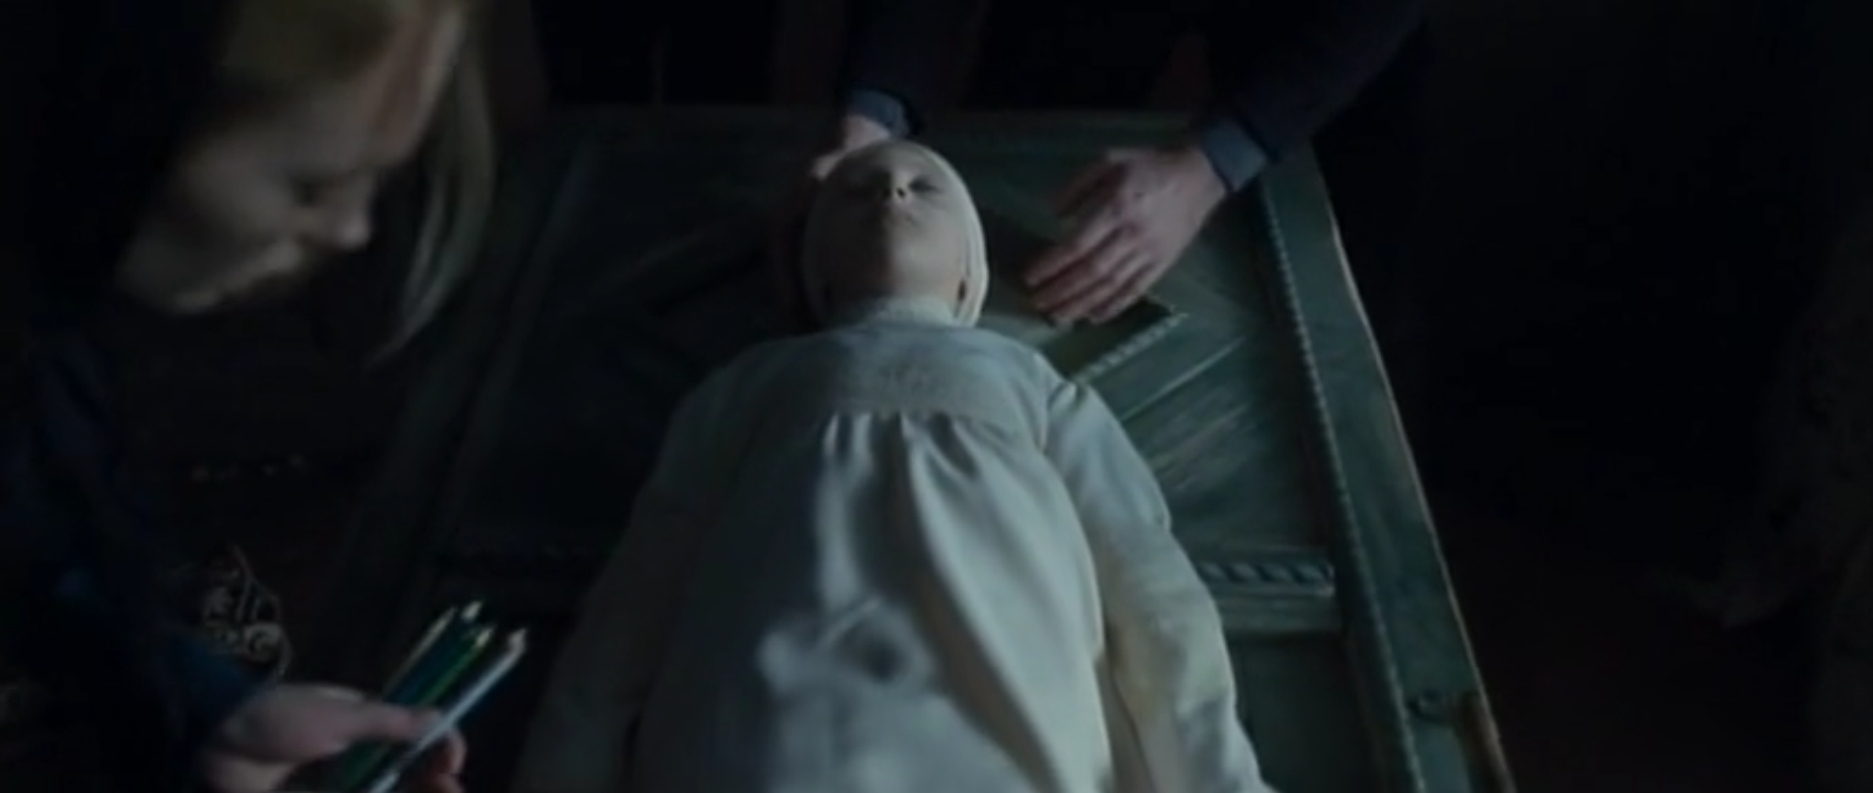
As the camera pulls back we see the mother depositing the pencils next to the daughter's body, revealing that the child will be buried with the potentially contaminated objects which may have caused her death.

Slide 33
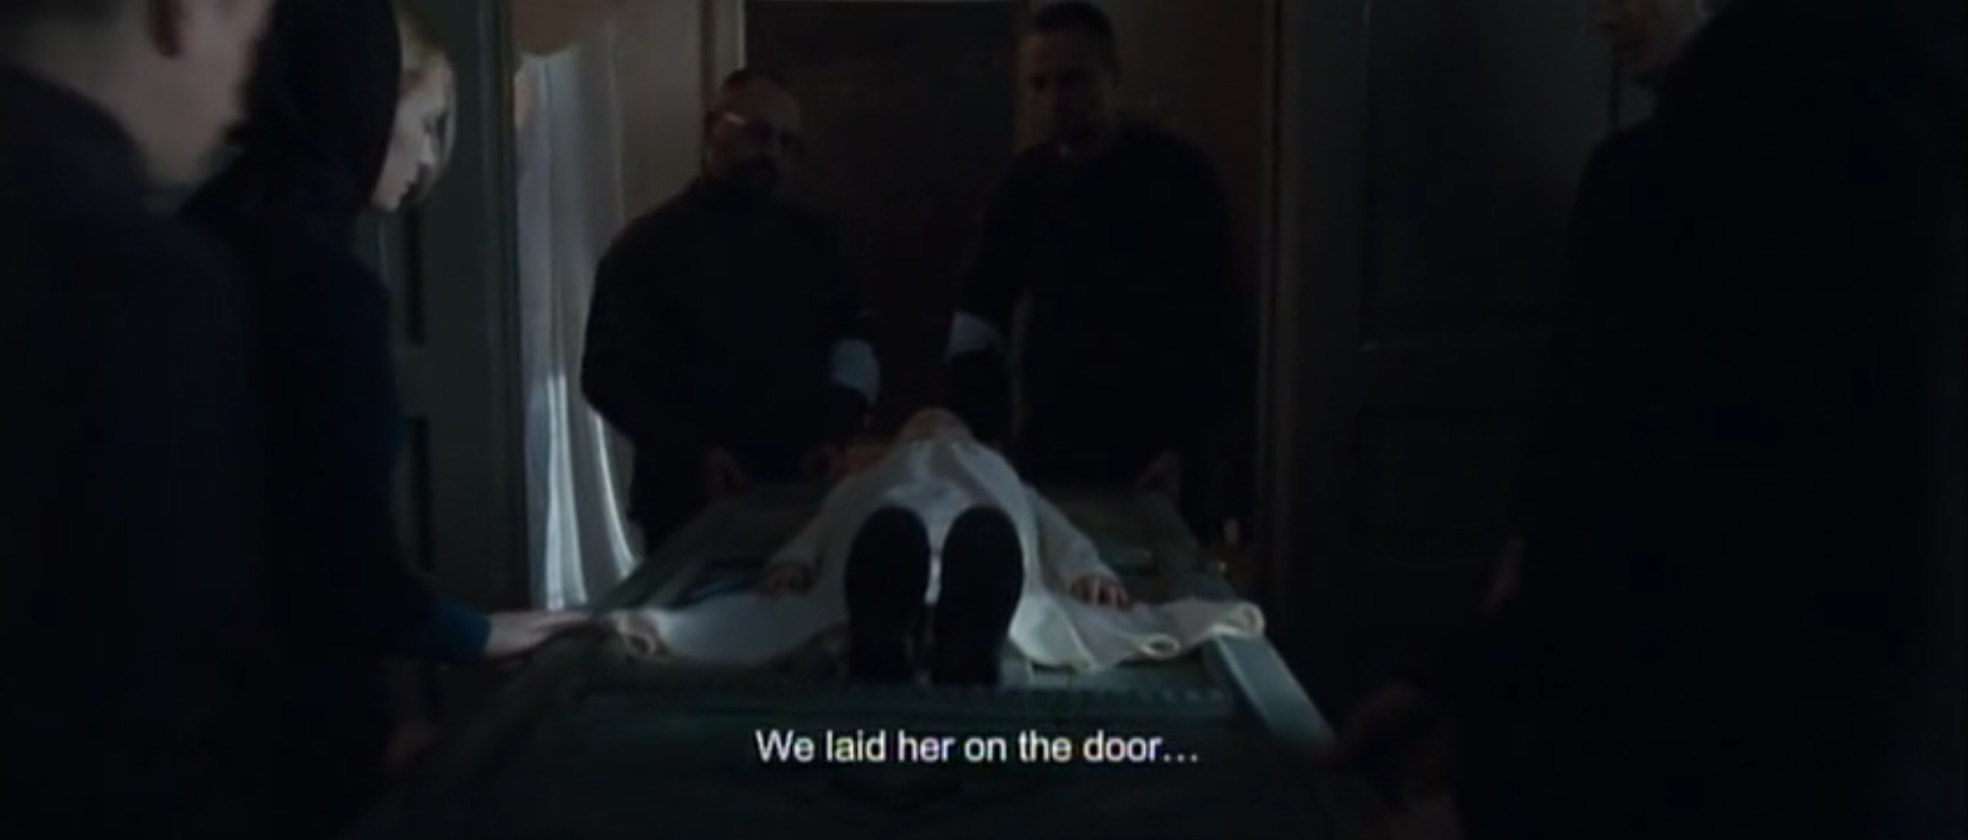
The Door
During that same scene the father says in voice-over: "We laid her on the door, the same door where my father had been lying. The door I had to steal from my own apartment.”
With those words the viewer finally grasps the importance of the door in this story. In their local traditions the door of the family home is used to transport the dead to their graves – a tradition threatened when the family are forced to flee their home.

Slide 34
With this knowledge we can now understand why the father returned to his city, putting himself at risk of being capture and arrest. Having lost his home and his daughter, this grieving father commits a desperate act of theft so that a family tradition can be retained.
In the face of overwhelming loss, this family tradition is the only thing they can preserve.

Slide 35
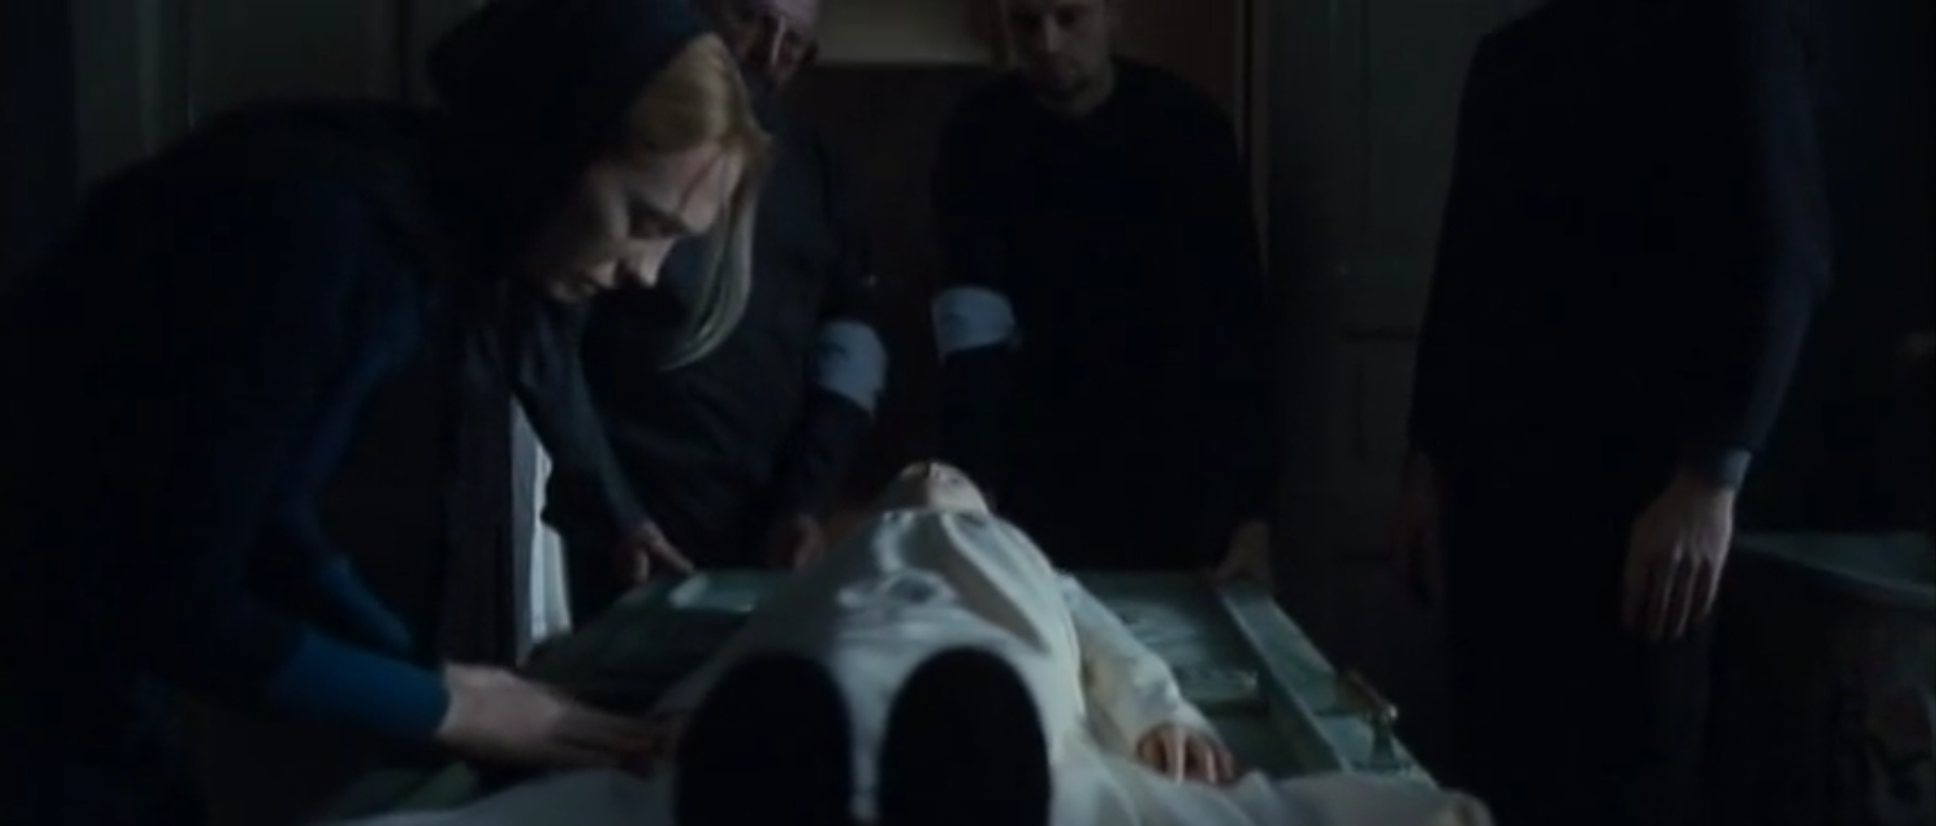
The Procession
The initial camera movement reframes the scene, the slow pull back allowing us to see the child’s feet at the end of the door and the pallbearers moving into position to lift her.
The camera remains locked in place as they lift her up and move through the doorways ahead.

Slide 36
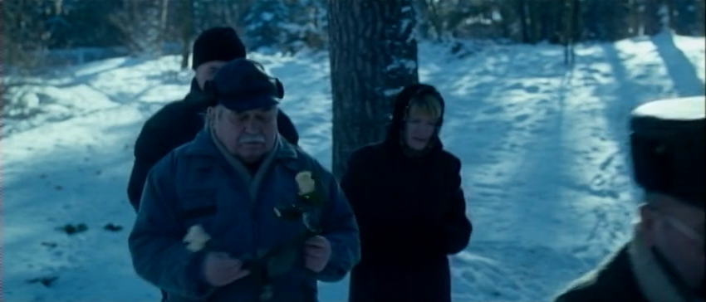
In the next shot, we see a snowy landscape, reminiscent of the one seen from the doctor’s office. A small procession, led by the priest, come forward with the child's corpse.
Among the mourners we see a man and a woman who scatter throw lightly coloured roses on the ground. These roses are symbols of innocence and carry religious connotations.

Slide 37
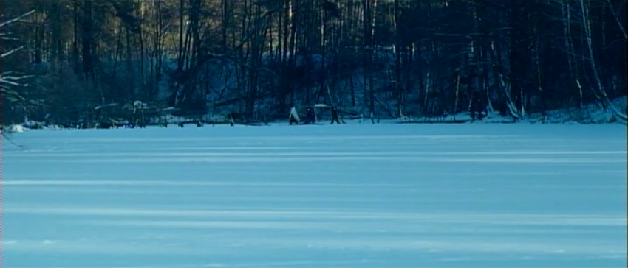
The Bridge
The procession continues until they reach a bridge that extends over what appears to be a frozen, snow-covered river. At that point, the group splits into two: the priest and the two pallbearers continue, and the rest stop at the beginning of the bridge. We see a shot in which the priest and pallbearer cross the bridge. It’s an abstract composition, framed in an extreme long shot the figures become small and barely distinguishable, all but engulfed by the landscape of snow and trees.

Slide 38
The next shot shows the parents standing the in foreground. As the other mourners turns their backs and leave. The parents remain still, at the beginning of the bridge, watching their daughter as she’s carried away.
In the next shot, the door is already on the other side of the bridge, and the parents can be seen in the background, with the priest, the men and the corpse in the foreground

Slide 39
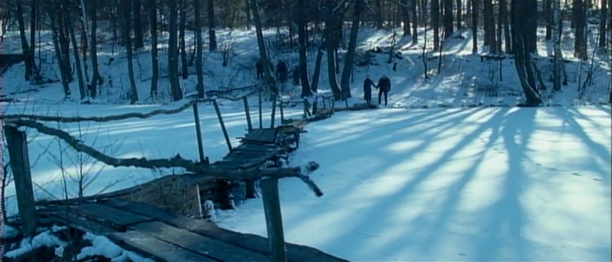
The priest and the men exit frame to the right, moving beyond our sight. In the background at the bottom of the frame the parents remain. They are alone in the frame and this new visual composition underlines their loneliness. In the end, we do not know exactly where the child will be buried.
In a film full of thresholds and portals the bridge serves as the last of these symbols. The parents who remain can not follow their daughter. The bridge becomes a symbol of the divides between life and death, possession and loss, the visible and the invisible, the known and the unknown.

Slide 40
Projekt współfinansowany
w ramach programu Unii Europejskiej
„Kreatywna Europa”

