Slide 1
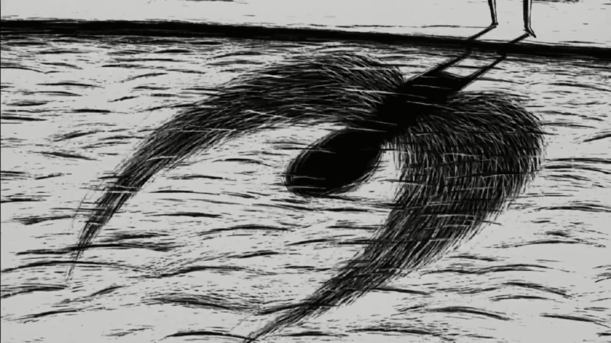
Other – Home and Territory
A Tragic Story with a Happy Ending, Dir. Regina Pessoa (2005)
Centrum Edukacji Obywatelskiej
Centre for Citizenship Education
Notes:
The presentation begins after the film screening, which is why we start discussing the film from the finale - a kind of happy ending, i.e. the disappearance of the heroine, to whom the surroundings cannot get used to.
Why is she not able to lead a ‘normal’ life?
What is normal?
Did her difference become normal in the end?

Slide 2
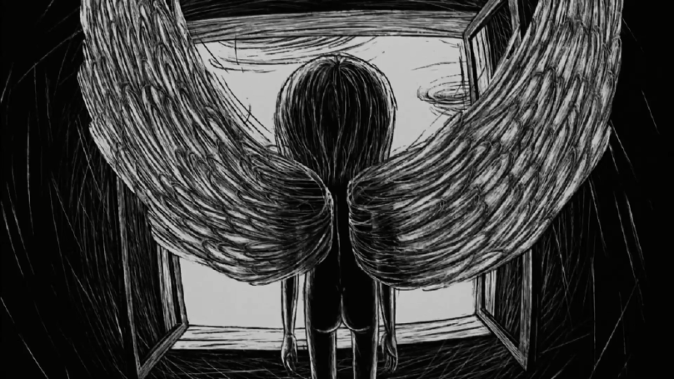
Does this movie have a happy ending?
Projekt współfinansowany
w ramach programu Unii Europejskiej
„Kreatywna Europa”
Notes:
Questions for discussion:
Does this movie end well? If so, for whom? If not, for whom? Let's vote and decide if it's really a happy ending.
Why did the heroine suffer?
Additional information:
Happy ending a model of action resolution in the film, in which all the threads end successfully for the main character and his accompanying people, as well as the environment except antagonists and perpetrators of evil. In happy ending, the main character's argument is important, which prevails over other views. The hero wins because they are right. Contemporary cinema treats this mechanism of identifying the viewer with the hero more ironically. In modern cinema, the main character does not have to survive to have a happy ending.
Happy end is a convention of storytelling characteristic of many film genres, including comedy and melodrama. Kliszowo used to sum up the happy end with a fairytale punch line: "And they lived happily ever after."

Slide 3
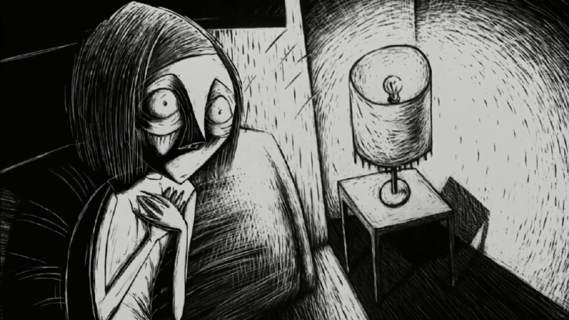
Does otherness mean loneliness?
Projekt współfinansowany
w ramach programu Unii Europejskiej
„Kreatywna Europa”
Notes:
Questions for discussion:
Is it good to be different? Or maybe it's better to be like everyone?
What would be the easiest thing to do in a group?
How different can you be to be appreciated but accepted?
Are you on the side of the heroine or the people in her community?
How do you feel when someone disturbs / invades your space, e.g. by noise?

Slide 4
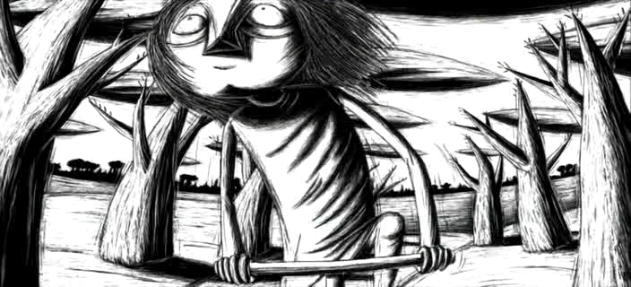
How do images and sound express emotions?
Projekt współfinansowany
w ramach programu Unii Europejskiej
„Kreatywna Europa”
Notes:
Questions for discussion:
What do you think best reflects the feelings: image or sound? When you are sad, what music do you listen to? What movies / images are you watching?
It is known that the minor key is more sad and the major one is cheerful. Can you still specify at what tempo / in what rhythm (fast, slow, increasing, steady) is the music that you would describe as sad?
If the rhythm is associated with a particular emotion, then what pace expresses sadness, what anxiety, what excitement?
The problem of the heroine and her surroundings is rhythm. It is the frequency of heartbeats, much higher for her than for "normal" people. How can this beat be seen in the movie?
Drawing animation is a series of drawings showing subsequent phases of movement. Drawings arranged side by side and quickly scanned create the illusion of movement in our brain. Example: flipbook - drawings drawn on adjacent pages seem to be one moving image.
Regina Pessoa - a Portuguese artist who was born raised in a small village in 1969. She did not have a TV at home, instead she listened to adult stories, fairy tales, read and drew. She also had no sheets of pape, so she followed in the footsteps of her uncle, who covered the house walls the drawings with using coal. Traces of this technuque and above all very suggestive handicrafts, can be seen in her later film. She began to think about him when she studied graphics at the Academy of Fine Arts in Porto.
She was then learning woodcut, linocut and screen printing techniques. She started thinking about a story she would like to translate into a movie. Each sentence inspired a specific drawing that evolved into another - and so the story developed from beginning to end.
However, first in the same technique (engraved drawing in plasterboard) Pessoa made her first film, Night (1999), which won nine awards. Thanks to this, she raised funds for the production of another, longer film that you just watched. The tragic story with a happy ending (2005) turned out to be a great success of the director.

Slide 5
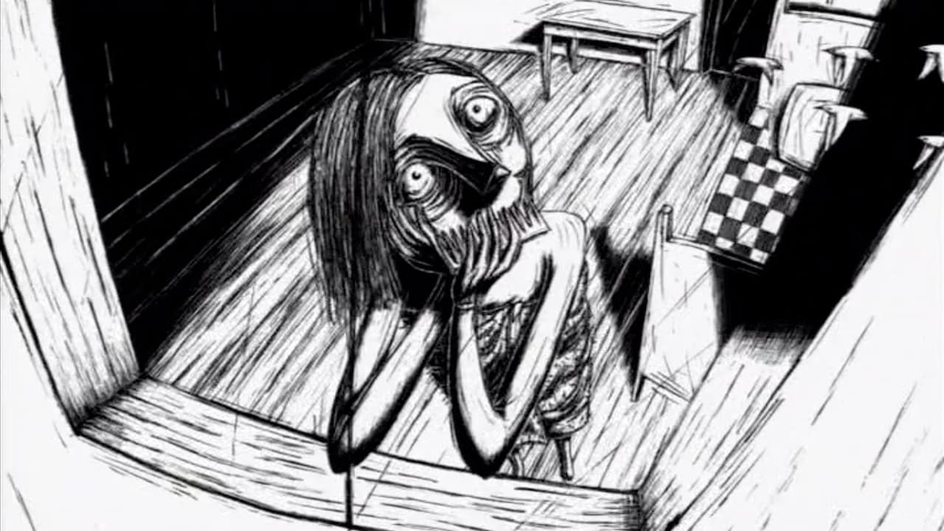
How does the animation convey the inner world of the heroine?
Projekt współfinansowany
w ramach programu Unii Europejskiej
„Kreatywna Europa”
Notes:
Questions for discussion:
Does the animation give more access to the hero's thoughts than a documentary or story?
Do we always know how the main character feels in an animated film?
What do you think could make this animation more personal?

Slide 6
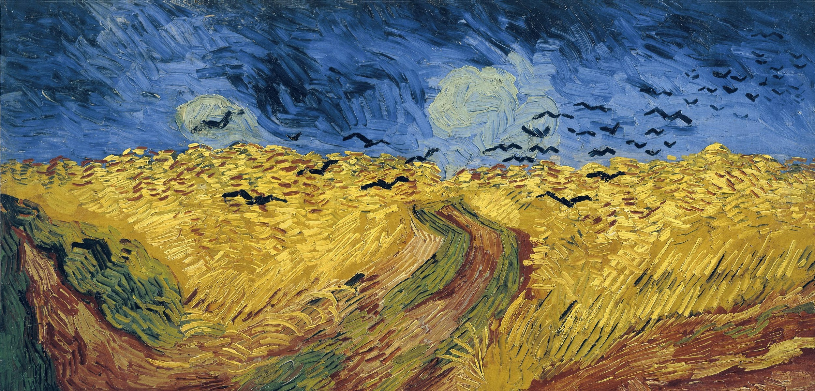
How to express feelings through paint?
Wheat field with crows, Vincent van Gogh, 1890, Vincent van Gogh Museum in Amsterdam
Projekt współfinansowany
w ramach programu Unii Europejskiej
„Kreatywna Europa”
Notes:
Questions for discussion:
What do you feel when looking at this image?
Can you imagine how Vincent van Gogh felt while painting?
Imagine that it is still from the movie. What scene will happen next?

Slide 7
Photo Sources:
Slide 1: Still from the movie Tragic Story with a Happy Ending, dir. Regina Pessoa
Slide 2: Still from the movie Tragic Story with a Happy Ending, dir. Regina Pessoa
Slide 3: Still from the movie Tragic Story with a Happy Ending, dir. Regina Pessoa
Slide 4: Still from the movie Tragic Story with a Happy Ending, dir. Regina Pessoa
Slide 5: Still from the film Tragic Story with a Happy Ending, dir. Regina Pessoa
Slide 6: Wheat field with crows, Vincent van Gogh, 1890, Vincent van Gogh Museum in Amsterdam, image source: public domain.
Projekt współfinansowany
w ramach programu Unii Europejskiej
„Kreatywna Europa”

